Slide 1


Topological Exploration for
Molecular and Condensed-Matter Systems
Harsh Bhatia
Oct 16, 2018
This work was performed under the auspices of the U.S. Department of Energy by Lawrence Livermore National Laboratory (LLNL) under contract DE-AC52-07NA27344. LLNL-PRES-759562
This document was prepared as an account of work sponsored by an agency of the United States government. Neither the United States government nor Lawrence Livermore National Security, LLC, nor any of their employees makes any warranty, expressed or implied, or assumes any legal liability or responsibility for the accuracy, completeness, or usefulness of any information, apparatus, product, or process disclosed, or represents that its use would not infringe privately owned rights. Reference herein to any specific commercial product, process, or service by trade name, trademark, manufacturer, or otherwise does not necessarily constitute or imply its endorsement, recommendation, or favoring by the United States government or Lawrence Livermore National Security, LLC. The views and opinions of authors expressed herein do not necessarily state or reflect those of the United States government or Lawrence Livermore National Security, LLC, and shall not be used for advertising or product endorsement purposes.

Slide 2
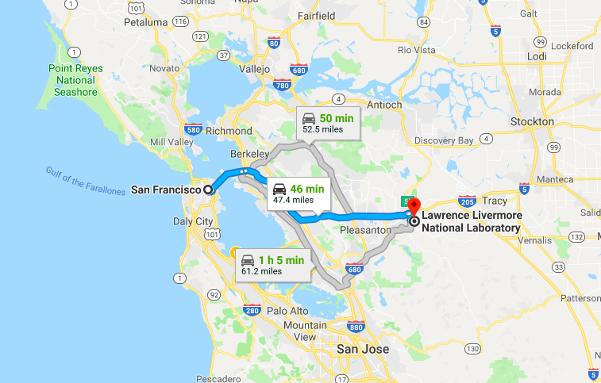
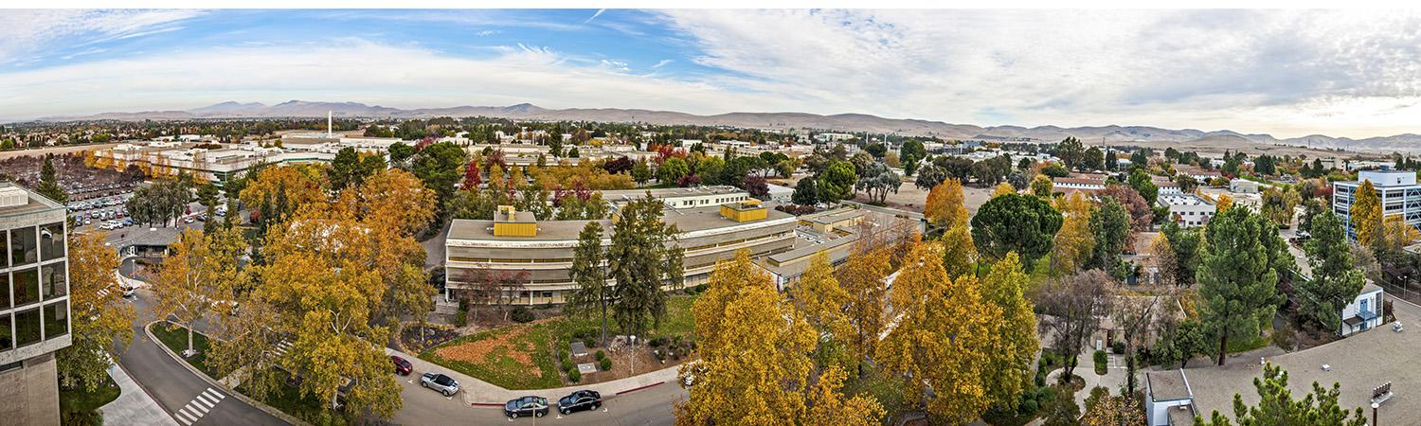
Lawrence Livermore National Laboratory offers interesting opportunities for interdisciplinary research
Data analysis, visualization, high-performance computing,
computational science, applied mathematics, etc.
Material science, bioscience and biotechnology,
nuclear and computer science, physics, etc.
National ignition facility

Slide 3

Scientific Computing and Imaging Institute is a world leader in analysis and visualization of scientific data
Scientific computing, biomedical computing
Scientific visualization, Information visualization
Image analysis
Computer graphics

Slide 4
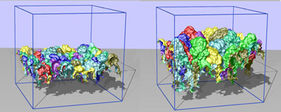
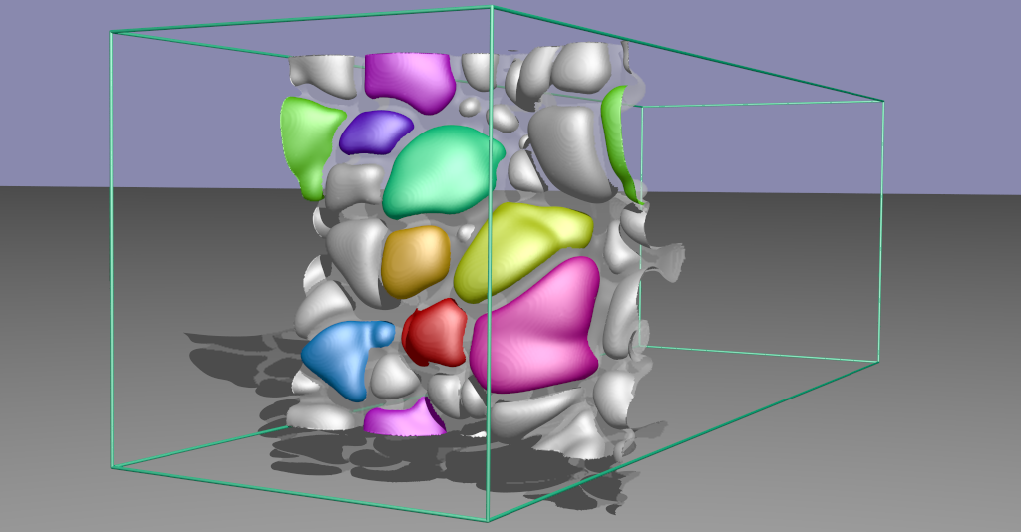
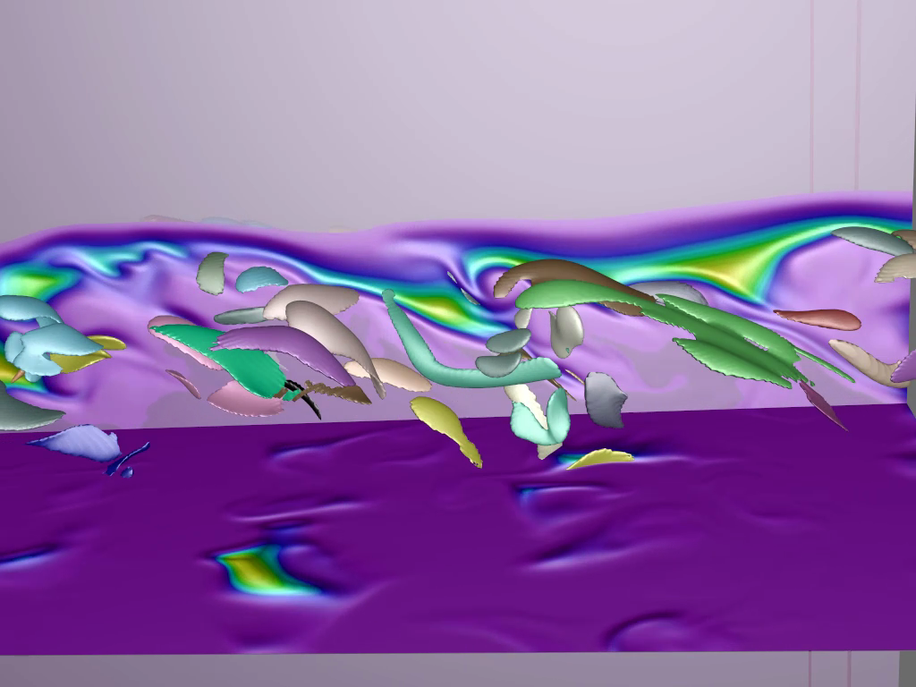
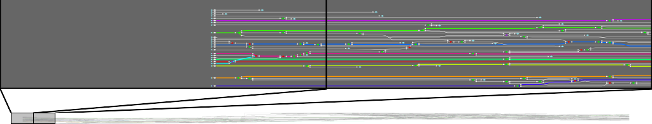
Topology Has Been Successful for Analysis and Visualization of Massive Scientific Data
Topological abstractions express structural
skeletons of scientific data and allow computing
many properties of interest,
e.g., counts, sizes, etc. of features
Time tracking of topological models allow
detailed analysis of dynamic phenomena

Slide 5
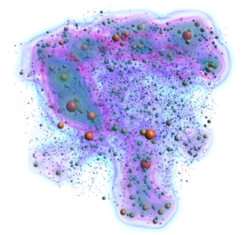
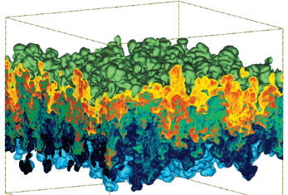
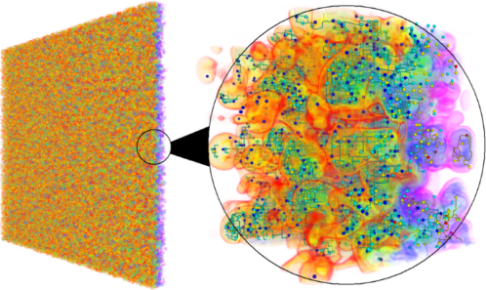
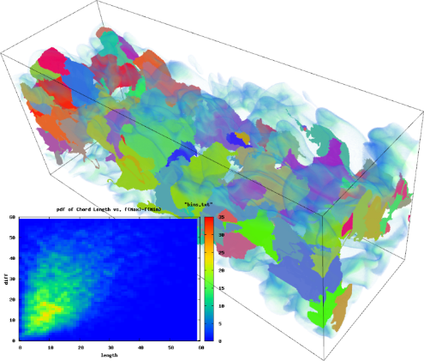
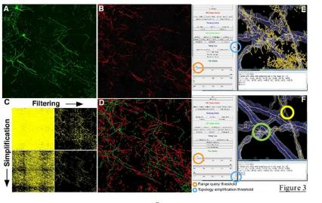
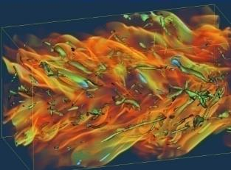
Topology Has Been Successful for Analysis and Visualization of Massive Scientific Data
Cosmology
Hydrodynamic Instabilities
Turbulent Mixing
Combustion
Biomedical
Combustion

Slide 6
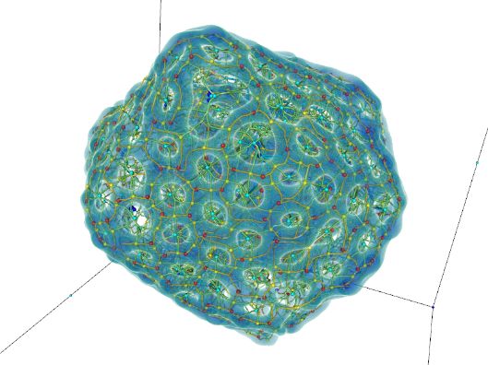
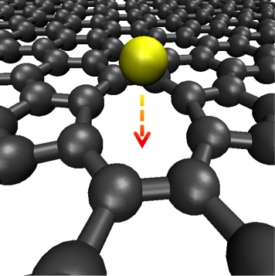
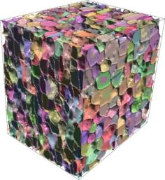
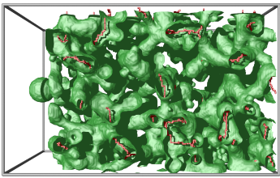
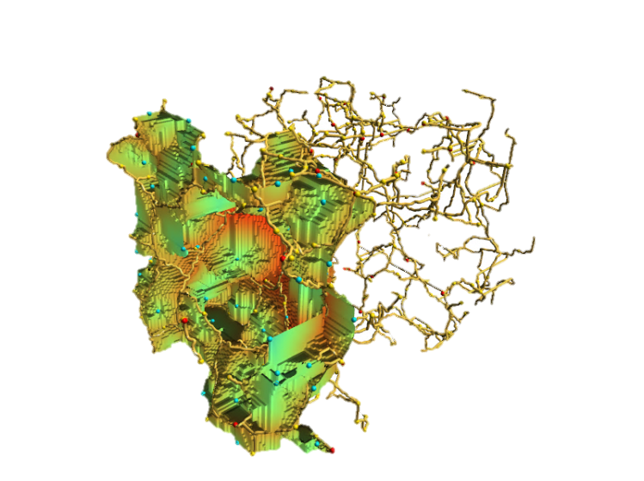
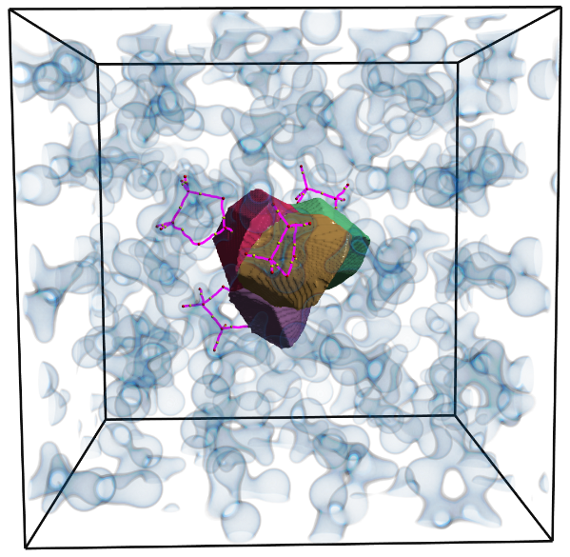
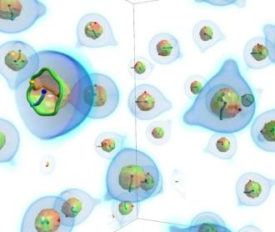
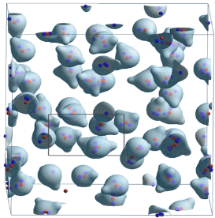
Topology Has Been Successful for Analysis and Visualization of Massive Scientific Data
Lithium diffusion in batteries
Material analysis (imaged)
Porous medium
Lithium solvation in batteries
Molecular analysis

Slide 7
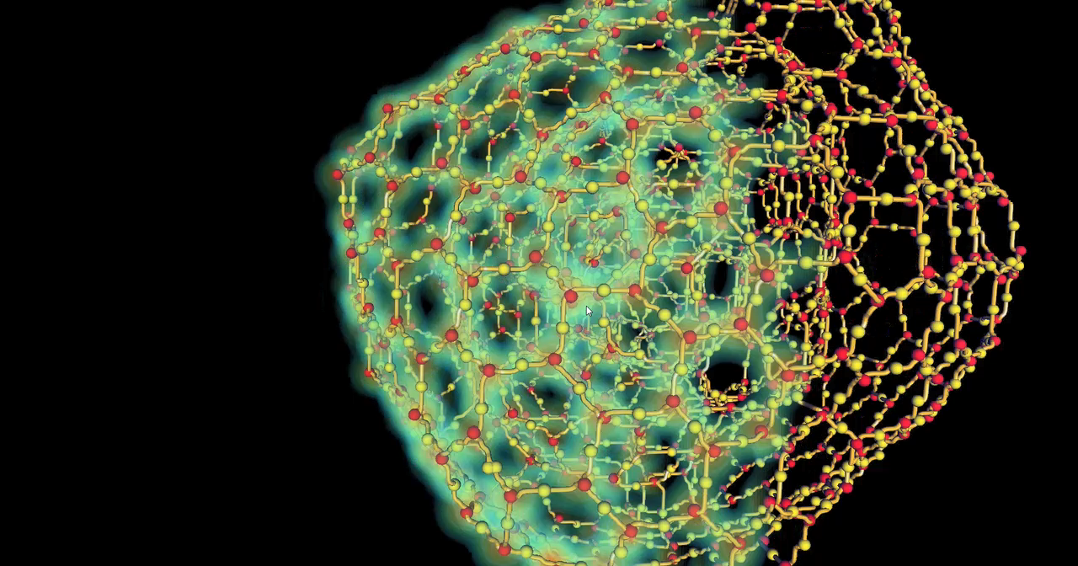
Topology Has Been Successful for Analysis and Visualization of Massive Scientific Data
Structural exploration of simulated lithium-ion batteries

Slide 8
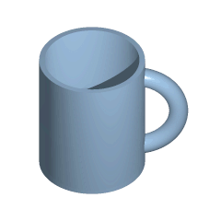
Topology provides a simple and intuitive data abstraction
Topology is the study of properties under continuous deformations
Deals with critical points and their connectivity
Describes the data as an abstract graph

Slide 9
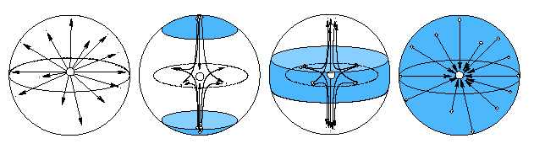

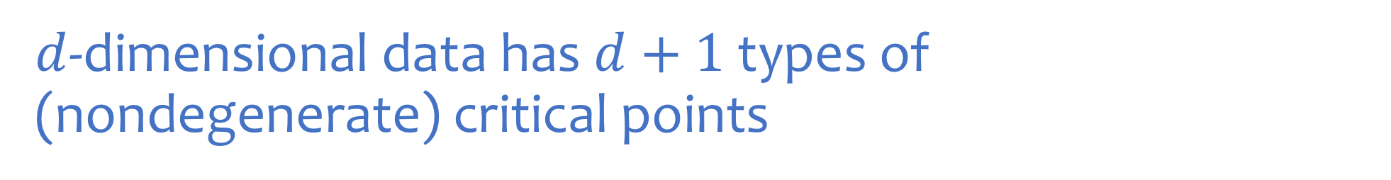
$d$-dimensional data has $d+1$ types of
(nondegenerate) critical points
classified based on the signs of $d$ eigenvalues
1D
2D
Local minimum
Local maximum
Local minimum
Saddle
Local maximum
3D
Local minimum
1-saddle
2-saddle
Local maximum

Slide 10
Topology is the study of properties under continuous deformations
Deals with critical points and their spatial connectivity

Slide 11
Topology is the study of properties under continuous deformations
Deals with critical points and their spatial connectivity

Slide 12
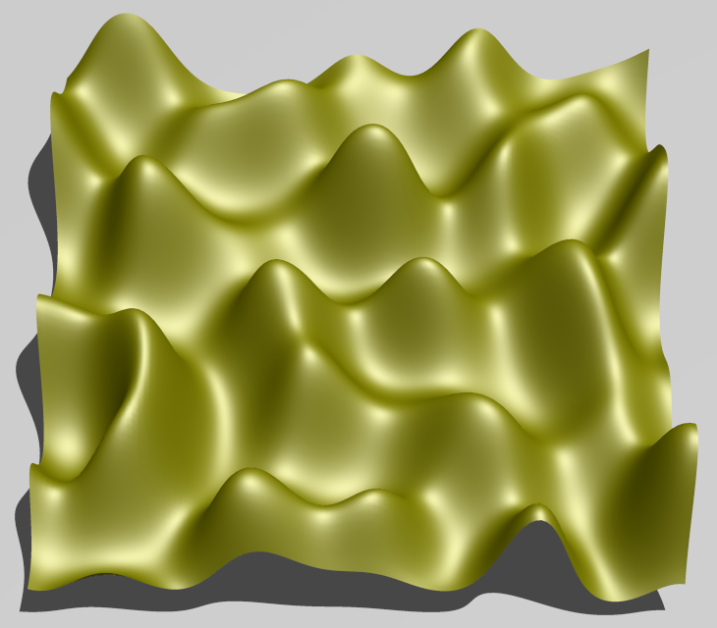
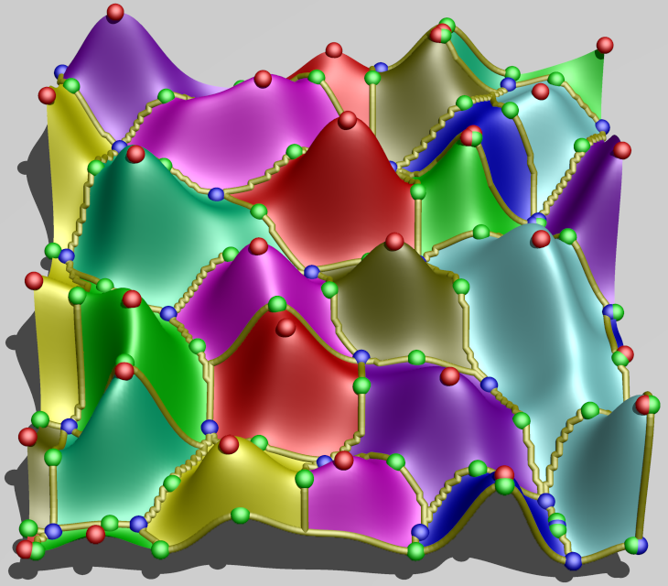
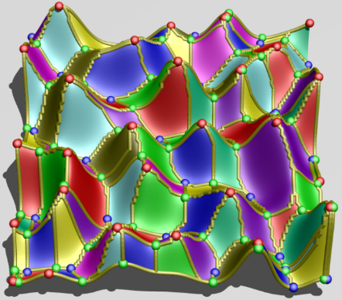
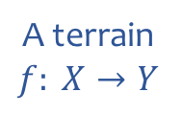
Topology is the study of properties under continuous deformations
Generalizes the notion of peaks, valleys, and ridges from the experience of navigating terrains to higher dimensions
A terrain
$$f: X→Y$$
Morse Complex.
Decomposition wrt peaks.
Morse-Smale Complex.
Decomposition wrt peaks and valleys.

Slide 13
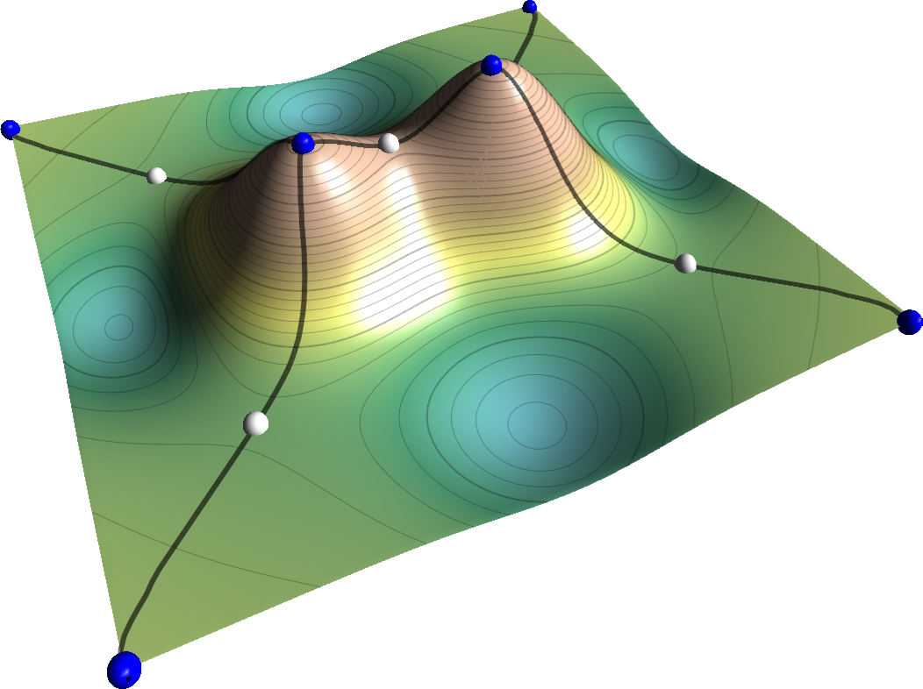
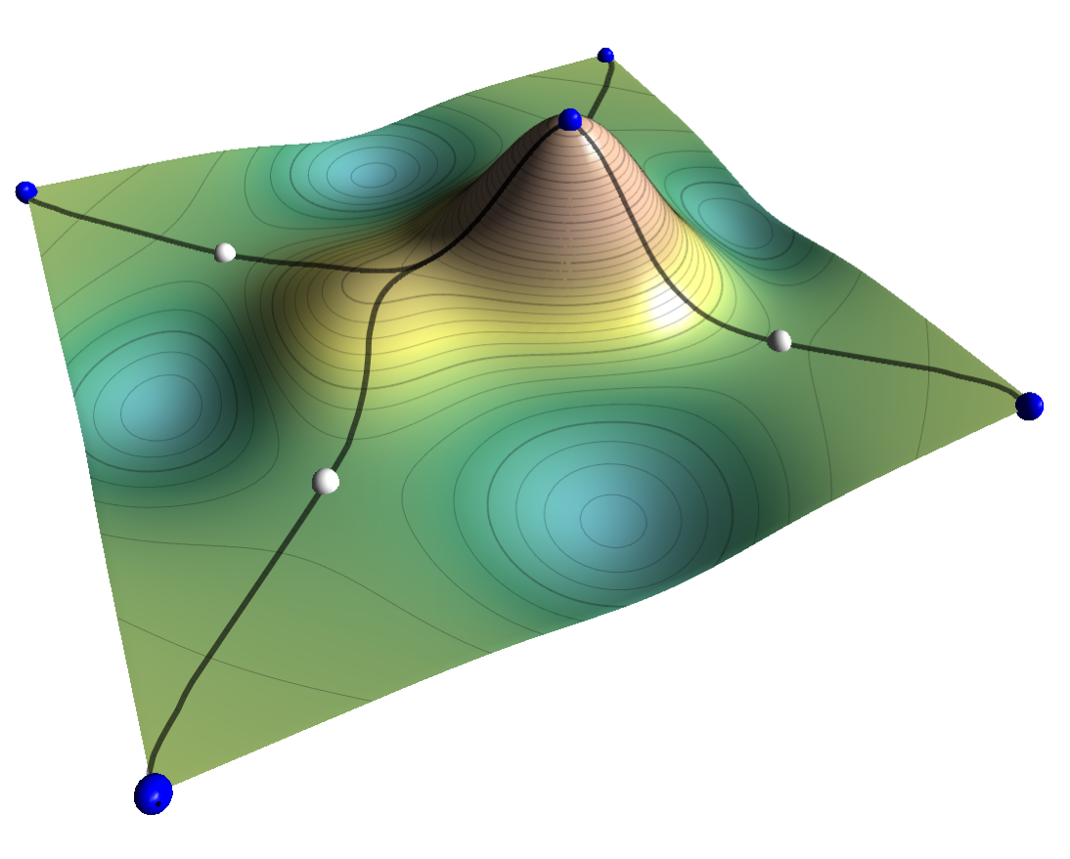
Topological abstractions allow multiscale representations of data by removing “noise”
Index lemma: Critical points can be cancelled in pairs with index differing by 1
(max, min) cancellation in 1D
(max, saddle) cancellation in 2D

Slide 14

2007
1990
2000
Quantum Theory of
Atoms in Molecules
The topology of electronic charge density
describes atomic properties

Slide 15
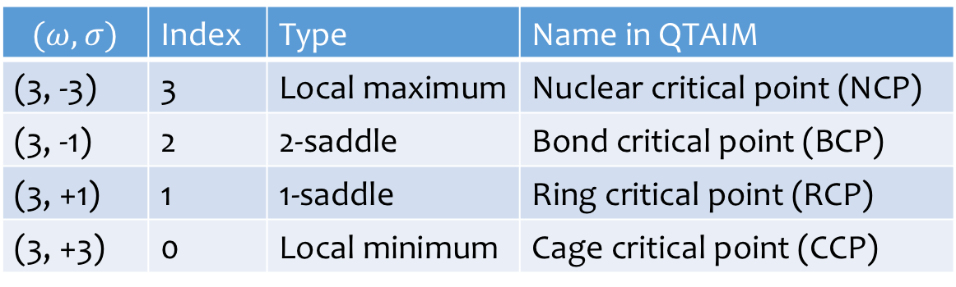
Topology of electronic charge density describes properties of atoms and bonds
A 3D function has four types of (nondegenerate) critical points
  classified based on the number and signs of nonzero eigen values of the Hessian
NCPs indicate locations of atoms, separated from each other by “zero-flux” surfaces
BCPs indicate locations of bonds between atoms (always lie on interatomic surfaces)
$$(ω,σ)$$ | Index | Type | Name in QTAIM
(3, -3) | 3 | Local maximum | Nuclear critical point (NCP)
(3, -1) | 2 | 2-saddle | Bond critical point (BCP)
(3, +1) | 1 | 1-saddle | Ring critical point (RCP)
(3, +3) | 0 | Local minimum | Cage critical point (CCP)

Slide 16
The topological decomposition gives the QTAIM decomposition

Slide 17
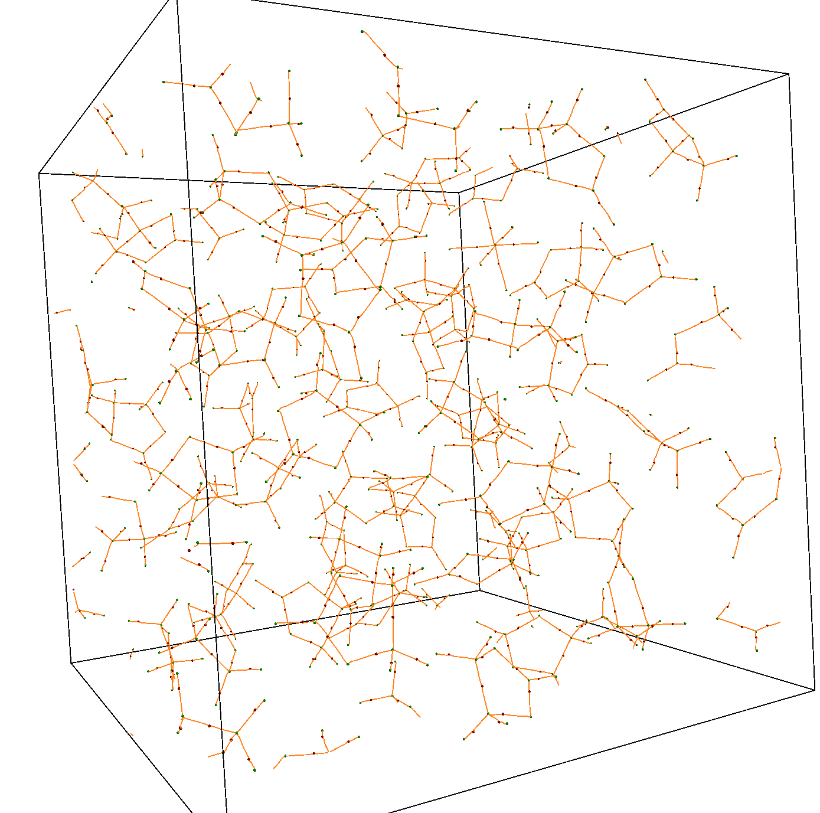
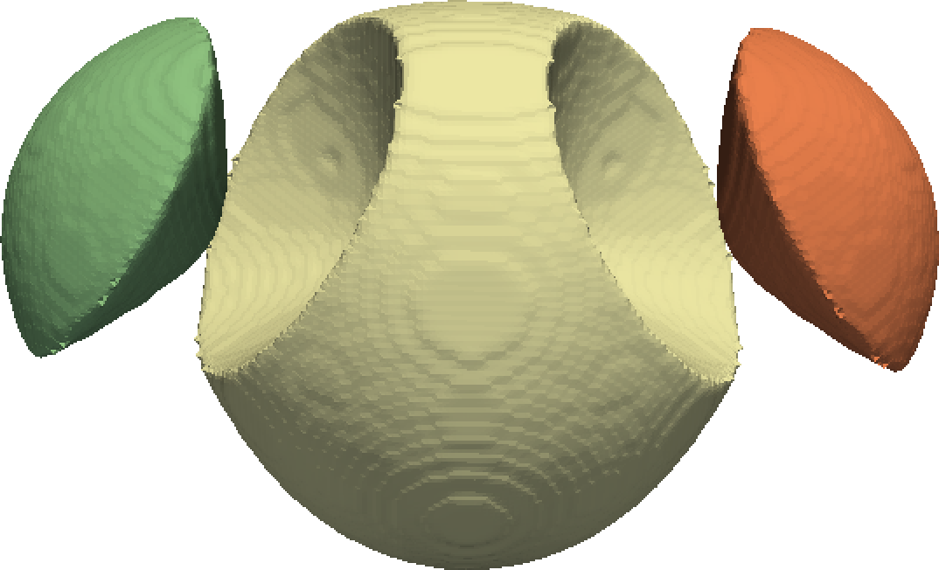
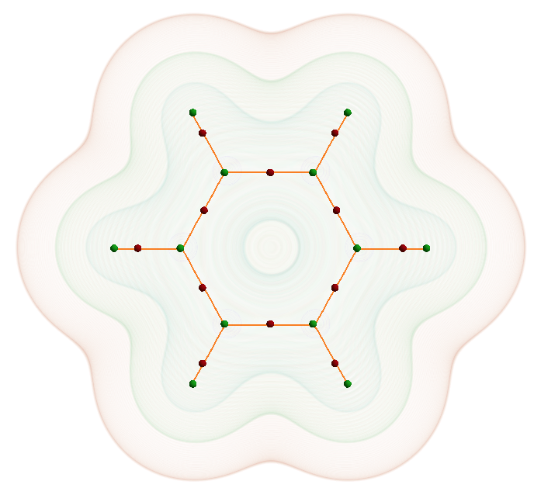
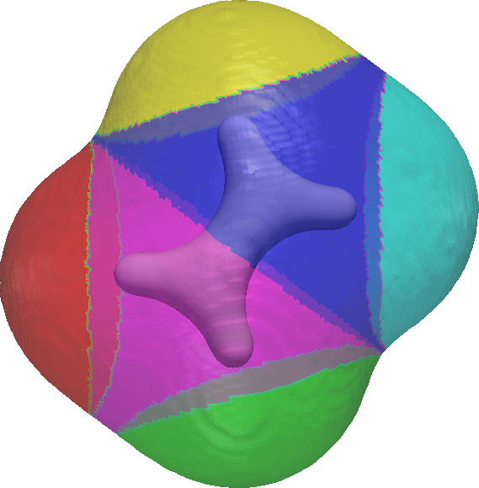
Topology of electronic charge density describes properties of atoms
Enables computing charge transfer between atoms, shape and volume of atoms, etc.
The molecular graph indicates how atoms are bonded
LiPF₆ in
Ethylene Carbonate
Benzene
H₂0
C₂H₄

Slide 18
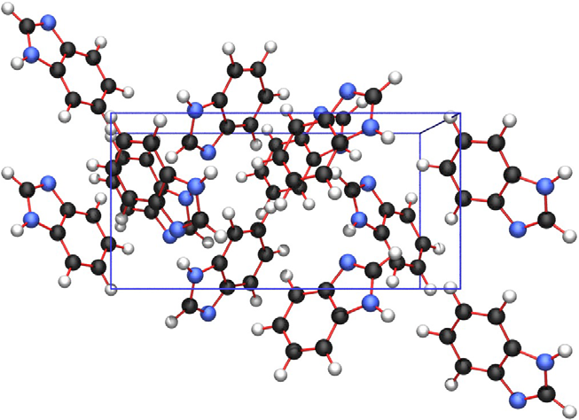
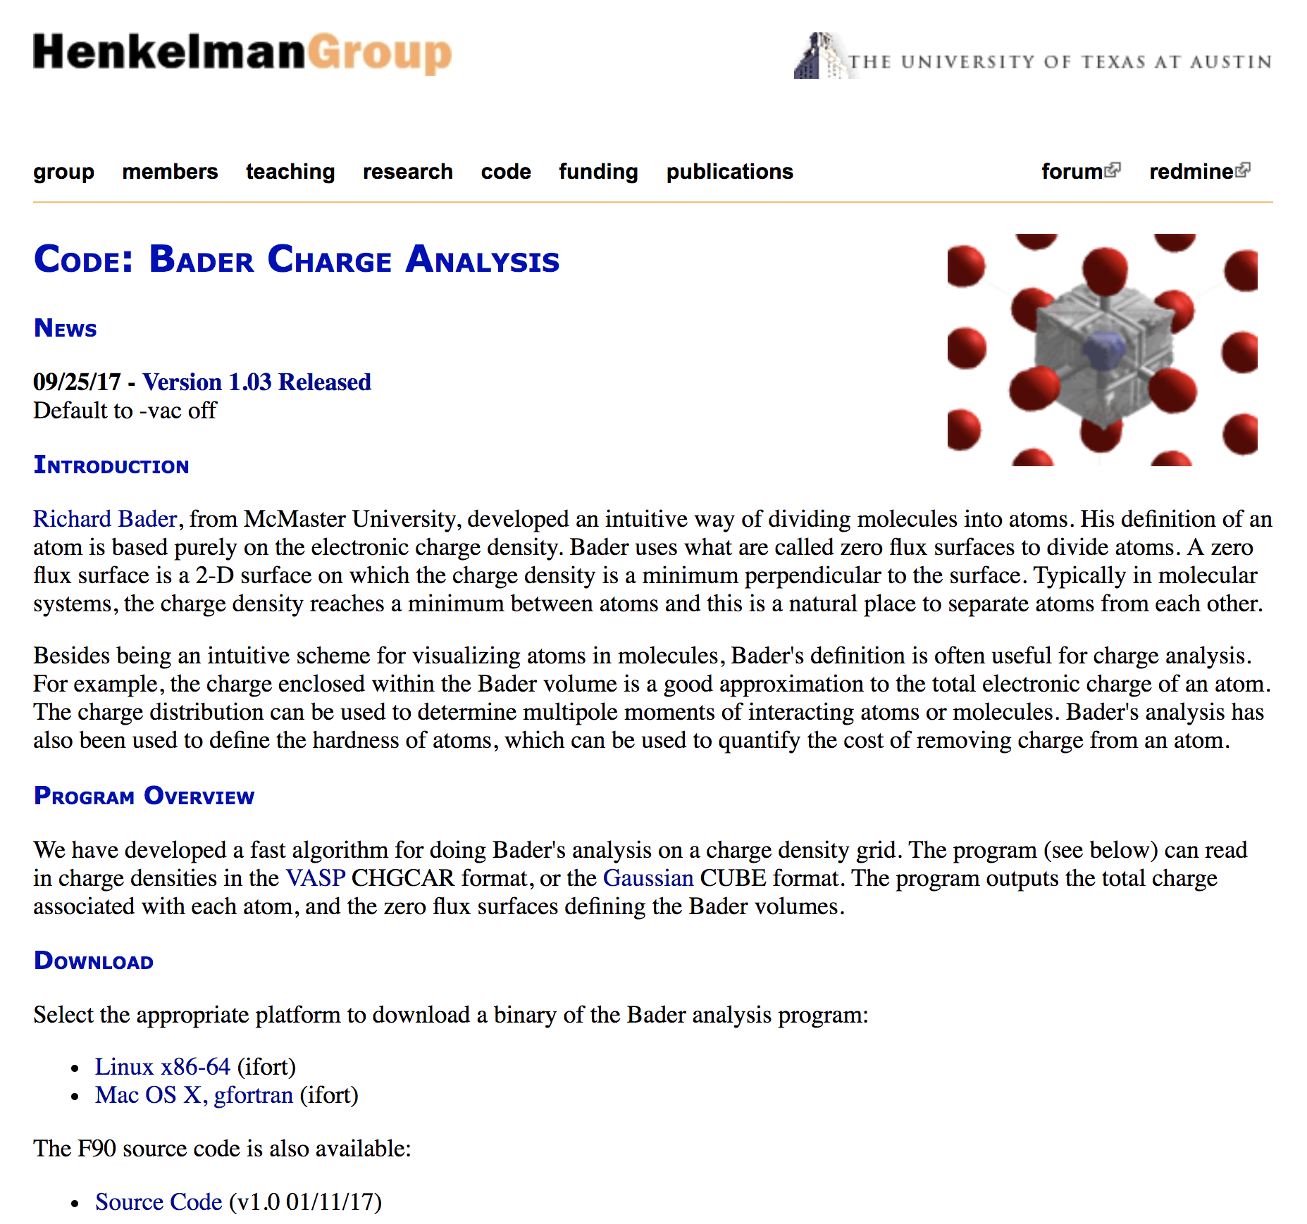
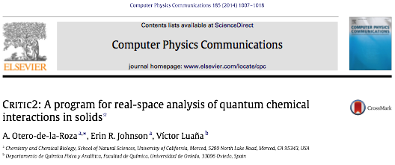
There existing several tools for performing QTAIM and bond analysis
Grid-based Bader analysis
Molecular Graph analysis
Henkelman et al., 2006
Sanville et al., 2007
  Scalability Issues
  Robustness & Consistency Issues

Slide 19
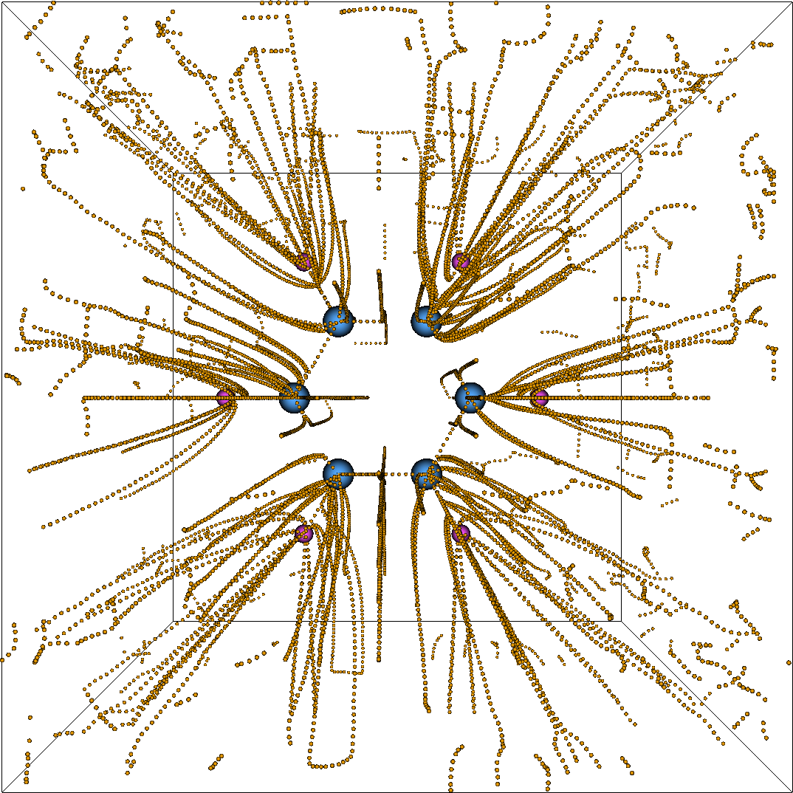
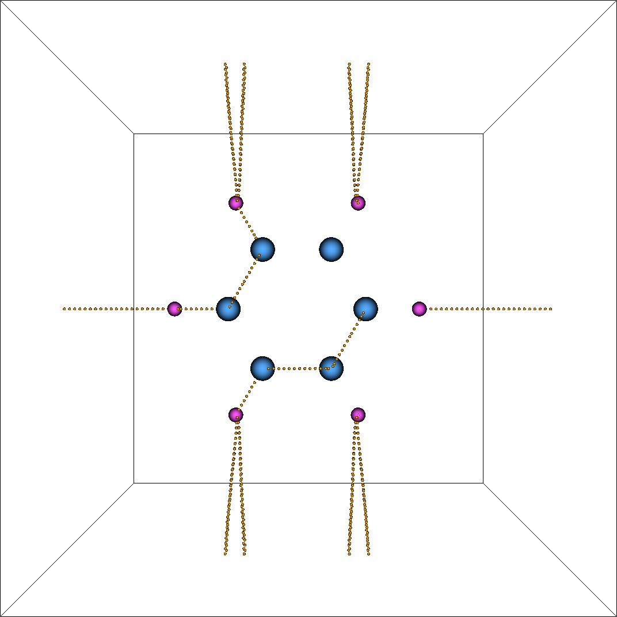
Numerical robustness and consistency are crucial to meaningful analysis
Molecular graph of a Benzene molecule (computed using Critic2)

Slide 20
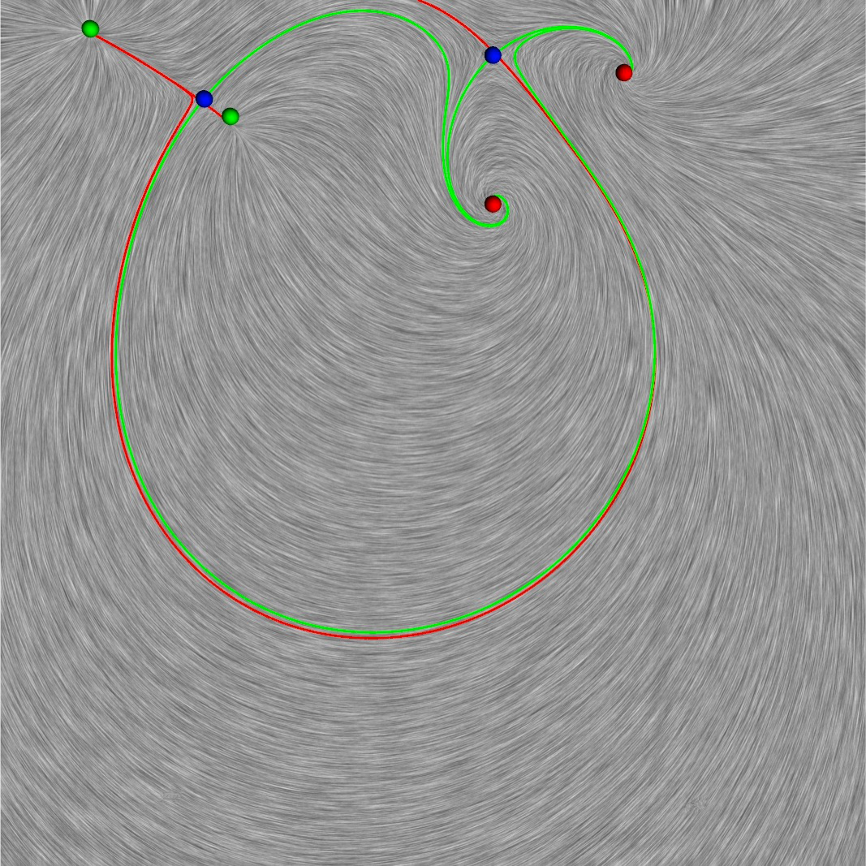
Numerical robustness and consistency are crucial to meaningful analysis
Notes:
----- Meeting Notes (10/28/14 16:22) -----
second example ?

Slide 21
Numerical robustness and consistency are crucial to meaningful analysis
Inaccuracy
varying levels of accuracy or confidence interval
depends upon the precision of the representation and algorithm
Inconsistency
violation of fundamental laws and invariants
defined objectively with respect to the theory
  Solve for three numbers.
  The numbers should sum to 1.0.
  Solution: a, b, c
  May be inaccurate due to numerical error. For example, a + b+ c ~ 1.01
  Consistency can be enforced in (at least) two ways
    c = 1.0 – (a+b)
    a = a / (a+b+c), …

Slide 22
Numerical robustness and consistency are crucial to meaningful analysis
Inaccuracy
varying levels of accuracy or confidence interval
depends upon the precision of the representation and algorithm
approximation to atomic charge or volume
  7.28341 vs. 7.28342
approximation to the “geometry” of a bond path
Inconsistency
violation of fundamental laws and invariants
defined objectively with respect to the theory
duplicated or missing critical points
duplicated or fragmented bond paths
invalid Morse sum
intersecting gradient paths
intersecting interatomic surfaces
  By improving precision, we may reduce inaccuracy, but we cannot guarantee consistency!

Slide 23
Discrete algorithms allow computing topology robustly and consistently
Errors in numerical approaches compound fast and are hard to track
Combinatorial handling of discrete data defined on discrete domain enables consistent analysis
  numerical computations are replaced by graph operations (integer-based)
Simulation of simplicity [Edelsbrunner and Mucke, 1990] can be used to resolve degenerate cases
  Removes equality between values in a consistent manner
  Allows defining less-than and greater-than operators unambiguously
Discrete gradient fields allow consistent computation of topological structures
  Combining numerical and combinatorial algorithms can provide high levels of accuracy and consistency

Slide 24


TopoMS
Topological analysis of molecular
systems using Morse-Smale complexes
QTAIM analysis
  Computation of atomic basins & their properties
Molecular graph analysis
  Computation and simplification of molecular graphs
A robust & generic framework for topological analysis
Computational focus
  Scalability
  Topological consistency & Numerical robustness
  Interactive denoising
  Simple and open-source API
Bhatia et al., J. Comp. Chem., June 2018.
https://github.com/LLNL/TopoMS

Slide 25
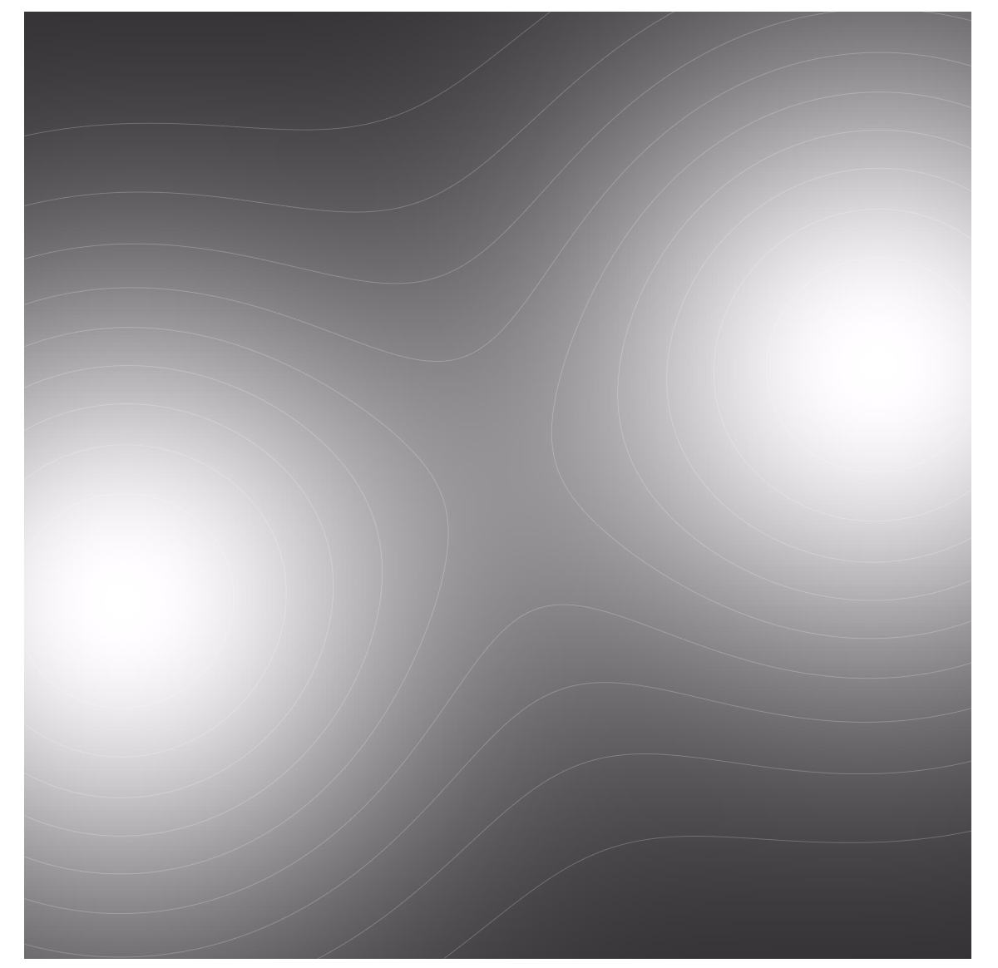
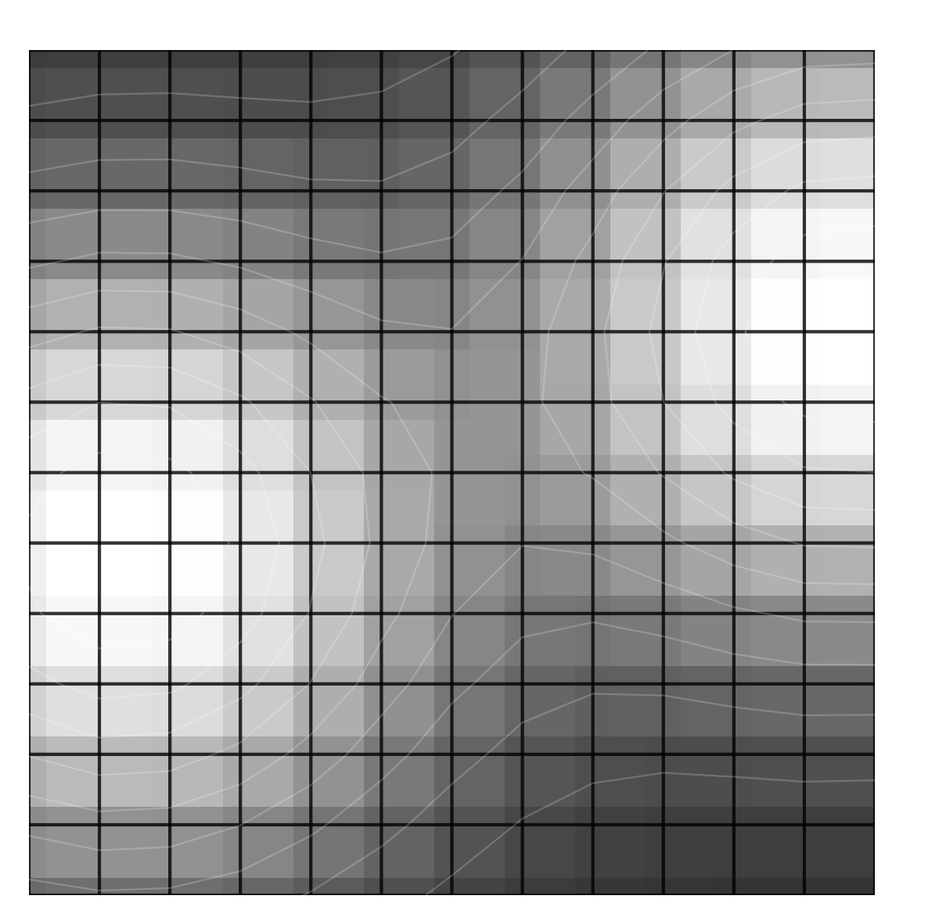
Discrete representations enable consistent analysis
continuous
discrete
Values at cells

Slide 26


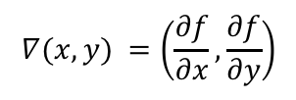
Discrete representations enable consistent analysis
continuous
discrete
Values at cells
Gradients are
“pairings” of cells
$$∇(x,y) =\left(\frac{∂f}{∂x},\frac{∂f}{∂y}\right)$$
pairs: $\left\langle α,β\right\rangle$
Notes:
Instead of a continuous gradient field, we have discrete gradient fields, where an arrow points between incident cells that differ in dimesnion by one,
These gradient arrows indicates direction of flow
Note that in discrete morse theory, we always draw gradient arrows pointing in the negative gradient direction

Slide 27

Discrete representations enable consistent analysis
continuous
discrete
Values at cells
Gradients are
“pairings” of cells
Critical points are
unpaired cells
$$∇\left(x,y\right)=0$$
Unpaired cells
Maximum
Saddle
Minimum
Maximum
Saddle
Minimum
Notes:
In smooth morse theory, critical poitns occur where the gradient is zero, and index of criticality is given by the number of principle directions the function is decreasing,
In the discrete case, cells not paired into gradient arrows are considered critical, and their dimension corresponds to their index of criticality.

Slide 28

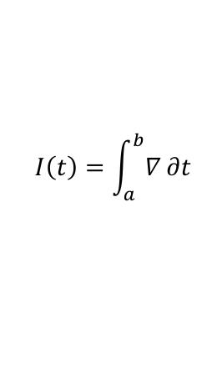
Discrete representations enable consistent analysis
continuous
discrete
Values at cells
Gradients are
“pairings” of cells
Critical points are
unpaired cells
Integral lines are
paths of paired
cells
$$I\left(t\right)=\int_{a}^{b}{∇}∂t$$
$$α_{0},β_{0},α_{1},β_{1},…,α_{n},β_{n}$$
Notes:
An integral line is a path of steepest ascent tangent to the gradient vectors everywhere, (basically a “streamline” in the gradient field
And the discrete equivalent is a v-path, a chain of gradient arrows, where the tail of each subsequent arrow is incident on the head of the previous one

Slide 29

Discrete representations enable consistent analysis
continuous
discrete
Values at cells
Gradients are
“pairings” of cells
Critical points are
unpaired cells
Integral lines are
paths of paired
cells
Topological decomposition can be computed consistently via graph traversals
Integral lines originating at p
paths ending at $α$
Notes:
Just as in the smooth case, where the ascending manifold of a critical point is the clusters of integral lines originating a it,
In the discrete case, the V-paths ending at a critical cell form its ascending manifold

Slide 30

Discrete representations enable consistent analysis
continuous
discrete
Values at cells
Gradients are
“pairings” of cells
Critical points are
unpaired cells
Integral lines are
paths of paired
cells
Topological decomposition can be computed consistently via graph traversals
Integral lines ending at p
paths originating at $α$
Notes:
Similarly, in the smooth case, descending maniofolds are formed by clusters of integral lines sharing a common destination,
In the discrete case, it is the V-paths sharing a common origin

Slide 31
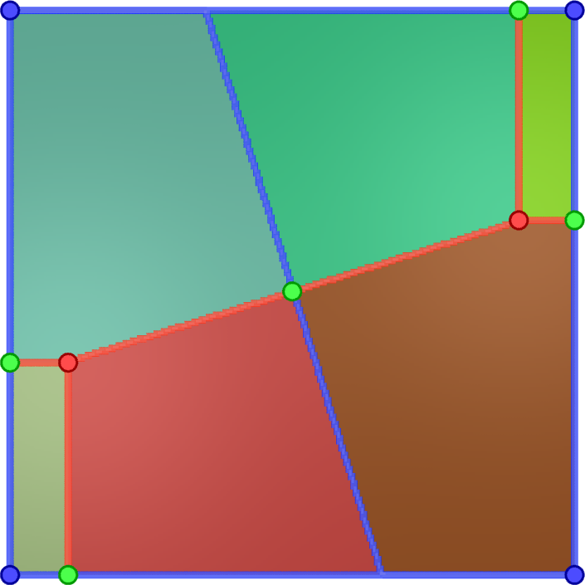
Discrete representations enable consistent analysis
continuous
discrete
Values at cells
Gradients are
“pairings” of cells
Critical points are
unpaired cells
Integral lines are
paths of paired
cells
Topological decomposition can be computed consistently via graph traversals
Notes:
Similarly, in the smooth case, descending maniofolds are formed by clusters of integral lines sharing a common destination,
In the discrete case, it is the V-paths sharing a common origin

Slide 32
QTAIM analysis in TopoMS
Input: electronic charge density and atomic positions
  Ignore “vacuum” regions
  Identify maxima and “certain” regions
    maxima exist only at grid vertices
    combinatorial; using the notion of “lower star” and “region-growing” approach
  Integrate gradient lines
    domain labeling with respect to maxima
    numerical; disallow intersections using a greedy approach
  Compute atomic basins and associated properties
    atom to maxima (possibly, one to many) mapping
    non-nuclear attractors are separated
Output: decomposition of space into atomic basins, and per-atom charge and volume

Slide 33
Extraction of molecular graph in TopoMS
Input: QTAIM decomposition of space into atomic basins
  Compute “conforming” discrete gradient
    combinatorial; ensure that discrete gradient does not cross zero-flux surfaces
  Compute Morse-Smale complex
    combinatorial; ensure that topological graph is consistent with QTAIM regions
  Compute the multiscale hierarchy (through persistence simplification)
    combinatorial; progressive and systematic removal of noise
  Extract molecular graph geometry
    extract BCPs, NCPs, and bond paths
Output: Multiscale molecular graph (final desired scale can be chosen interactively)

Slide 34
Symmetric charge distribution in a water molecule

Slide 35
TopoMS provides robustness against grid bias

Slide 36
TopoMS provides robustness against grid bias

Slide 37
TopoMS provides better and faster numerical results
Convergence to fine-grid results
2.5 – 4x faster results

Slide 38
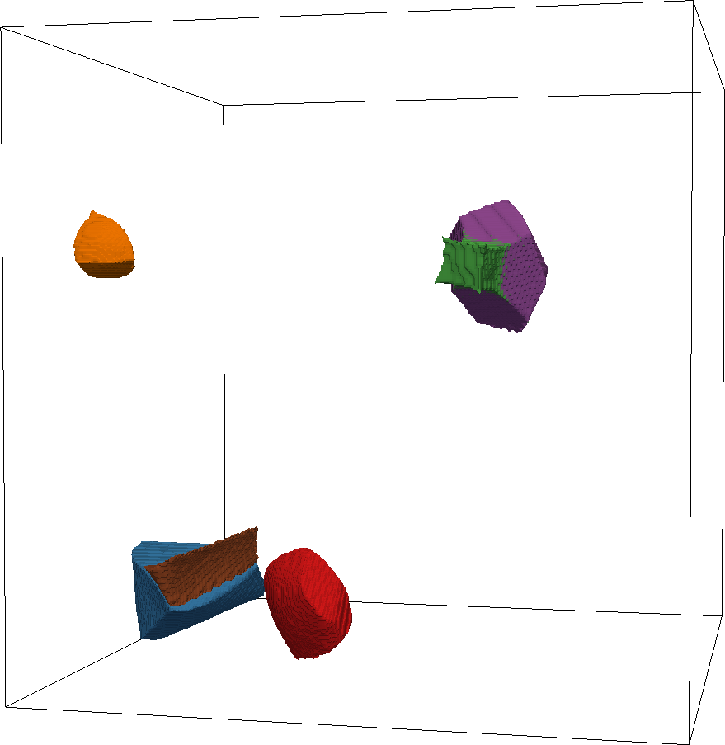

LiPF₆ in (CH₂O)₂CO

Slide 39
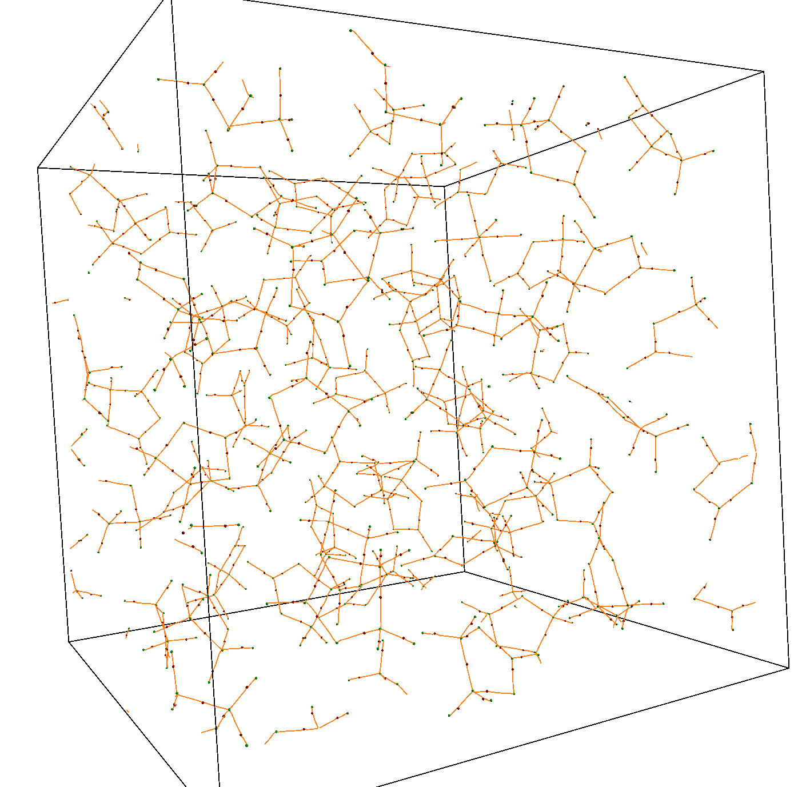
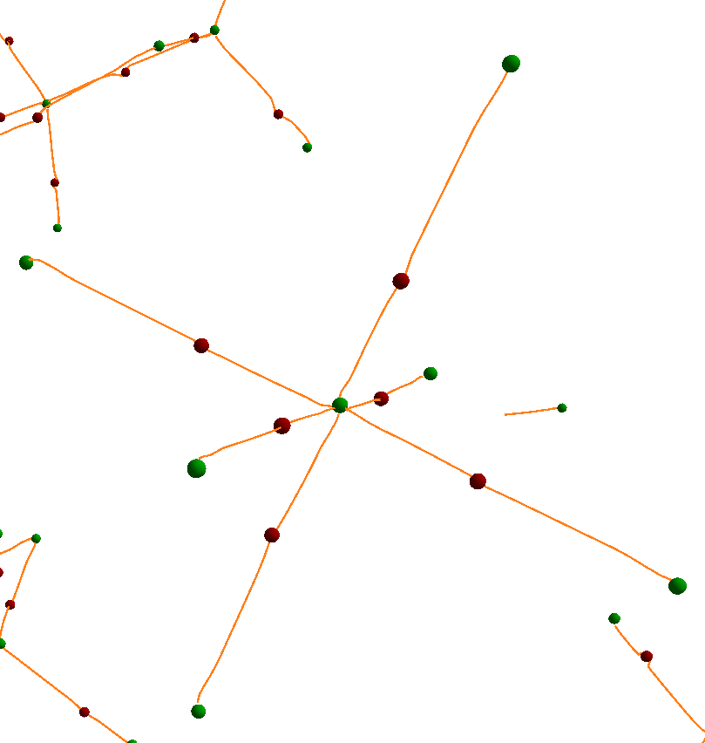

PF₆⁻
(CH₂O)₂CO

Slide 40
TopoMS provides guaranteed consistent results

Slide 41


TopoMS provides guaranteed consistent results

Slide 42
Going forward with TopoMS
TopoMS provides robust and consistent analysis of molecular systems
Multiscale analysis through noise cancellation
Numerically robust
Guaranteed consistent
Open-source available (https://github.com/LLNL/TopoMS)
TopoMS v1.0
  QTAIM analysis
  Molecular graph analysis

Slide 43
Going forward with TopoMS
TopoMS v1.1 (to be released Oct 2018)
  Bader analysis
    analysis of bond paths
    support for “reference charge”
  Support for Quantum Chemical Topology (QCT)
  Support for non-orthogonal lattice
  Support for windows platform
Planned
  Detailed study and exploration of noise cancellation
  Integrate TopoMS with VASP

Slide 44
Acknowledgements
U.S. Department of Energy, Office of Science
  Advanced Scientific Computing Research
  Basic Energy Sciences
Gyulassy, A
Lordi, V
Pask, J
Pascucci, V
Bremer, P-T

Slide 45

TopoMS v1.1 released
Analysis of bond paths
Support for “reference charge”
Support for non-orthogonal lattice
Support for non-charge fields
Support for windows platform

Slide 46
Topology is the study of properties under continuous transformations
Deals with critical points and their spatial connectivity

Slide 47


Discrete gradient field defines mapping between cells of the domain in the direction of gradient
Discrete gradient field.
Discrete Morse-Smale complex.

