Slide 1
ShapeWorks
The tutorial

Slide 2
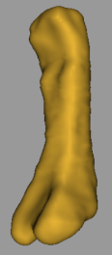
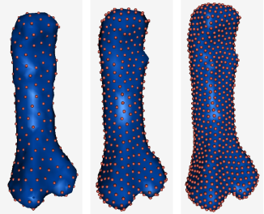
Correspondence Pipeline
Notes:
Describe the steps involved in the process, before delving into the orthopedics applications

Slide 3
Command Line Tools
Seg3D/ITK
ShapeWorksGroom
ShapeWorksRun
Analysis: PCA, Group differences
ShapeWorksView
Notes:
Describe the steps involved in the process, before delving into the orthopedics applications

Slide 4
ShapeWorksGroom
Command line collection of preprocessing filters
Syntax
Basic filters available
isolate
hole_fill
antialias
fastmarching
blur
DEMO: torus example
Notes:
Describe the steps involved in the process, before delving into the orthopedics applications

Slide 5
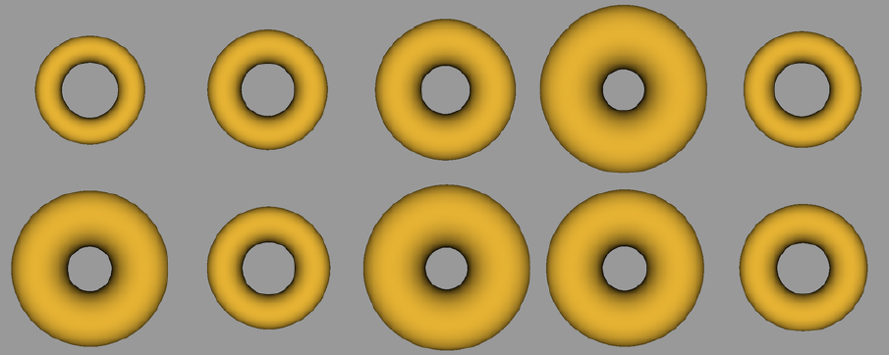
ShapeWorksGroom
Example tori shapes from population parameterized by r and R
Notes:
Describe the steps involved in the process, before delving into the orthopedics applications

Slide 6
ShapeWorksRun
Command line tool to initialize and optimize particle positions on shapes in the ensemble
Syntax
Notable parameters
# particles
adaptivity
alignment
DEMO: torus example
Notes:
Describe the steps involved in the process, before delving into the orthopedics applications

Slide 7
ShapeWorksRun
Correspondences overlaid on 3 of the input shapes
Notes:
Describe the steps involved in the process, before delving into the orthopedics applications

Slide 8
ShapeWorksView
GUI to visualize correspondences and perform statistical analysis
Syntax
Notable parameters
Reconstructed shapes
Modes of variation
Group differences (not in demo, only if 2 populations are available)
DEMO: torus example
Notes:
Describe the steps involved in the process, before delving into the orthopedics applications

Slide 9
ShapeWorksView
Modes of variation captured by the correspondence model.
The first (top) and second (bottom) modes capture the shape variation consistent with the generative model

Slide 10
Recent Work†
†M Datar, Y Gur, B Paniagua, MA Styner, RT Whitaker, “Geometric Correspondence for Ensembles of Nonregular Shapes,” MICCAI 2011
Notes:
Razzmatazz… should this be a part of the case study slides, or the tutorial slides ?

Slide 11
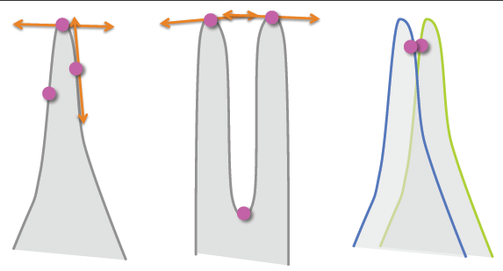
Challenges of Nonregular Shapes
(a) (b) (c)
Fig: Incorrect correspondences near sharp features when (a) points with different tangent spaces interact, (b) nearby points sampling different parts of the surface interact, (c) optimization is based only on point positions on different shapes
Geodesic distances
computed using intermediate triangular meshes
pre-computed between vertices [Fu, et. al† ]
otherwise computed using two-layered Barycentric interpolation
Surface normal entropy
penalize divergence from “mean” in the space of surface normals
helps disambiguate correspondences near convoluted features
† Fu, Z., Kirby, M., Whitaker, R.: A fast iterative method for solving the eikonal equation on triangulated meshes. SIAM Journal on Scientic Computing (2011) To appear

Slide 12
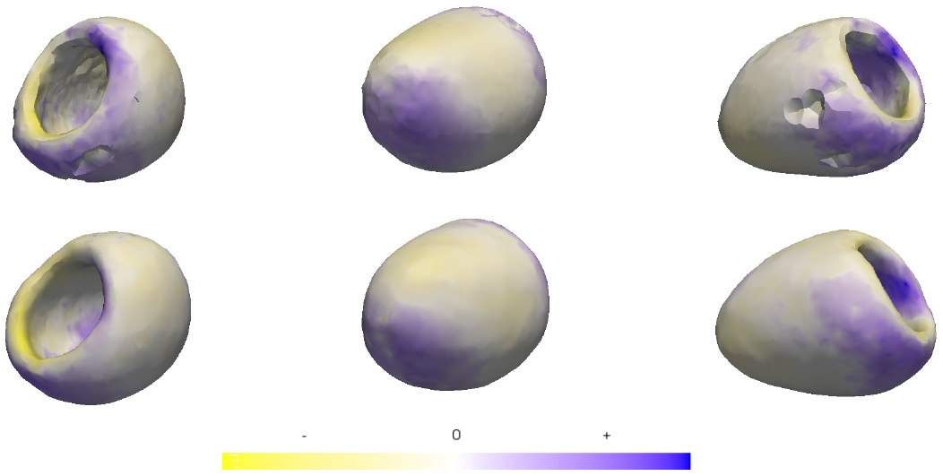
Group Comparison: LV wall† Dr. Raimond Winslow Institute for Computational Medicine, The Johns Hopkins University
Mean differences between normal and ischemic groups (blue => expansion, yellow => contraction)
Top: PBM*, Bottom: proposed method
Study shape differences between normal and ischemic LV wall segmented at end diastole (ED)
Results
Group mean differences significant with p-value < 0.01
Shape changes spatially consistent with previously published results
†M Datar, Y Gur, B Paniagua, MA Styner, RT Whitaker, “Geometric Correspondence for Ensembles of Nonregular Shapes,” MICCAI 2011
Notes:
Data came from Dr. Winslow at JHU. Do we need more details here ?

Slide 13
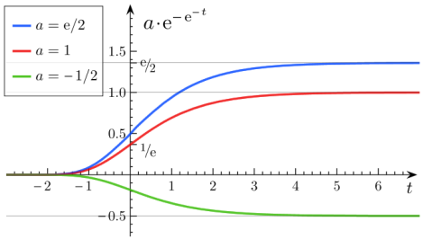
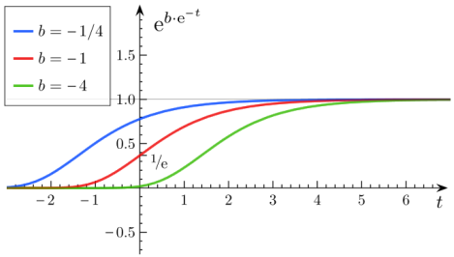
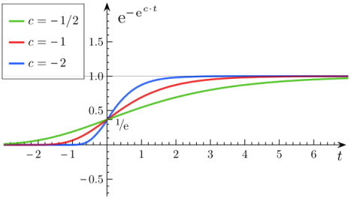
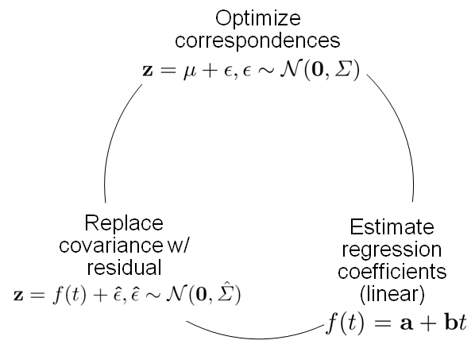
Nonlinear Growth Model
Varying asymptote*
Varying delay*
Varying speed*
*
Estimate Gompertz* model parameters
Fig: Replacing linear regression model with nonlinear Gompertz model for optimization
Fig: Progression of growth at three time-points from neonate – 4 years
* Wikipedia: Gompertz Function, URL: http://en.wikipedia.org/w/index.php?title=Gompertz_function&oldid=462307381
Notes:
Linear regression model substituted with the more biologically correct Gompertz growth model (nonlinear regression)
Parameter estimation using nonlinear least squares (LM method)
Applied to study early brain development in healthy children
Data came from Guido

Slide 14
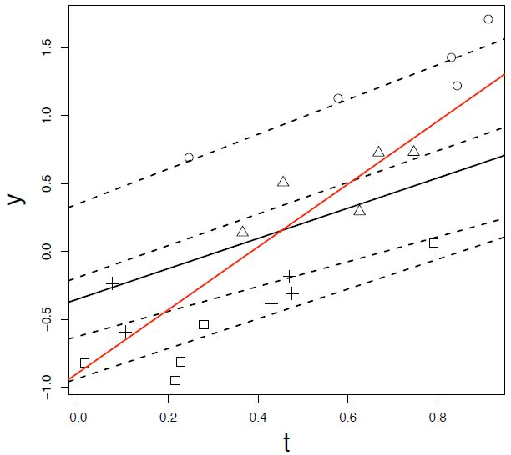
Mixed Effects Model
†M Datar, P Muralidharan, A Kumar, S Gouttard, J Piven, G Gerig, RT Whitaker, PT Fletcher, "Mixed-Effects Shape Models for Estimating Longitudinal Changes in Anatomy,” STIA 2012
Notes:
Need more details here…
Linear model insufficient for computing trends in a hierarchical manner – individual vs. group
Mixed effects model included in the list of optimization strategies to counter this
Group (fixed effects) and individual (random effects) parameters estimated using Bayesian EM scheme

Slide 15
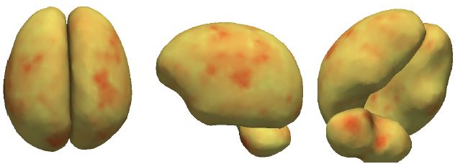
Mixed Effects Model: Trends
Group trend
Individual trend
†M Datar, P Muralidharan, A Kumar, S Gouttard, J Piven, G Gerig, RT Whitaker, PT Fletcher, "Mixed-Effects Shape Models for Estimating Longitudinal Changes in Anatomy,” STIA 2012
Notes:
Need more details here…
Applied to a study of early brain growth in healthy children
Figures show group trends (i.e. colorcoded by slope parameter from fixed effects) and variation within individual (i.e. colorcoded by variation in the slope parameter from random effects)

Slide 16
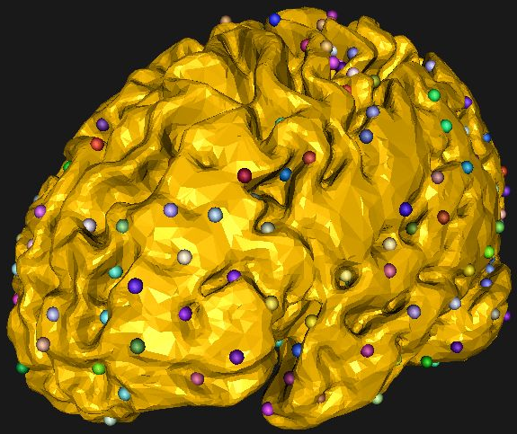
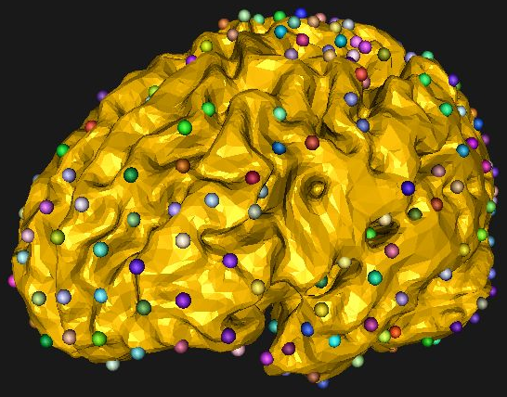
Pairwise Distance Features
Pairwise interparticle distance (Euclidean/Geodesic) as a feature for correspondence optimization
Fig: Initial results from study of cortext shapes. Two examples from the population with correspondences overlaid. Note that correspondences are not good near the top of the cortex, suggesting the need for additional features (e.g. curvature) to be included
Notes:
Ongoing work…

Slide 17
Thank you !
Questions ?

