Slide 1
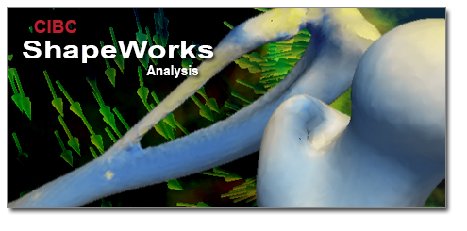
Statistical Shape Analysis
Shireen Elhabian, Prateep Mukherjee
and Ross Whitaker
Saturday, January 4th , 2014
Notes:
Hello every body, My name is Shireen, I will be presenting to you the statistical shape analysis part of this workshop and I will be presenting some case studies where one of the SCI softwares (shapeworks) will come into play for shape analysis
Then Prateep will jump in and demo to us how to use it on a sample data

Slide 2
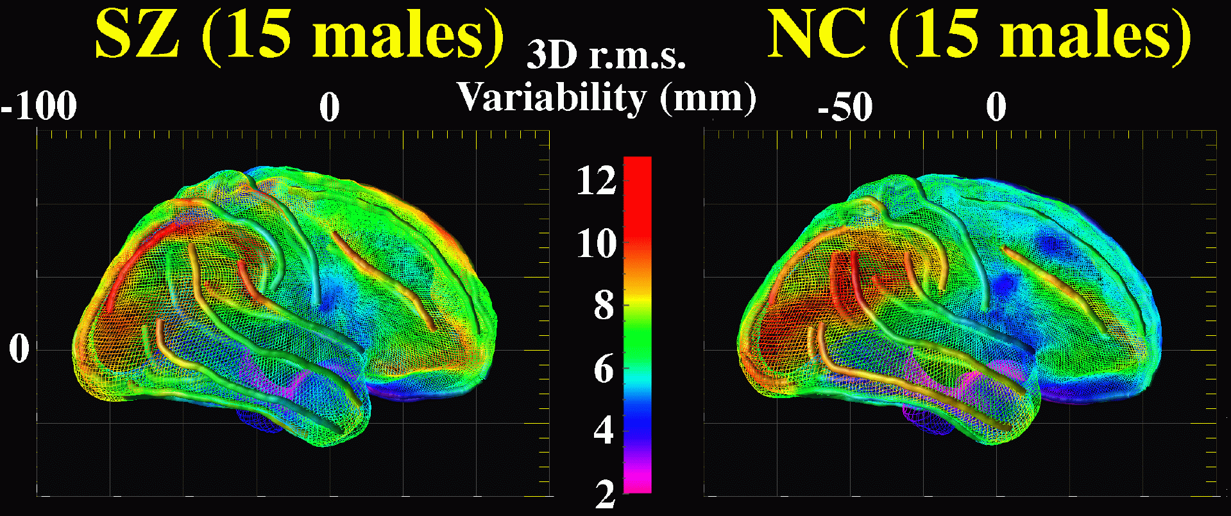
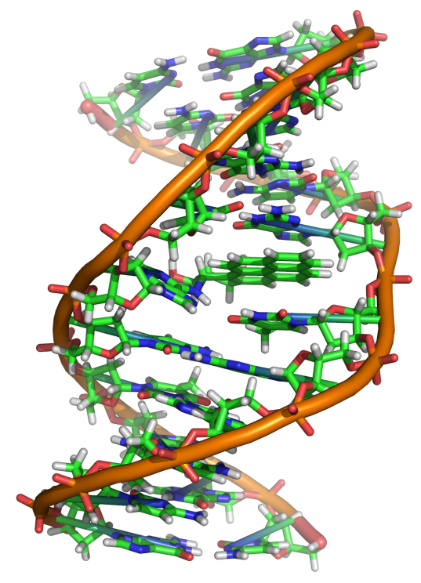
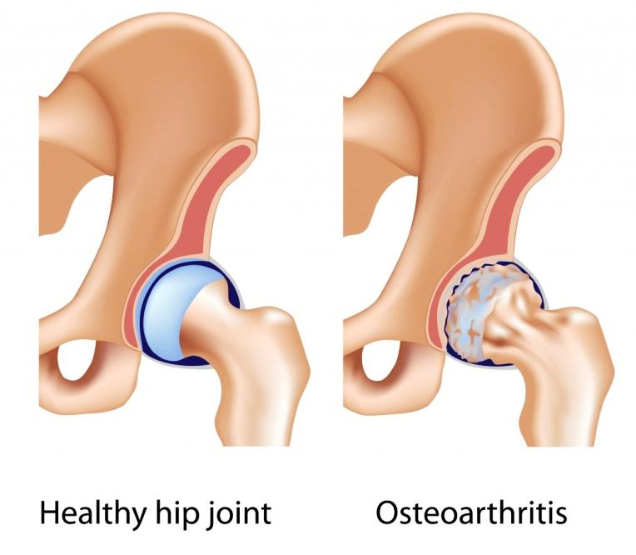
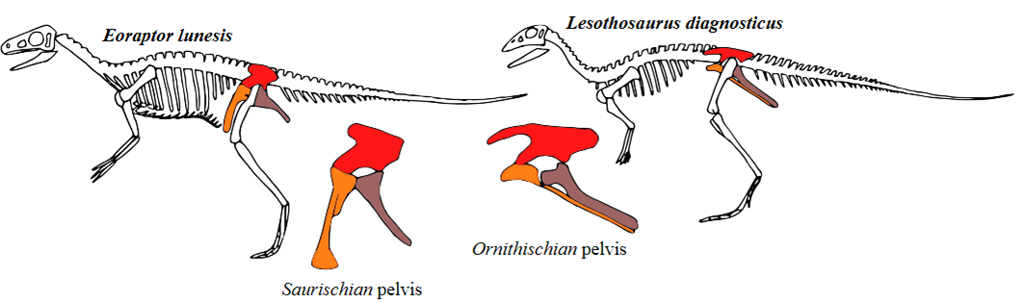
Study of ‘Shape’ What questions can it answer ?
Genetics
How does a gene mutation change skeletal development?
Neuroanatomy
Is there a difference in the shape of brain structures between schizophrenic and normal populations?
Evolutionary Biology
Is the shape of a given bone a good classifier for species?
Biomechanics
How does the hip joint change as a function of age?
Notes:
The study of shape can answer various questions imposed by different areas of study.
For example, shape analysis can quantify the developmental changes over time for a given study, such as watching skeletal development as a response for a gene mutation.
Further, the study of shape can boost classification, for example in biology, is a shape of some bone discriminative enough to be used as a classifier for species.
In neuanatomy where shape differences can help diagnosing schizophrenic people through the study of the shape of brain structures.
Also in biomechanics where we can quantify the shape changes certain joints as function of age.

Slide 3
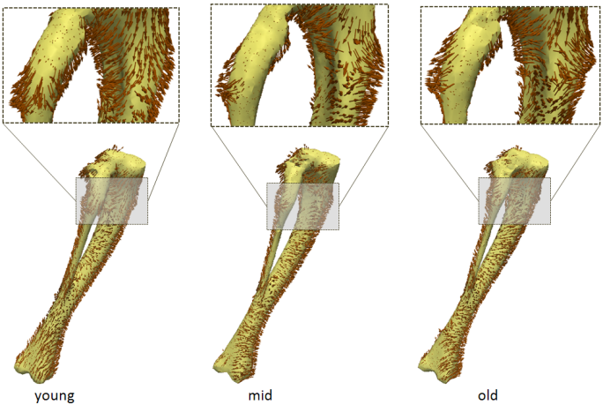
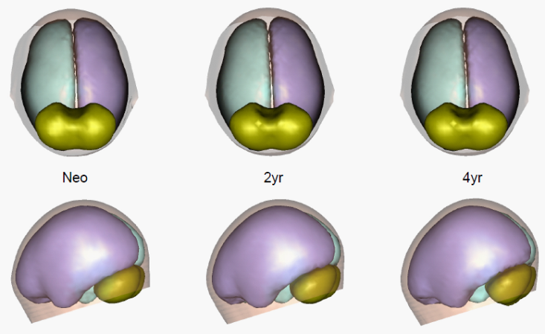
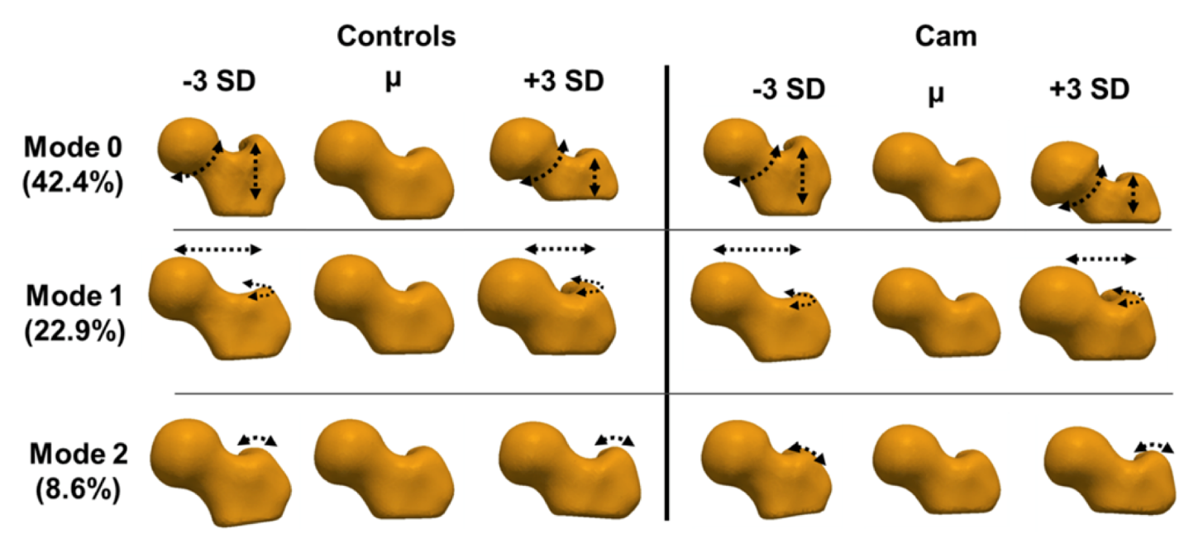
Shape analysis is ubiquitous…
Group Differences
Normative Growth
Variability in population
Notes:
So, by all means, shape analysis is ubiquitous, everywhere we may face questions like quantifying group differences, monitoring growth or making sense of variability in a given population.
All such questions can be answered by shape analysis.

Slide 4
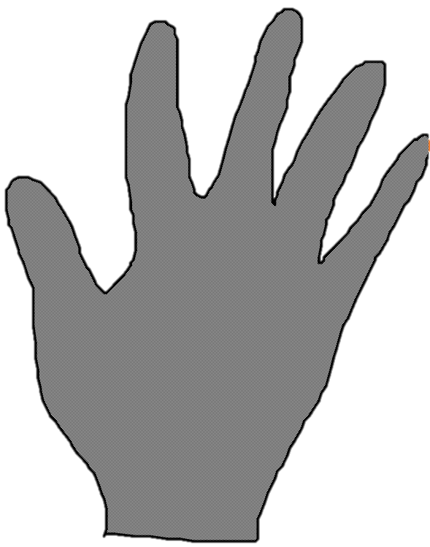
Statistical Shape Analysis It’s all about representation…
Notes:
To study shape, it is important to come up with a compact and accurate representation of such a shape,
Point based representation is one of the most popular representations to study shape and this is the one we use in ShapeWorks
For instance, here is a 2D example of a hand shape, we can choose the tips of the figures to represent such a shape,
this might be a compact representation but not enough to model the geometric structure of such a hand (we lost the geometric details of the shape)

Slide 5
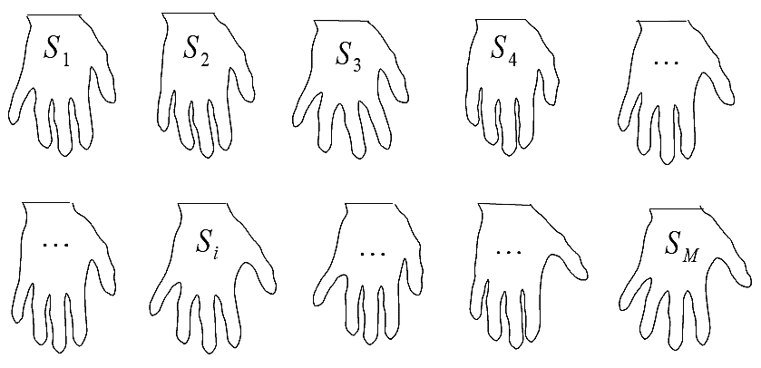
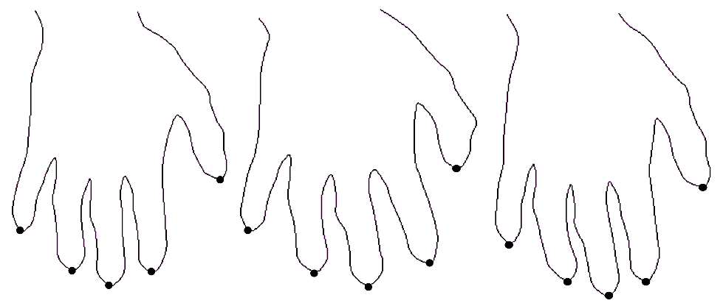
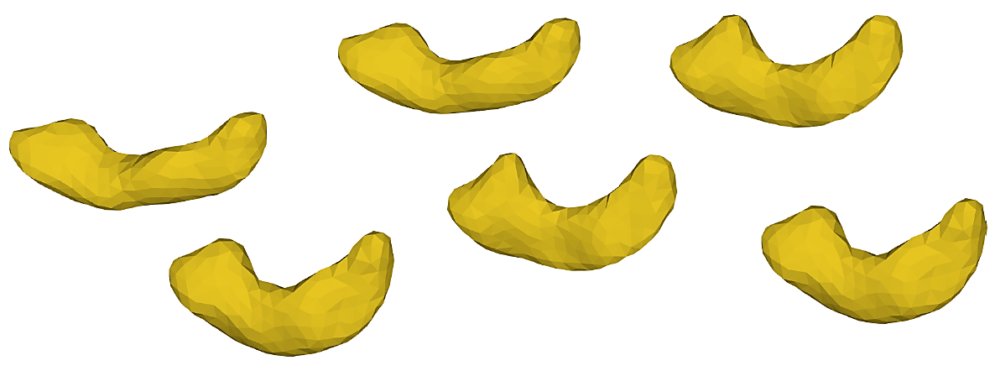
Statistical Shape Analysis It’s all about representation…
Given a collection of shapes, we can use a point based representation for each $S_{i}$
BUT…
How do we choose the “same” points ??
Notes:
The question now becomes how would we choose the same points across different instances in the same population so that this respresentation is compact while capturing enough geometric details of the underlying shapes

Slide 6
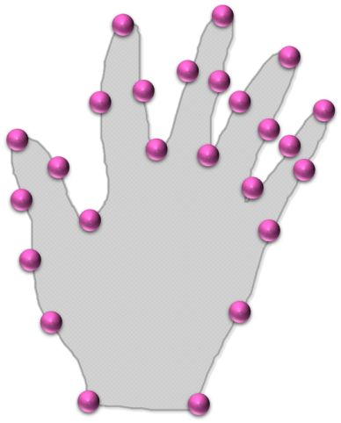
Statistical Shape Analysis It’s all about representation…
$$y_{}^{M}$$
$ℝ^{2M}$
$$p^{k}={\left(x^{k},y^{k}\right)}^{T}$$
$ℝ^{2}$
$$y_{}^{1}$$
$$y$$
$$x_{}^{1}$$
0
$$S_{i}=\left(\begin{aligned}p_{i}^{1} \\ p_{i}^{2} \\ … \\ p_{i}^{M}\end{aligned}\right)=\left(\begin{aligned}x_{i}^{1} \\ y_{i}^{1} \\ … \\ x_{i}^{M} \\ y_{i}^{M}\end{aligned}\right)$$
$$x$$
Configuration Space
Shape Space
Notes:
Let’s have a look on how a shape is represented …
Each shape can be viewed as a collection of M points in N-dimensional , here it is a 2D shape in a 2D space , that is each shape is considered as a configuration in a configuration space.
Each shape can be also be viewed as a point in a higher dimensional shape space.

Slide 7
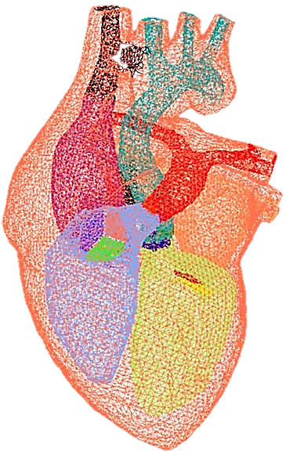
Statistical Shape Analysis It’s all about representation…
$$p^{k}={\left(x^{k},y^{k}\right)}^{T}$$
$$p^{k}={\left(x^{k},y^{k},z^{k}\right)}^{T}$$
$ℝ^{2}$
$ℝ^{3}$
$$y$$
$$y$$
$$z$$
$$x$$
$$x$$
Configuration Space
Notes:
This representation can be extended to 3D to model various anatomical structures by simply adding a third dimension

Slide 8
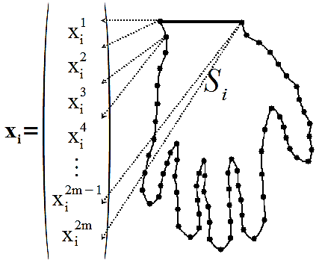
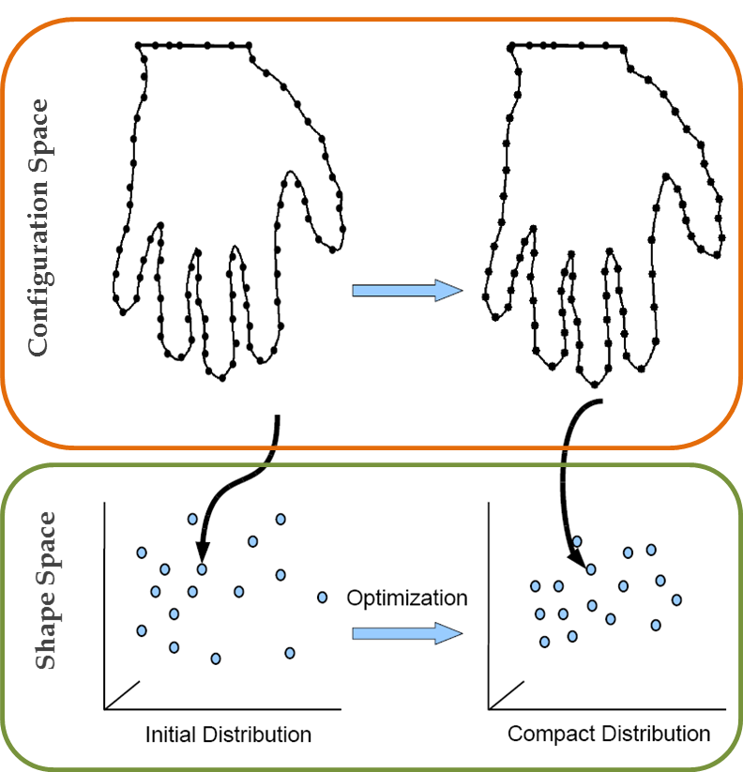
Point Correspondence Model Balancing accuracy vs. low variance
Accurate Representation
(in Configuration Space)
vs.
Compact Model
(in Shape Space)
Notes:
The process of deriving a correspondence model given a collection of shapes is a way to achieve an accurate representation in the configuration space while in the meantime a compact model in the shape space.
The end-result would be a point-representation for each shape where the points are in correspondence across shapes.
This is considered as a trade-off between surface sampling energy and correspondence energy
This balance is achieved in shapeworks via gradient descent optimization of particle positions using a cost function based on entropy.

Slide 9
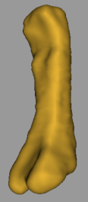
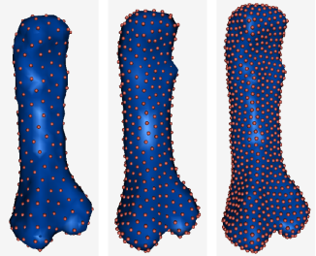
Correspondence Pipeline
Notes:
Here are the steps involved in the process. The pipeline is mainly divided into a preprocessing stage followed by the particle-based-modeling algorithm which will derive the correspondence model.
Given shapes as binary segmentations, the first thing is to apply some rigid registration to make them live in the same coordinate frame.
To overcome artifacts of this binary segmentations appearing as jagged edges, antialiasing filter is then applied.
Each shape is now ready to be represented implicitly as the zero-level of its distance transform.
Now the PBM algorithm starts with initializing particles on all the given shapes using a splitting strategy.
These particles are then optimized to balance the trade-off between surface sampling and compact modeling in the shape space.
An alignment process is applied along the optimization iterations to make sure that the sampled shapes are globally aligned.

Slide 10
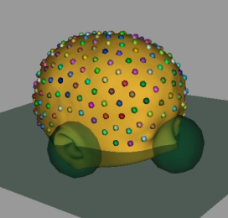
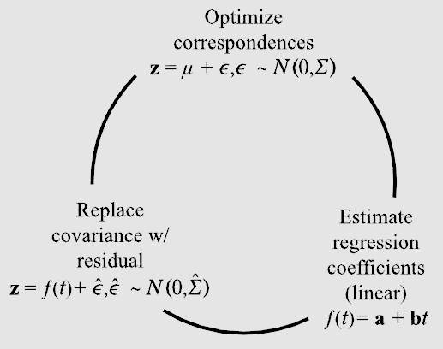
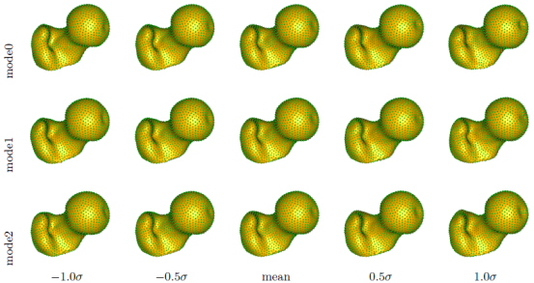
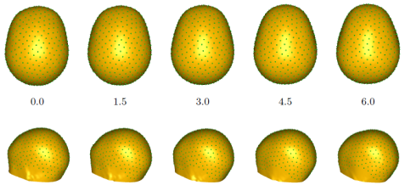
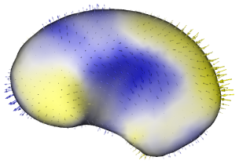
ShapeWorks Pipeline
Input Segmentation | Distance Transform | Antialiased Surface
Preprocessing
…
Entropy Minimization | Open Surfaces | Linear Regression
Optimization
…
Modes of Variation | Group Differences | Regression Shape
Visualization/
Applications
…
Notes:
Shapeworks have a pipeline that can preprocess segmented shapes in a population, initialize and optimize correspondences on each of them (using various techniques, best suited to the use case) and perform analysis on the point clouds obtained as a result

Slide 11
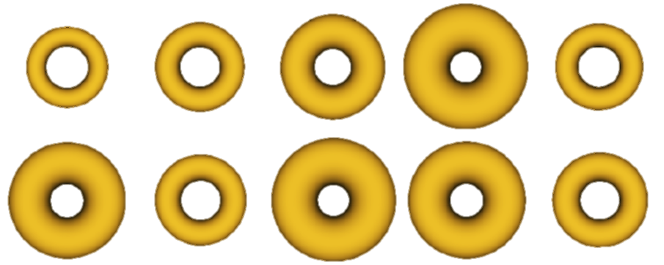
Toy Example Synthetic Tori
Population: Tori parameterized by radii (R,r)
Generated Correspondences
Notes:
To give you an idea of what is the resulting shape model would capture.
Here we have a synthetic population of tori parameterized by inner and outer radii
Here are the generated correspondences on sample shapes

Slide 12
Toy Example Synthetic Tori
Modes of variation
Notes:
The modes of variation reflects the parameters that were used to generate those shapes …
We can observe in the first row the torus is getting thinner or thicker as we go way from the mean
While in the second row the torus is expanding or shrinking.

Slide 13
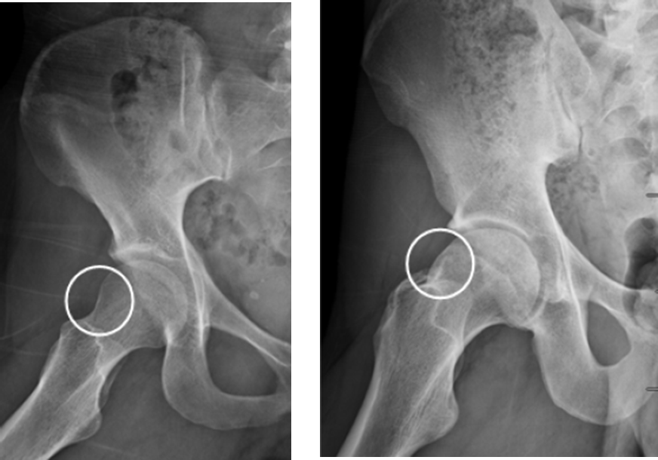
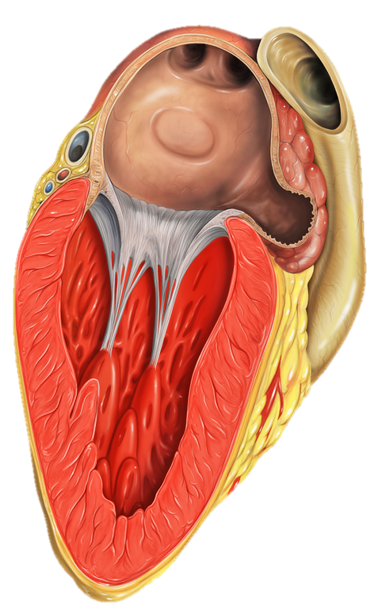
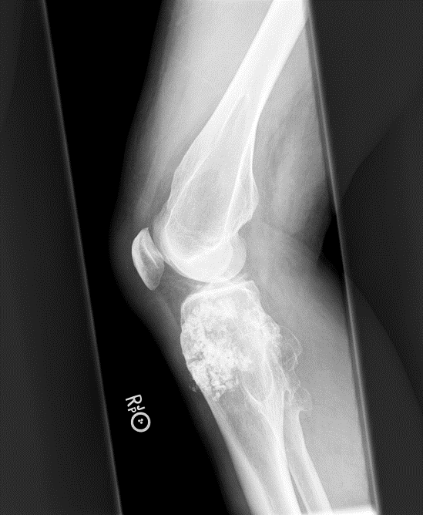
Applications
Notes:
Now lets move to real life applications where shapeworks come into play

Slide 14
ShapeWorks for Cardiology Left Atrial Appendage – Stroke Prediction
The left atrial appendage (LAA) is a muscular pouch connected to the left atrium of the heart.
It can be thought of as a left-over heart after we grow up.
Functions as a reservoir for the left atrium.
If it traps blood longer than it should be, blood clots and causes stroke
Can shape analysis aid in predicting whether someone will have a stroke or not ?!!
Notes:
People with the Atrial fibrillation face a much higher risk of stroke than others, and require treatment to prevent this potentially crippling and sometimes fatal consequence.
The most important step to treat A-fib is to prevent blood clots from forming by treating patients with anticoagulants.
The left atrial appendage serves as a resrvoir for the let atrium of the heart.
If the left atrial appendage traps blood longer than it should be, this increases the probability of having a stoke since blood clots.
So can shape analysis be used to predict whether someone with A-fib will have stroke.
Is there quantifiable difference between the shapes of stoke and no-stroke person
Atrial fibrillation, characterized by multiple irregular electrical signals that cause the heart’s upper chambers to contract rapidly, without their usual coordination. This sends an erratic signal to the ventricles, the lower chambers that supply blood to the lungs and rest of the body.

Slide 15
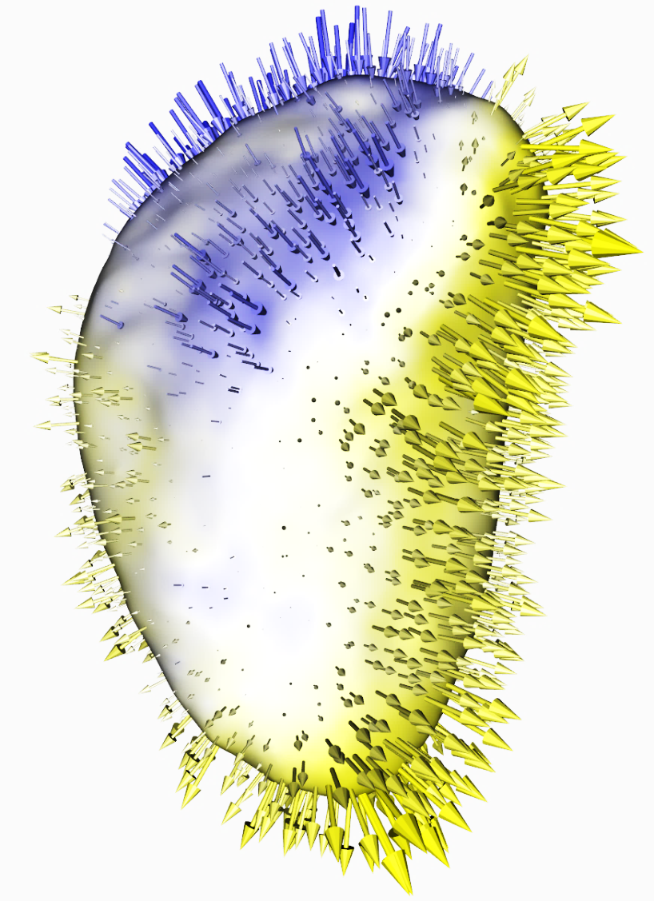
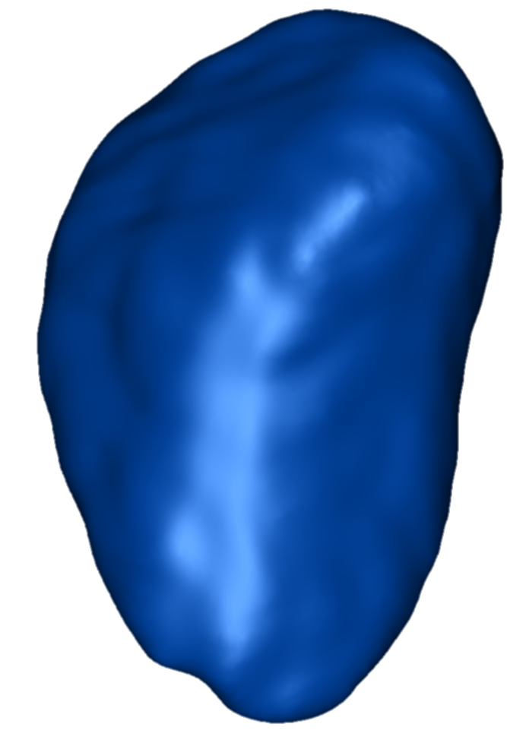
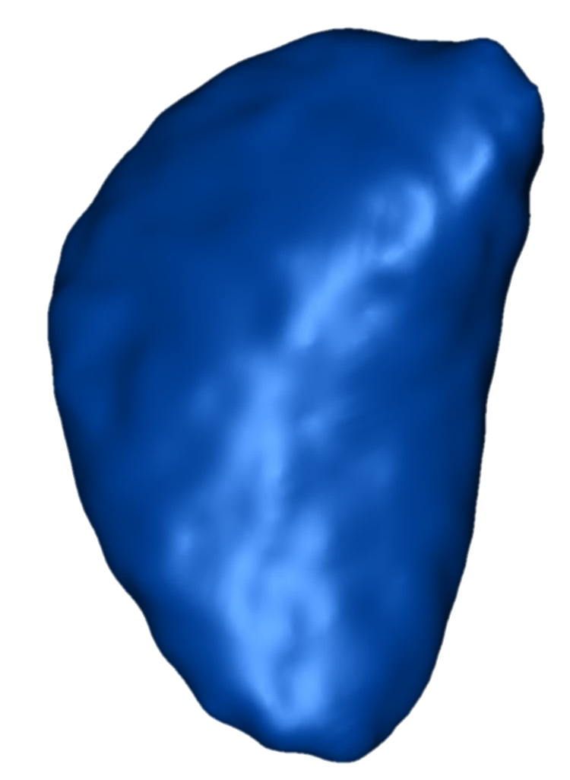
ShapeWorks for Cardiology Left Atrial Appendage – Stroke Prediction
The LAA of two groups was segmented, one group with no history of having stroke while the other group has evident history of having stroke.
Group 1:
no history of stroke
Group 2:
history of stroke
Group difference (group 1 to group 2)
Notes:
Two groups of LAA were segmented where one group has no history of having a stoke while the other group has a long history of stokes.
Here are the mean shapes derived from the correpsondence model optimized by shapeworks,
We can observe group differences between the two populations where having an evident history of stokes affect the shape of the left atrial appendage,

Slide 16
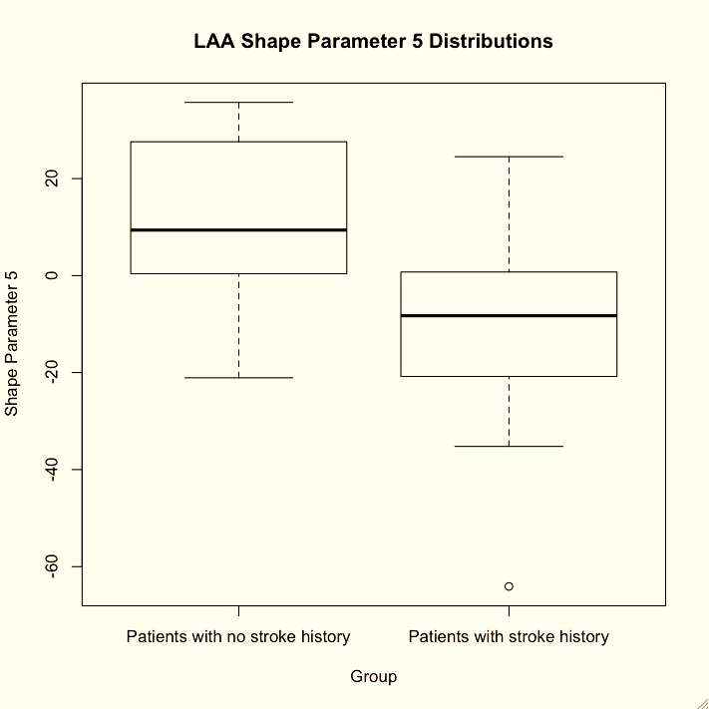
ShapeWorks for Cardiology Left Atrial Appendage – Stoke Prediction
The significant shape difference between the two groups was found in the fifth PCA mode.
A boxplot of the distributions is shown on the right.
The p-value for a t-test of significant group mean difference is 0.0051
Notes:
In particular, we observed a significant shape difference between the two group in the fifth PCA mode
Here is a boxplot of the distribution of the 5th shape parameter where we can see a difference between the two groups.
As such, shape analysis can capture shape variation induced by having a long history of stoke, also it can aid in predicting whether a given subject is vulnerable to stoke or not.

Slide 17
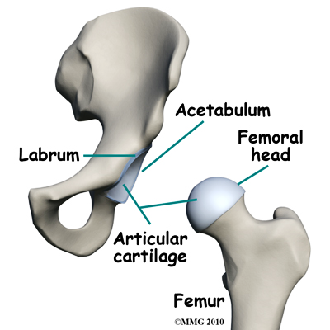
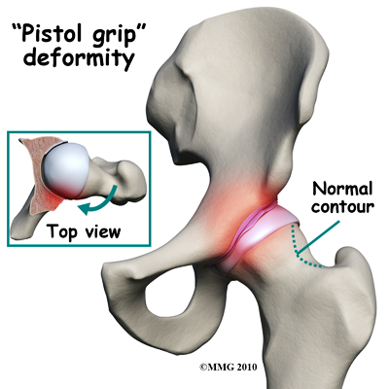
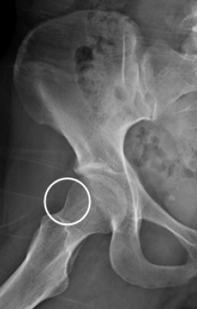
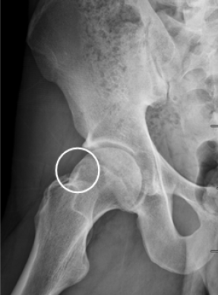
ShapeWorks for Orthopedics CAM-FAI Characterization
Dr. Jeffery Weiss, Dr. Andrew Anderson, clinicians @ Orthopedics Department of Orthopedics, University of Utah
CAM-FAI = ‘cam’ type Femoro Acetabular Impingement
Treatment: surgical debridement
How much to ‘shave off’ ? And from where ?
Fig: Radiographs of subjects with healthy (left) and cam FAI (right) femurs. Circles indicate the anterolateral head-neck junction.
Objective: quantify 3D variation and morphologic differences between control and cam femurs
Harris, Michael D., Manasi Datar, Ross T. Whitaker, Elizabeth R. Jurrus, Christopher L. Peters, and Andrew E. Anderson. "Statistical shape modeling of cam femoroacetabular impingement." Journal of Orthopaedic Research 31, no. 10 (2013): 1620-1626.
Notes:
Let’s move to orthopedics
Femoroacetabular impingement is a recently described disease of the hip joint
it is marked by reduced clearance between the femoral head and acetabulum due to morphologic abnormalities of the femur, acetabulum , or both.
Impingement refers to some portion of the soft tissue (labruim and/or articular cartilage) around the hip socket getting pinched or compressed.
cam-type impingement (more common in men) occurs when the round head of the femur isn't as round as it should be to move properly inside the hip socket.
The result is a shearing force on the labrum and the articular cartilage, which is located next to the labrum.
This can damage articular cartilage and the labrum
Currently, diagnosis of cam FAI is largely done using 2D radiographic measurements of femur morphology and do not provide quantitative information that translates well for preoperative planning
If physicians could be provided with knowledge of the size and shape of a cam lesion, a more exact diagnosis, as well as detailed preoperative planning, may be facilitated.
The labrum is a dense ring of fibrocartilage firmly attached around the acetabulum (socket). It provides depth and stability to the hip socket.
The articular cartilage is the protective covering over the hip joint surface.

Slide 18
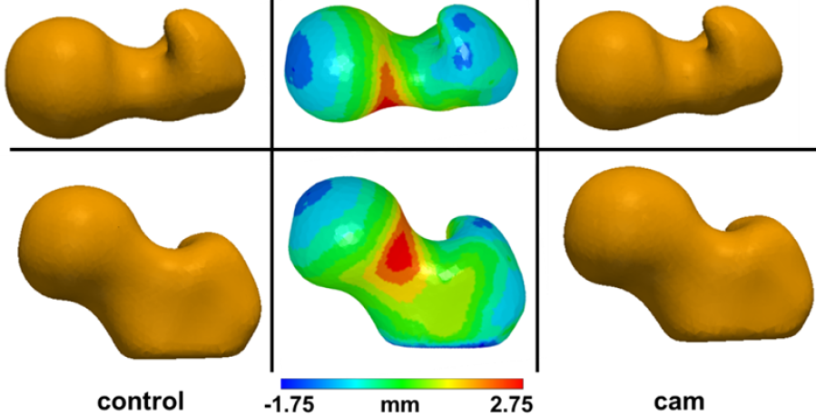
ShapeWorks for Orthopedics CAM-FAI Characterization
Dr. Jeffery Weiss, Dr. Andrew Anderson, clinicians @ Orthopedics Department of Orthopedics, University of Utah
Mean Shapes
Mean shape deviations between control and CAM groups most pronounced at the anterolateral head-neck junction (max = 2.7mm)
Fig: Two views (two rows) of the mean control (left) and cam (right) shapes. Mean control shape (center), color coded to depict shape differences in comparison with mean CAM shape
Harris, Michael D., Manasi Datar, Ross T. Whitaker, Elizabeth R. Jurrus, Christopher L. Peters, and Andrew E. Anderson. "Statistical shape modeling of cam femoroacetabular impingement." Journal of Orthopaedic Research 31, no. 10 (2013): 1620-1626.
Notes:
Mean Shapes
Statistically significant group differences (p-value < 0.01)
Mean shape deviations between control and CAM groups most pronounced at the anterolateral head-neck junction (max = 2.7mm)

Slide 19
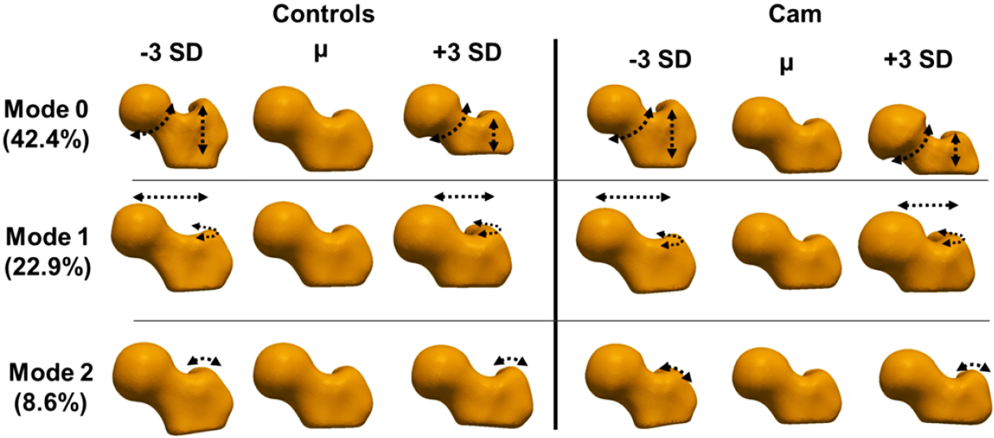
ShapeWorks for Orthopedics CAM-FAI Characterization
Dr. Jeffery Weiss, Dr. Andrew Anderson, clinicians @ Orthopedics Department of Orthopedics, University of Utah
Modes of variation
Understand morphological variability in Cam-FAI
Consistent differences captured by individual modes for control and CAM groups
Harris, Michael D., Manasi Datar, Ross T. Whitaker, Elizabeth R. Jurrus, Christopher L. Peters, and Andrew E. Anderson. "Statistical shape modeling of cam femoroacetabular impingement." Journal of Orthopaedic Research 31, no. 10 (2013): 1620-1626.
Notes:
Mode 0: variation in head-neck concavity, distance between trochanters
Mode 1: neck extension and anteroposterior curvature of the greater trochanter
Mode 2: coronal curvature of the greater trochanter

Slide 20
ShapeWorks for Orthopedics Multiple Osteochondromas
Dr. Kevin Jones, M.D., clinicians @ Huntsman Cancer Institute Department of Orthopedics and Huntsman Cancer Institute, University of Utah
Multiple osteochondromas (MO),
Individuals with multiple osteochondromas (MO) demonstrate shortened long bones.
Possible reason: steal phenomenon
Studied using mice models
Data: Segmented femurs (50), Segmented tibiae (36)
Can we characterize the effects of disease progression ?
Segmented femur and tibia+fibula used in study
Jones, Kevin B., Manasi Datar, Sandhya Ravichandran, Huifeng Jin, Elizabeth Jurrus, Ross Whitaker, and Mario R. Capecchi. "Toward an understanding of the short bone phenotype associated with multiple osteochondromas." Journal of Orthopaedic Research (2012).
Notes:
Another application for shapeworks in orthopeidcs is multiple osteochondromas
This is a genetic disease which causes a special type of cancer that would result in bone deformation, in particular bones get shorter and fatter.
This is mostly known as the steal phenomena.
A study on mice models of different ages was conducted where one group was considered as control and the other group had gone through gene mutation to cause this disease.
The analysis was done on femur as well as tibia and fibula bones.

Slide 21
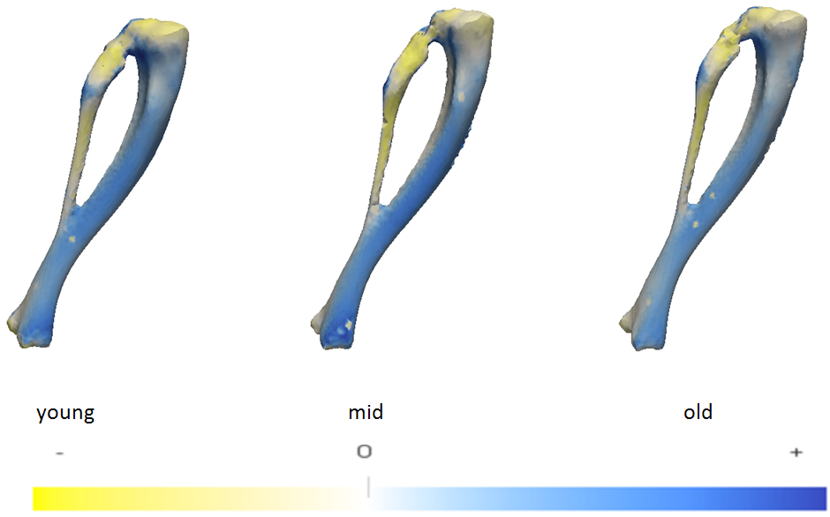
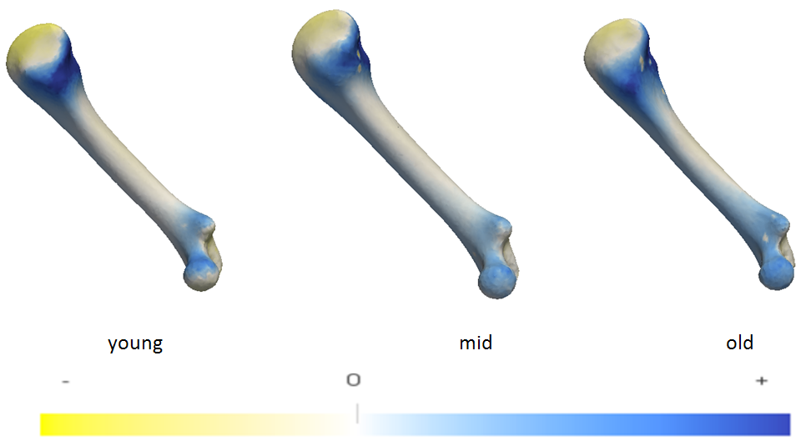
ShapeWorks for Orthopedics Multiple Osteochondromas
Group mean differences
Indicate shortening of mutant bones
Do not validate ‘steal phenomenon’
Dr. Kevin Jones, M.D.@ Huntsman Cancer Institute Department of Orthopedics and Huntsman Cancer Institute, University of Utah
Fig: Group mean differences for femur
Fig: Group mean differences for tibia+fibula
Color code: expansion (blue) or contraction (yellow) w.r.t normal
Statistically significant group differences (individual p-values < 0.01)
Correlation with length evident visually in the group means
Jones, Kevin B., Manasi Datar, Sandhya Ravichandran, Huifeng Jin, Elizabeth Jurrus, Ross Whitaker, and Mario R. Capecchi. "Toward an understanding of the short bone phenotype associated with multiple osteochondromas." Journal of Orthopaedic Research (2012).
Notes:
Population analysis was done on 3 age groups (young, middle and old-aged)
MO mice had shorter femora and tibiae than controls, more pronouncedly when the gene mutation was induced earlier during skeletal growth.
For the fumer bone, Parallel analysis found 5 significant modes of variation for each pair of groups. While for Tibia+fibula bones, Parallel analysis found 4 significant modes of variation for each pair of groups.
The group differences between all pairs using these modes were significant with a p-value < 0.01

Slide 22
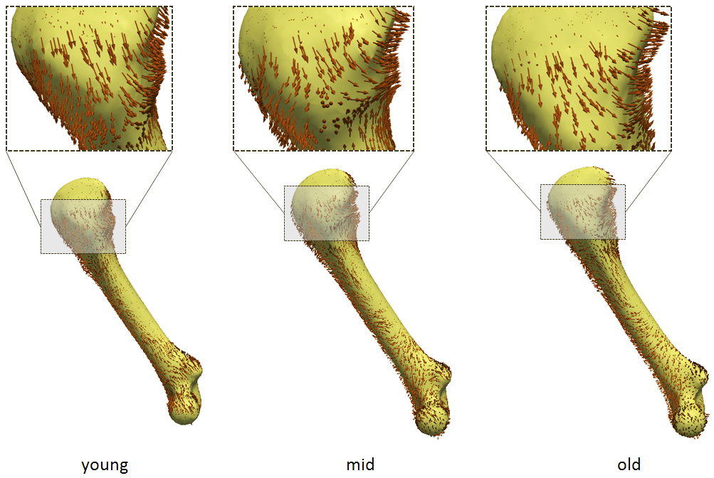
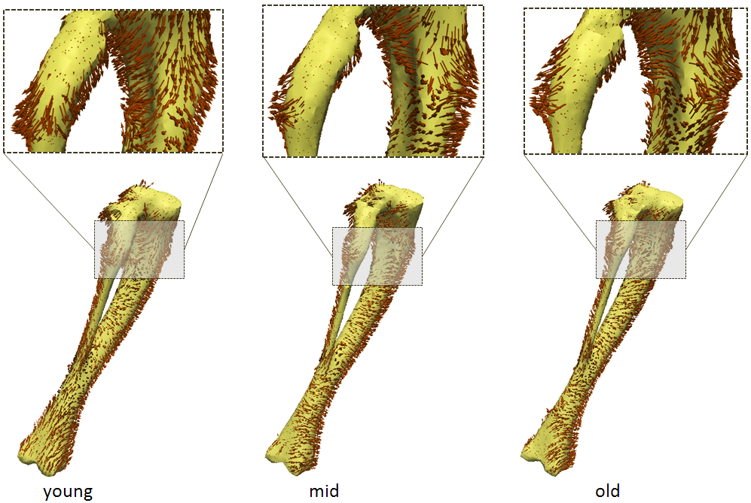
ShapeWorks for Orthopedics Multiple Osteochondromas
Dr. Kevin Jones, M.D.@ Huntsman Cancer Institute Department of Orthopedics and Huntsman Cancer Institute, University of Utah
Fig: Directional analysis for femur
Fig: Directional analysis for tibia+fibula
Arrows show local deformation from mean-normal to mean-mutant shape
Gives visual indication of the steal phenomenon, with:
Tangential deformation in most areas of the mean shape, leading to shortening in length
Orthogonal deformation near “bumps”, leading to local increase in girth
Jones, Kevin B., Manasi Datar, Sandhya Ravichandran, Huifeng Jin, Elizabeth Jurrus, Ross Whitaker, and Mario R. Capecchi. "Toward an understanding of the short bone phenotype associated with multiple osteochondromas." Journal of Orthopaedic Research (2012).
Notes:
Here is the directional analysis for femur as well as tibia and fibula bones to give visual indication of the steal phenomenon
We can observed the tangential deformation in most areas leading to length shortening
While orthogonal deformation near bumps indicates the bone is getting fatter.

Slide 23
Correspondence Pipeline
Notes:
Describe the steps involved in the process, before delving into the orthopedics applications

Slide 24
Thanks for your attention

