Slide 1

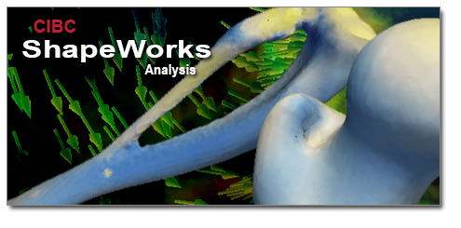

Statistical Shape Analysis
Tutorial
Shireen Elhabian, Prateep Mukherjee
and Ross Whitaker
Saturday, January 4th , 2014

Slide 2
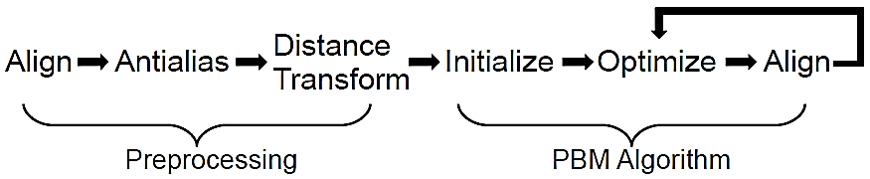
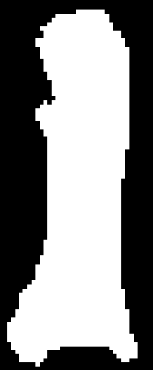
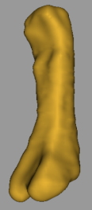

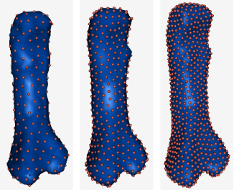
Correspondence Pipeline
Notes:
Describe the steps involved in the process, before delving into the orthopedics applications

Slide 3
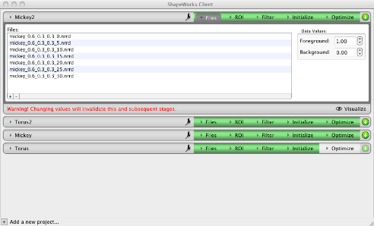


Main Components
SandBox
ShapeWorksGroom
ShapeWorksRun
Internet
Python
cibc2.sci.utah.edu =
shapeworks-server.sci.utah.edu
ShapeWorksServer
SSL
connection
ShapeWorksBroker
cibc3.sci.utah.edu
SSL
connection
SandBox
ShapeWorksGroom
ShapeWorksRun
Python
SCI File System:
All projects are stored here
ShapeWorksServer
Seg3D 2.1.1
localhost
ShapeWorksView
ShapeWorks Client
ShapeWorks Broker
ShapeWorks Server

Slide 4
Let’s Get Started
Copy all the software given in the USB stick at a convenient location in your computer
Click on start menu and type ‘cmd.exe’ to start a command prompt
First, start ShapeWorks Broker
ShapeWorksBroker.exe broker_address=localhost \
broker_rootdir=c:\shapeworks_run
Make note of password generated. It will be required to start ShapeWorks Client
Click on start and start another command prompt
Start ShapeWorks Server
ShapeWorksServer.exe broker_address=localhost \
shapeworks_dir=c:\Shapeworks
* Refer to lab document(Section 2) for more instructions

Slide 5
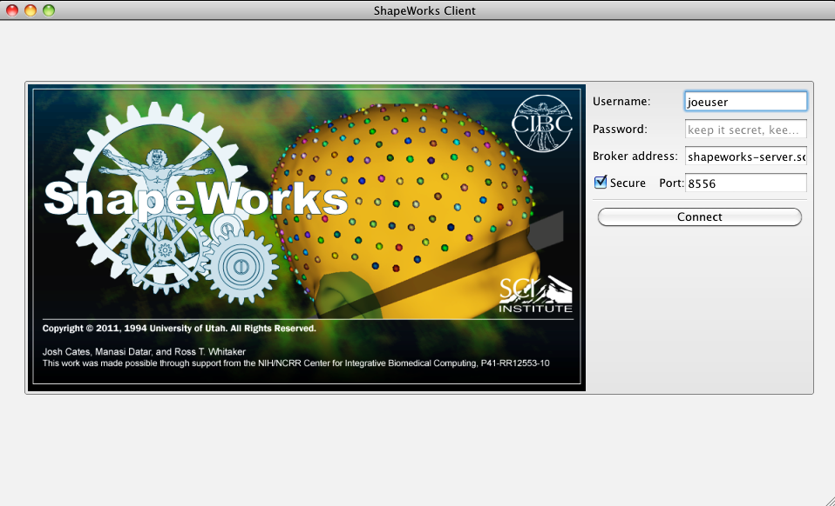
Connecting to a Server
Enter the username and password created during running the broker

Slide 6
Correspondence Pipeline
Notes:
Describe the steps involved in the process, before delving into the orthopedics applications

Slide 7
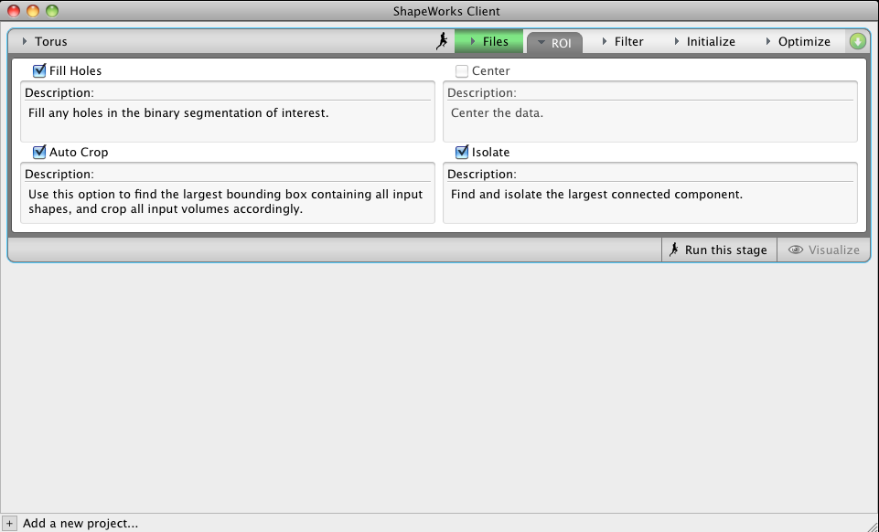
Configuring a Project

Slide 8
Configuring a Project

Slide 9
Configuring a Project

Slide 10
Configuring a Project

Slide 11
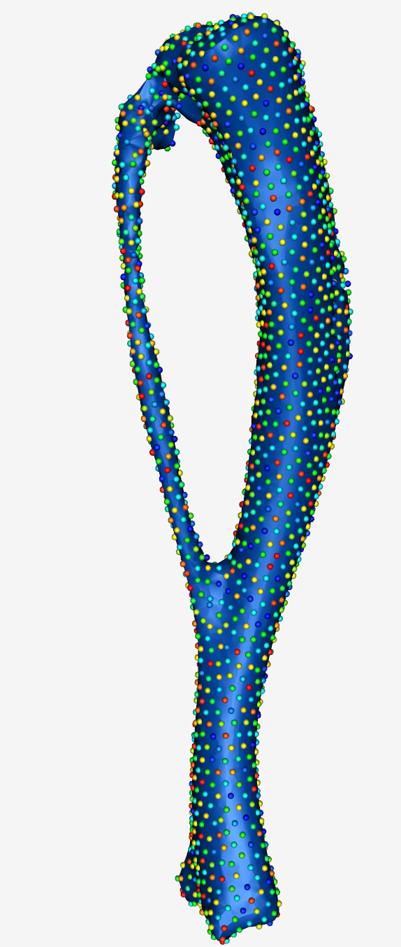
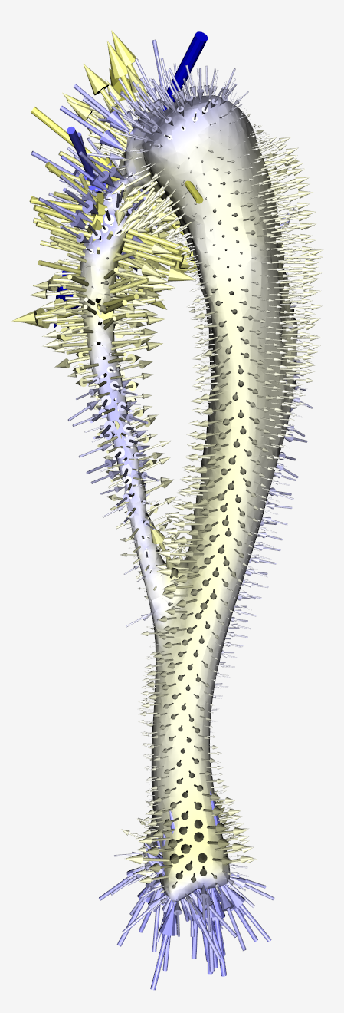
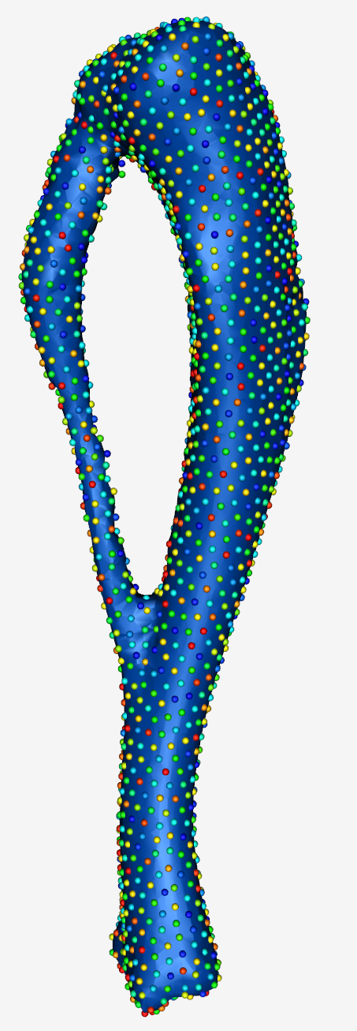
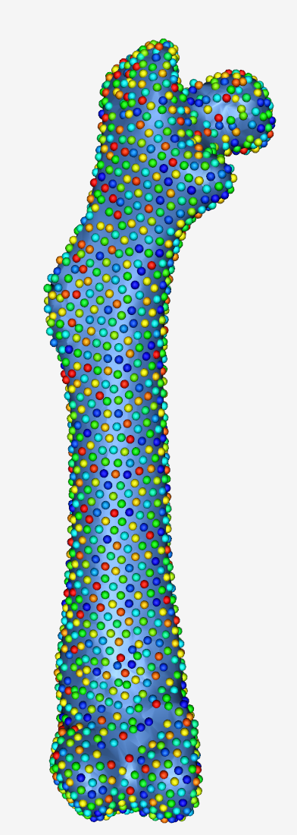
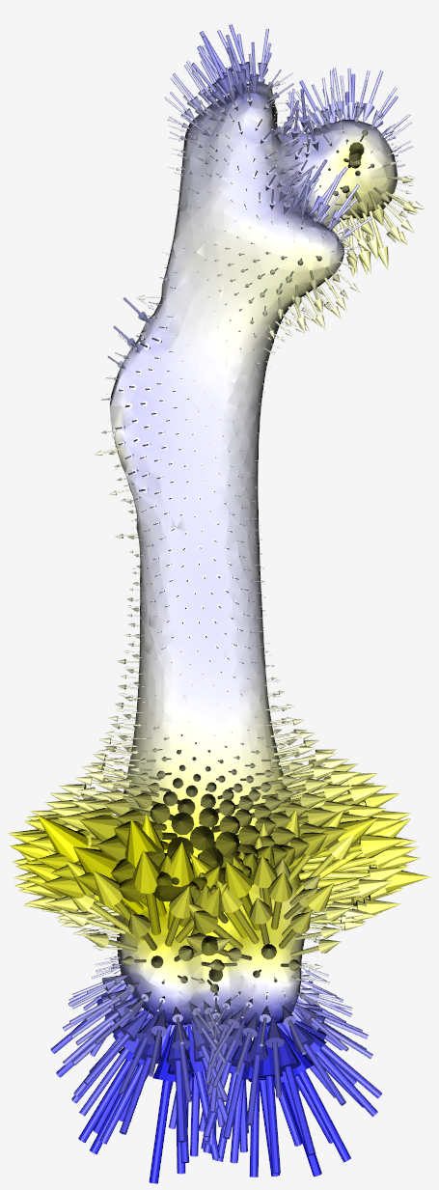
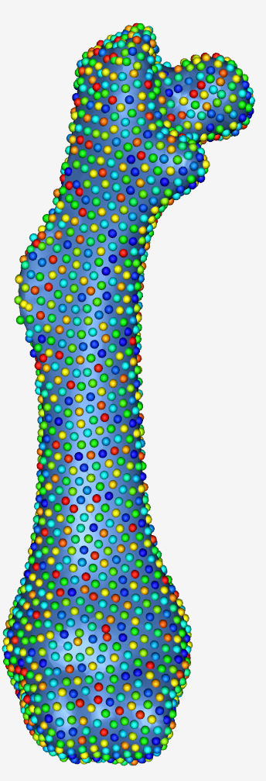
ShapeWorksView
Multiple Osteochondromas
Group mean differences for tibia+fibula – young
Group mean differences for femur – young
normal
mutated
normal
mutated

Slide 12
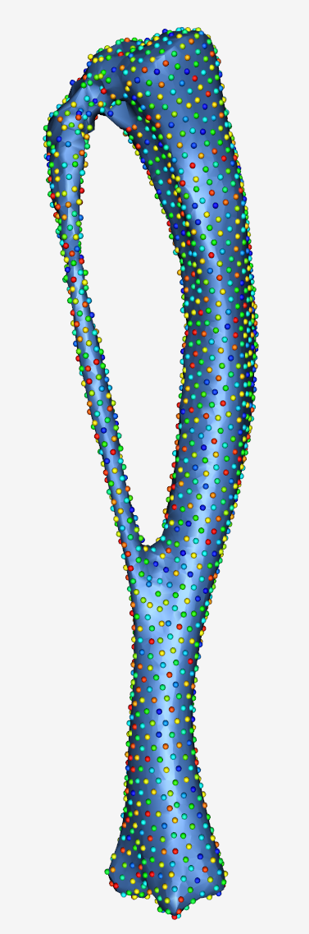
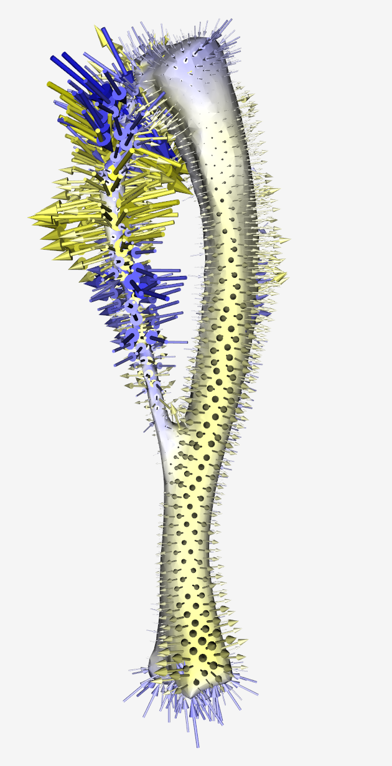
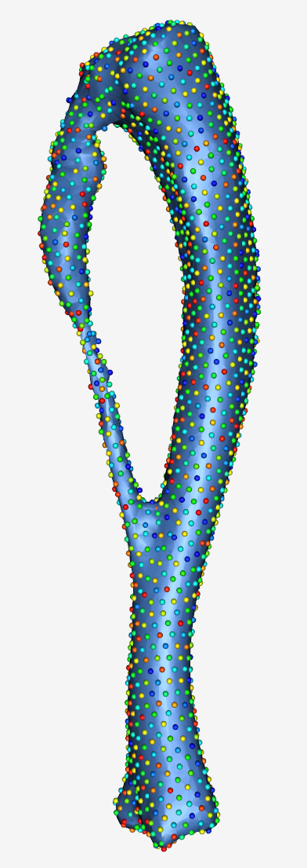
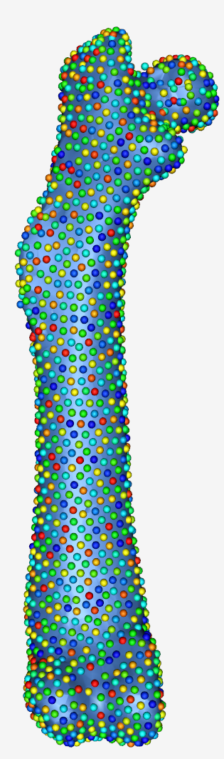
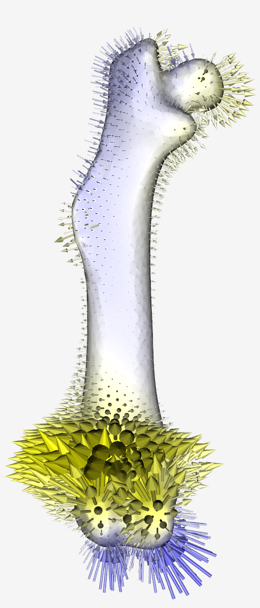
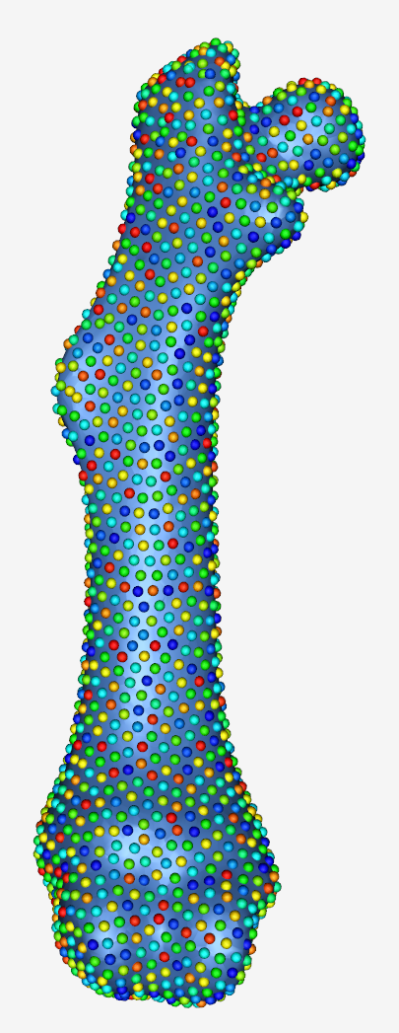
ShapeWorksView
Multiple Osteochondromas
Group mean differences for tibia+fibula – middle-aged
Group mean differences for femur – middle-aged
normal
mutated
normal
mutated

Slide 13
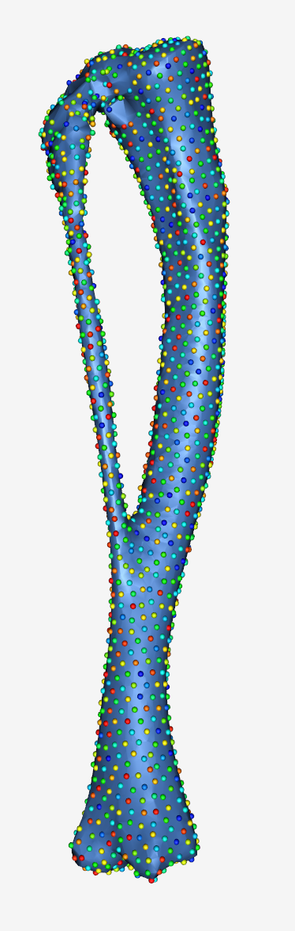
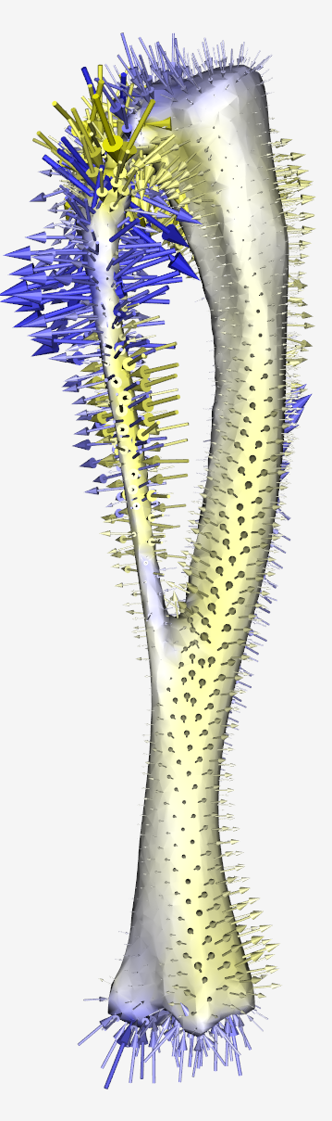
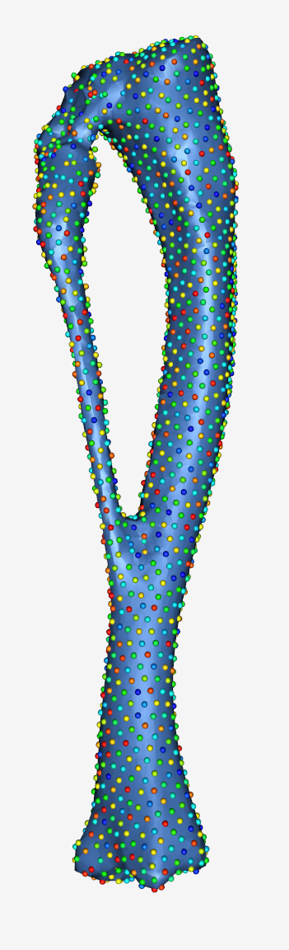
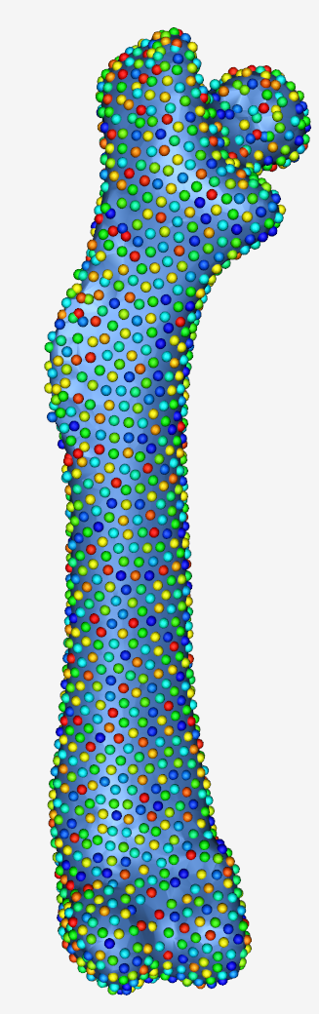
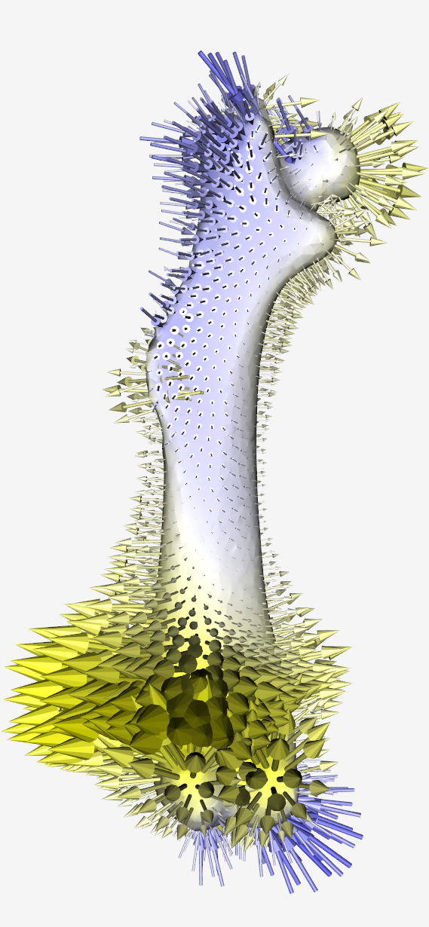
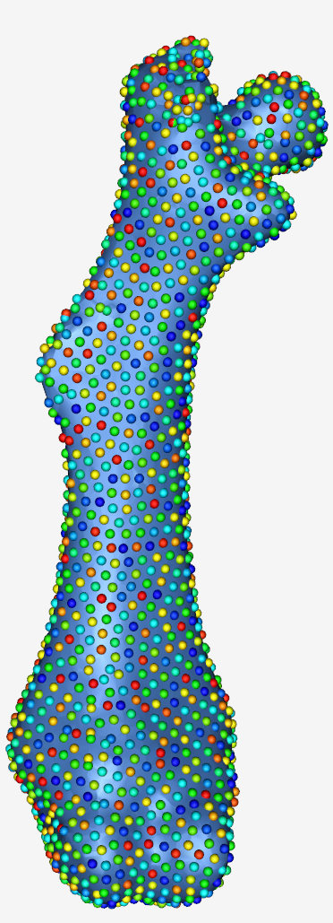
ShapeWorksView
Multiple Osteochondromas
Group mean differences for tibia+fibula – old
Group mean differences for femur – old
normal
mutated
normal
mutated

Slide 14
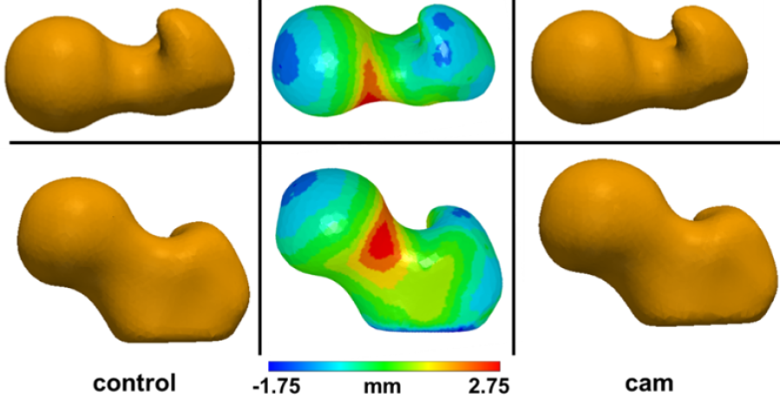
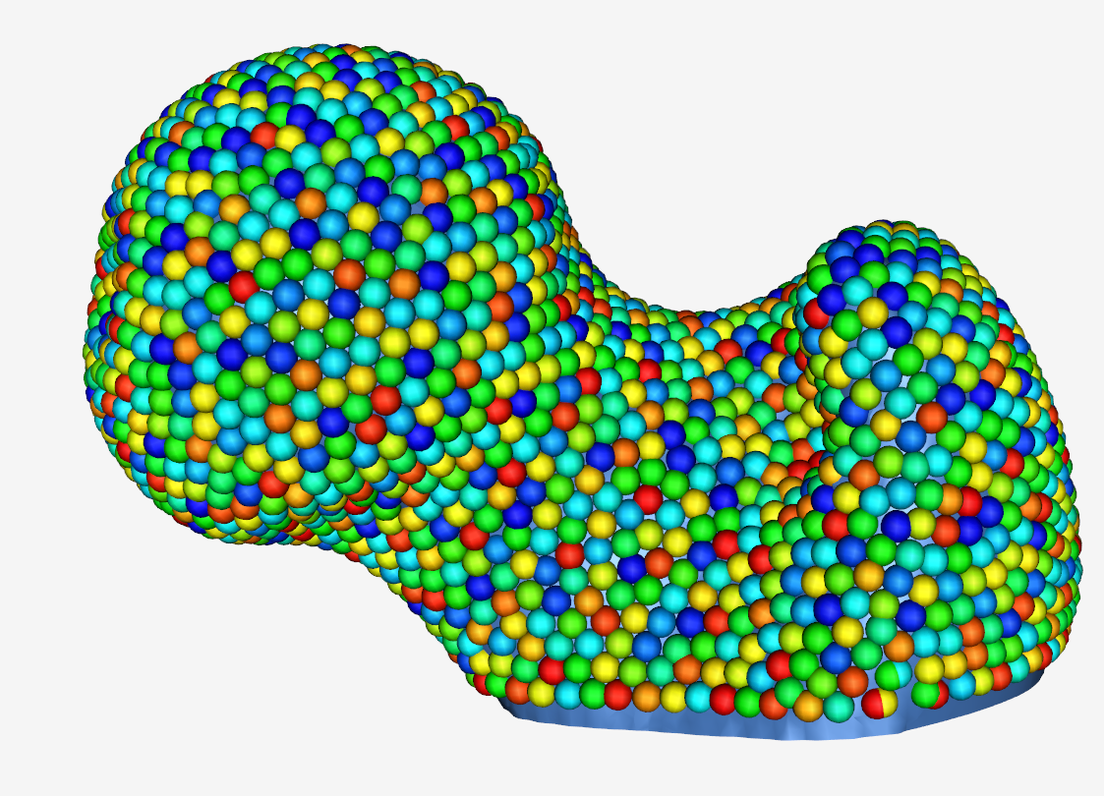
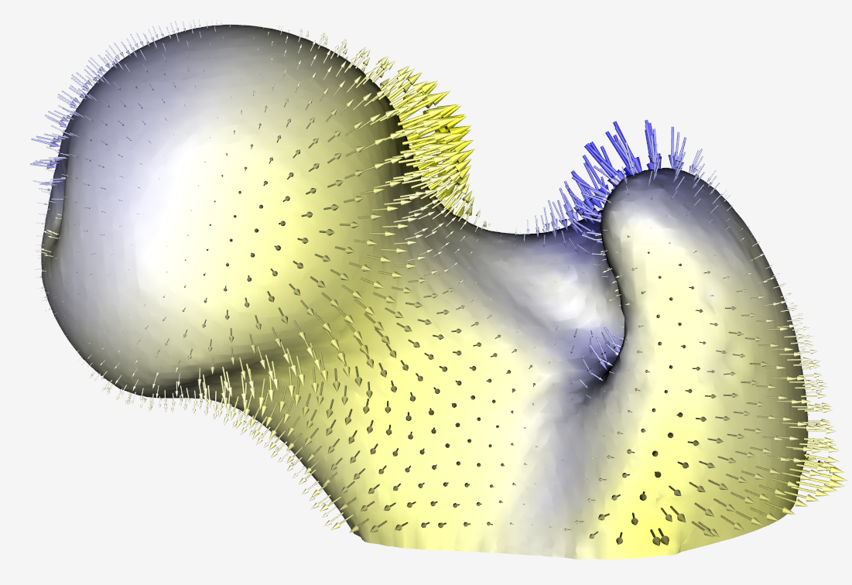
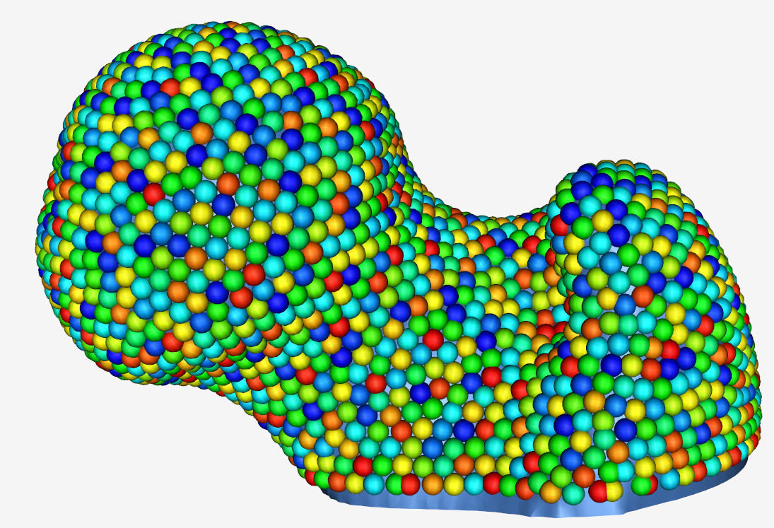
ShapeWorksView
CAM-FAI Characterization

Slide 15
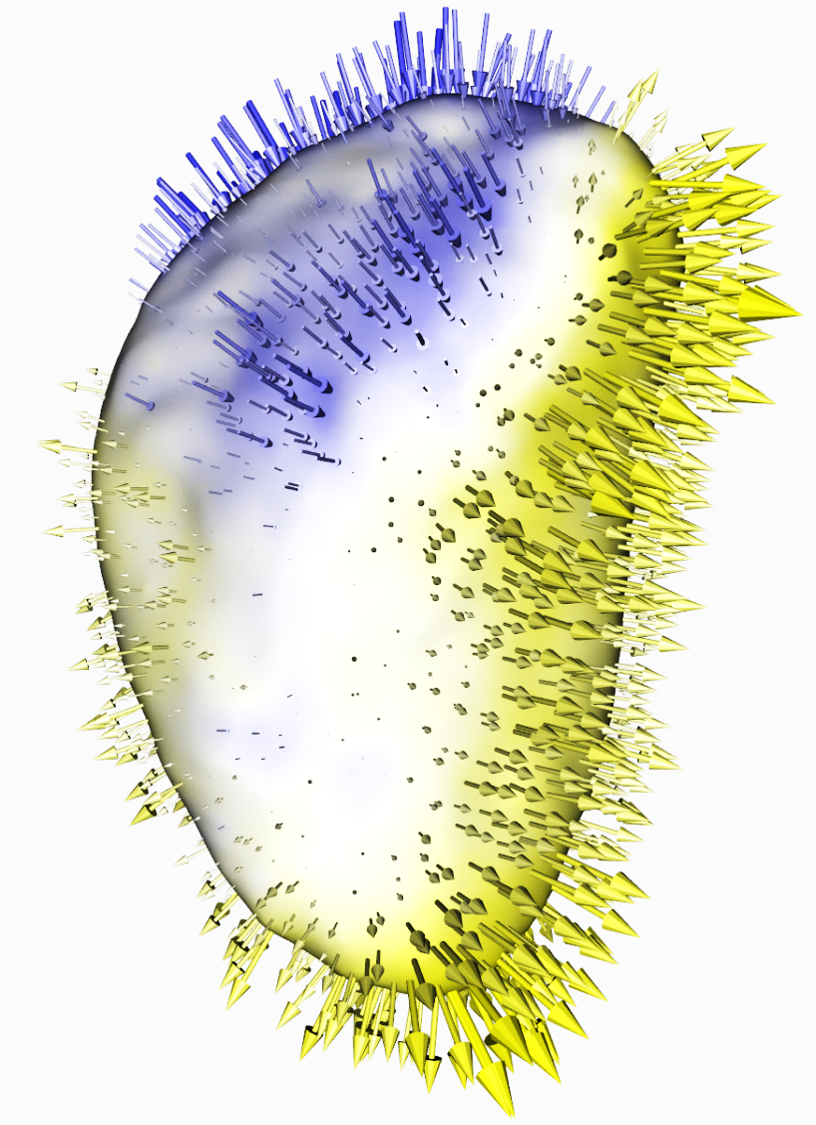
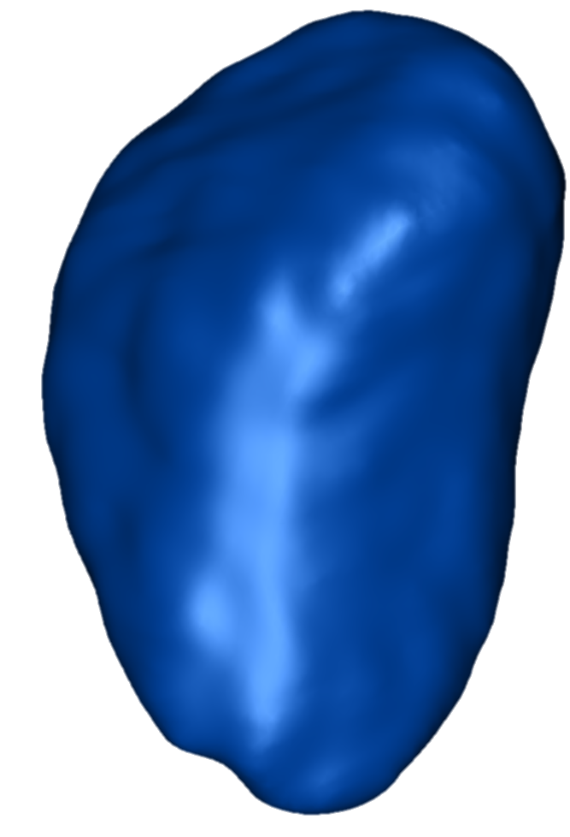
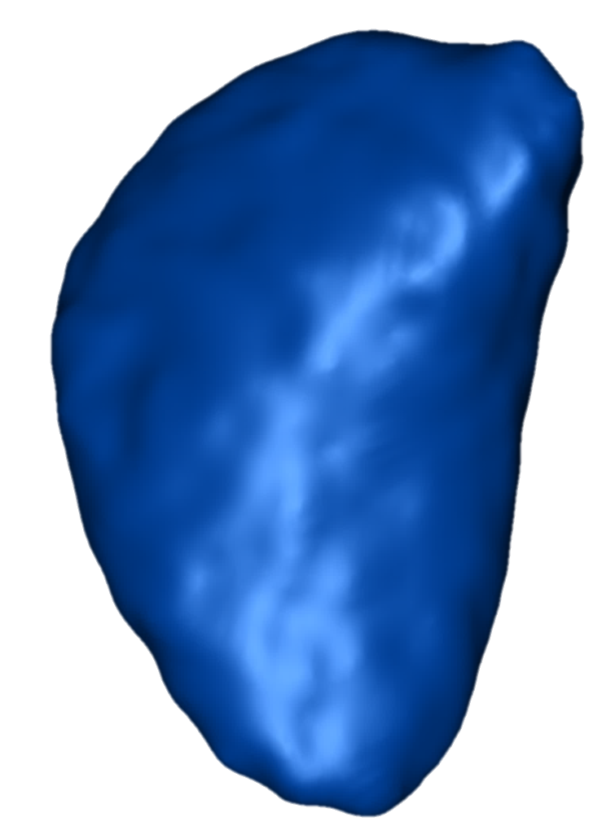
ShapeWorksView
Left Atrial Appendage
The LAA of two groups was segmented, one group with no history of having stroke while the other group has evident history of having stroke.
Group 1:
no history of stoke
Group 2:
history of stoke
Group difference (group 1 to group 2)

Slide 16
Thanks for your attention

