Slide 1
Efficient and Flexible Hierarchical Data Layouts for a Unified Encoding of Scalar Field Precision and Resolution
1 2 3
Duong Hoang¹ – Brian Summa² – Harsh Bhatia³ – Peter Lindstrom³
Pavol Klacansky¹ – Will Usher¹ – Peer-Timo Bremer³ – Valerio Pascucci¹
0
Notes:
Hi. So I will be talking about efficient and flexible data layouts for encoding scalar field precision and resolution.

Slide 2
Data compression is increasingly more important and common
Scientific data has been getting larger and larger
Two main compression approaches
10240 x 7680 x 1536 x 64 bits
900 GB
Reducing resolution
Reducing precision
1
Notes:
So scientific data has been getting larger and larger thanks to advance in computing power in recent years.
Volumes that measure hundreds of gigabytes in size such as the one shown here is nowadays very common. If you want to study of such volumes, and do not have a very powerful workstation then the next best option is probably to perform some kind of compression.
There are two main compression approaches: reducing the data resolution, or reducing its precision. It is interesting to note that so far there has not been much effort in studying how to combine these two forms of data reduction, but we will see in this talk that we can combine them to achieve significant data reduction.

Slide 3
Our data layout allows access to the whole precision-resolution space
Resolution
Precision
Progression in
precision
Progression in
resolution
Single point
Single curve
Whole space
Quantization
ZFP
Octrees
JPEG2000
Ours
2
[L14] Fixed-rate compressed floating-point arrays [TM01] JPEG 2000: Image Compression Fundamentals, Standards and Practice
Notes:
So, let’s try to categorize data reduction techniques in this 2D space of precision and resolution.
Most compression techniques perform some kind of quantization, which reduces the data precision. Hence, each such technique produces one approximation that corresponds to one point in this space.
Next, bit plane embedded coders such as ZFP can produce a progression in precision, where if we continue to decode, we obtain data approximations that are more and more accurate.
On the other hand, resolution-based techniques such as octrees give us a progression in resolution, where approximations get finer and finer as we decode.
JPEG2000 is probably the first attempt at combining resolution and precision; it gives us a single progression curve in the precision-resolution space.
Finally, the data layout that we are presenting allows data reconstruction at any point in this 2D space, and therefore any progression curve is possible.

Slide 4
Reducing both resolution and precision leads to better approximations
Reference
Low precision
Low resolution
Middle resolution/precision
See [HKB19] for more details
3
[HKB19] A Study of the Trade-off Between Reducing Precision and Reducing Resolution for Data Analysis and Visualization
Notes:
So why do we care so much about allowing access to the whole precision-resolution space?
The first reason is that we can achieve better data quality by combining reduction in resolution and reduction in precision.
If we reduce data in either axis only, we are quite limited in the amount of data we can reduce before the data quality is too low, for example we can see banding artifacts if we go too low in precision and pixelated artifacts if we go too low in resolution. In contrast, the last image here is of middle resolution and middle precision and is free from visual artifacts.
More details can be found in our 2018 VIS paper.

Slide 5
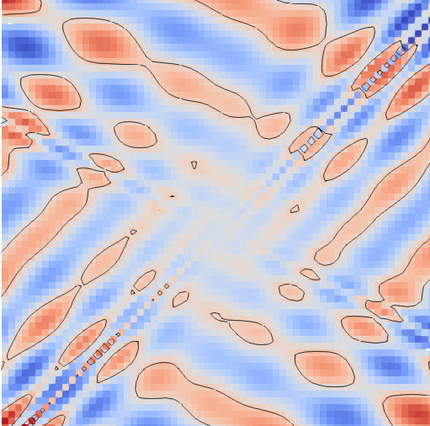
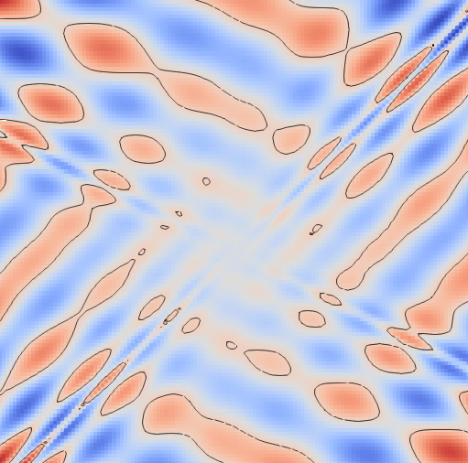
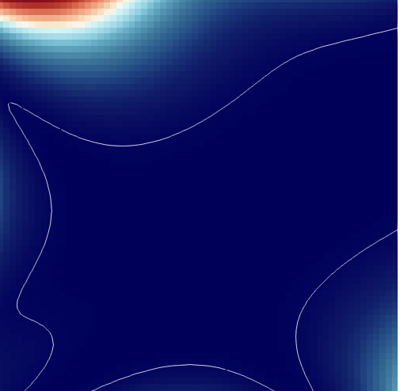
Some contours need more resolution, others precision
Reference
Low resolution
Low precision
4
Notes:
The second reason why we want to allow access to the full precision-resolution space is that sometimes we need resolution and sometimes we need precision for the task at hand.
Here we want to extract an isocontour from a 2D function. On the top row the function is rapidly varying, so more resolution is needed for a more accurate contour. On the bottom row, however, the function is much smoother so more precision is needed instead. You can see this by comparing the contour in the second column with the one in the third column. For the top row, the third column is better than the second, while for the bottom row, the second column is better than the third.

Slide 6
We want single data layout, multiple queries
B
A
D
Resolution
C
Precision
A
B
C
D
R=0, P=3
R=0, P=0
R=1, P=1
SELECT * FROM Data WHERE Resolution=R
AND Precision=P
R=3, P=0
5
Notes:
Given that sometimes approximations with more resolution are better and some other times those with more precision are better, what we really want is a single data layout from which we can query the data at different resolution and precision levels, depending on the task at hand.

Slide 7
How to reduce resolution and precision
Image
Pixel values
01001011
10011110
10011110
01001011
10011110
01001011
01001011
10011110
01001011
11011110
11011110
01001011
01001011
11011110
11011110
01001011
2x4 image
2x4 values
4-bit image
4-bit values
01001011
10011110
10011110
01001011
01000000
10000000
10010000
01000000
10011110
01001011
01001011
10011110
10010000
01000000
01000000
10010000
01001011
11011110
11011110
01001011
01000000
11010000
11010000
01000000
01001011
11011110
11011110
01001011
01000000
11010000
11010000
01000000
6
Notes:
So let’s see how we can do that. First let’s get into a little bit more detail on what we mean by reducing resolution and reducing precision. Consider this 4x4 greyscale image and its pixel values in binary.
We can obtain a 2x4 approximation to this image by retaining only half the number of pixels in X and throwing away the rest of the pixels.
We can also obtain a 4-bit approximation of this image by retaining the most significant 4 bits for each pixel, zeroing out the rest of the bits. The technical term for this is quantization. In this case we can say that we retain only the first four bit planes of the image.
So given that in either case we know exactly which bits to retrieve, we can easily query the data at any resolution and precision levels, right?

Slide 8
Problem: by default, disk reads span across precision and resolution levels
On-disk bits
01001011
10011110
10011110
01001011
01001011
10011110
10011110
01001011
10011110
01001011
01001011
10011110
01001011
11011110
11011110
01001011
01001011
11011110
11011110
01001011
10011110
01001011
01001011
10011110
Assuming disk reads happen in chunks of 4 bytes
Need four disk reads in either case
01001011
11011110
11011110
01001011
01001011
11011110
11011110
01001011
Solution: organize bits in chunks
that do not span resolution levels or bit planes
01000000
10000000
10010000
01000000
10010000
01000000
01000000
10010000
Chunk $i$
Chunk $i+1$
Chunk $i+2$
…
…
01000000
11010000
11010000
01000000
01000000
11010000
11010000
01000000
7
Notes:
Actually the problem is a bit more complicated, because in practice, disk reads happen not in units of individual bits but rather in unit of multiple bytes at a time for performance reason.
So this is how the bits are typically laid out on disk for the previous image, in row-major order of the pixels. If we assume that disk reads happen in blocks of four bytes, then for either the resolution or the precision case, even though we want only a subset of the bits, we have to perform four disk reads to get the bits that we want, and essentially we are reading the whole image from disk with these four reads. Of course we can throw away the bits that we are not asking for, but this is obviously very wasteful, since if we already fetch the bits from disk we may as well use them.
Our solution to this problem is to rearrange the bits and organize them into chunks such that each chunk does not span across resolution levels or bit planes. Then if we read from the disk in units of chunks we can choose to only read bits that belong to certain resolution levels or bit planes. This way we do not read bits that we do not need. But first we have to associate each bit of the data with a bit plane and a resolution level.

Slide 9
We start by constructing a resolution tree
0
4
1
5
8
12
9
13
2
6
3
7
10
14
11
15
0
1
2
3
4
5
6
7
8
9
10
11
12
13
14
15
8
Notes:
Let’s see how we can associate each bit to a resolution level.
We do so by constructing a tree where every node is associated with a grid point.
In fact, the association is bijective, so every grid point is also associated with a tree node.
In the paper we give a formula to go from a grid point to the index of its corresponding node in the tree, that’s why you see here we can number every tree node and grid point accordingly.
The nodes and grid points here are colored by their resolution level, and as we traverse the tree from the top down, we obtain finer and finer approximations of the original field.

Slide 10
Our formula for resolution trees is parameterized on $d$
Log branching factor
0
4
1
5
0
8
2
10
8
12
9
13
4
9
5
11
$$d=2$$
$$d=1$$
2
6
3
7
1
12
3
14
10
14
11
15
0
6
13
7
15
0
1
2
3
1
2
3
4
5
6
7
4
5
6
7
8
9
10
11
12
13
14
15
8
9
10
11
12
13
14
15
9
Notes:
In fact there are more than one way to construct such a tree. In the paper we give a general formula that depends on a parameter d which controls the branching factor of the tree.
We have already seen the case of d=2, where the resulting tree is analogous to a quadtree in 2D.
d can also be 1, and the resulting tree is analogous to a kd-tree as can be seen on the right.
In 3D the formula also allows for d=3, producing a tree that is analogous to an octree.
In 3D d=3 is the most natural choice however it’s totally possible to use d=1 or d=2 as well.

Slide 11
We model bit planes as chains of nodes
Bit planes
C
B
B
0
1
1
0
0
1
0
1
1
1
0
1
1
1
0
0
…
1
1
0
0
1
0
1
0
0
1
0
0
1
1
1
0
…
0
1
0
0
0
0
0
1
1
0
1
0
1
0
1
1
…
Resolution
C
Precision
10
Notes:
We can actually extend our tree model to incorporate precision as well.
To do so, we start by constructing a resolution tree but only for the first bit plane.
For the second bit plane, we add one child for each node of the first bit plane.
Similarly for the third bit plane we add one child for each node of the second bit plane.
Suppose there are only three bit planes, our precision-resolution tree is now completely constructed.
With this tree we can take a cut (which can simply be understood that taking a connected set of nodes that contains the root). Each cut corresponds to some approximation of the original field. For example, this cut here gives the approximation C that is low in resolution but high in precision because we take only the first two resolution levels but all bit planes. On the other hand, this approximation B is low in precision and high in resolution because in the cut we take all resolution levels but only the first bit plane.

Slide 12
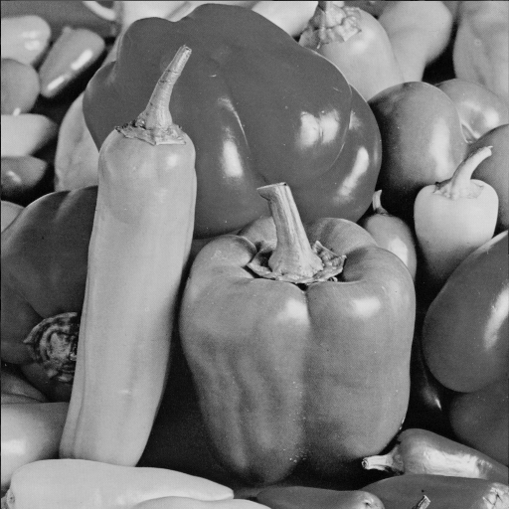
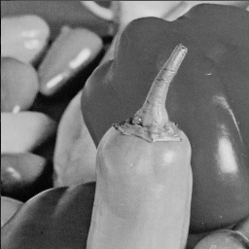
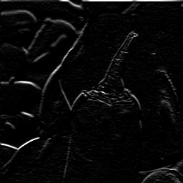
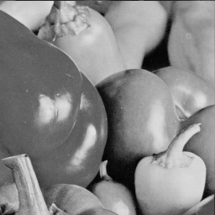
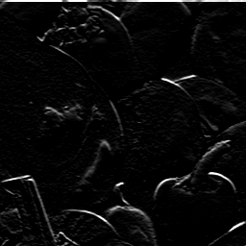
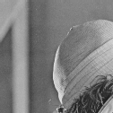
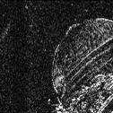
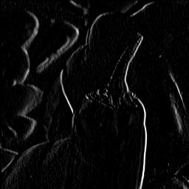
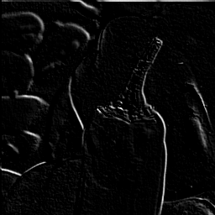
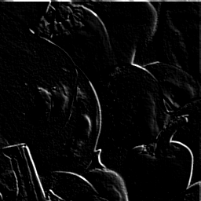
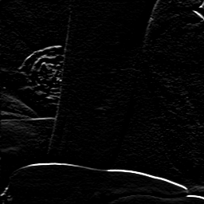
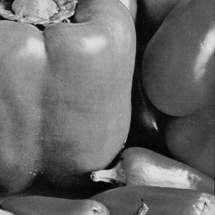
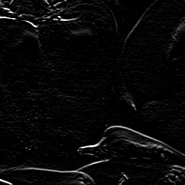
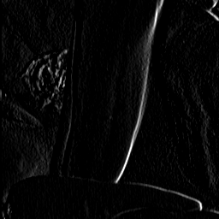
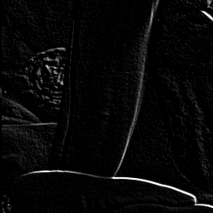
Our data layout family has various parameters
Bricking
Filtering
Blocking and compression
Linear B-spline wavelets
ZFP
………
………
Chunking
11
Notes:
Although our tree model is complete, in practice, to arrive at an efficient data layout, there are a number of concerns to be addressed. So in our data model we introduce a few more abstractions to address these practical concerns. From left to right, we consider partitioning the data into bricks for random access, filtering or transforming the data samples for high-quality data at coarse resolution levels, and finally compressing the transform coefficients in blocks.
Of course, as mentioned before, the compressed bits are grouped in chunks and written to disk in units of chunks. With parameters such as the brick size, the filtering operator, the block size, compression method, and chunk size, our data model is complete. We note that certain choices for these parameters recover known data layouts in the literature such as the IDX file format or JPEG2000. We found that we can achieve effective compression by using the linear b-spline wavelets for data filtering and ZFP as our encoder of choice to compress the wavelet coefficients, so those are our default parameter choices.

Slide 13
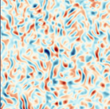
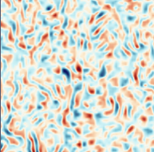
Bricks can be independently and adaptively reconstructed
Reference
Refinement map
Reconstruction
2 knobs per brick (resolution, precision)
Fetch only
relevant chunks
1 knob
(data budget)
Fetch chunks that
minimize RMSE
12
Notes:
Let’s see how data reconstruction works in our framework.
Assuming we have compressed and stored this 2D image on disk.
To query from the data layout, in general we have two knobs that are resolution and precision levels for each brick of the data. So the red-ish image here indicate how refined each brick is. You may imagine we have two such refinement map, one for resolution and one for precision. Given the refinement maps, the data layout fetches only the relevant data chunks from disk and returns a corresponding approximation.
There is another way the data can be queried: when given a data budget, the layout fetches chunks that minimize the root-mean-square error over the whole field and returns an approximation where each brick can be differently refined in resolution and precision, depending on the actual data. We can do this because in the wavelet domain there is a natural ordering of bits that minimizes the RMSE in a data-agnostic way.

Slide 14
Our method is competitive with state-of-the-art compressors
Reference, 2 GB
SZ, 6.5 MB
Ours, 6.4 MB
TTHRESH, 6.4 MB
Reference, 10 GB
ZFP, 12 MB
Ours, 2 MB
[TDC17] Significantly improving lossy compression for scientific data sets based on multidimensional prediction and error-controlled quantization
[BRL19] TTHRESH : Tensor compression for multidimensional visual data
[L14] Fixed-rate compressed floating-point arrays
13
Notes:
Our data layout can be used purely as a compressor, so let’s compare the compression performance of our method against the state-of-the-art compressors, namely SZ and TTHRESH.
You can see that at the same compression ratio (here about 300x), our data quality is somewhere in between that of SZ and TTHRESH, and we are not very far behind TTHRESH.
When comparing against ZFP, our method is able to push the compression ratio further while maintaining visual quality because we can leverage data reduction in resolution on top of the compression in precision done by ZFP.

Slide 15
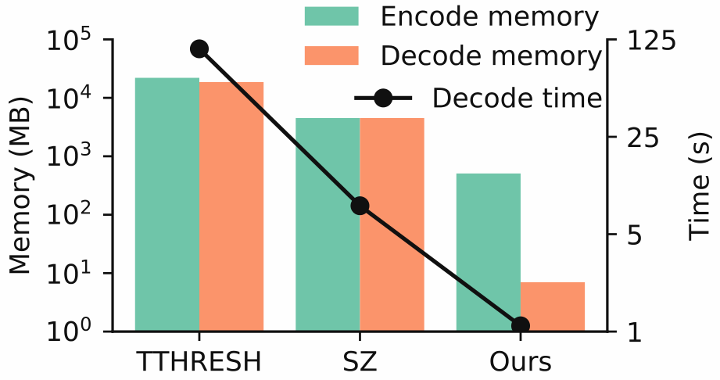
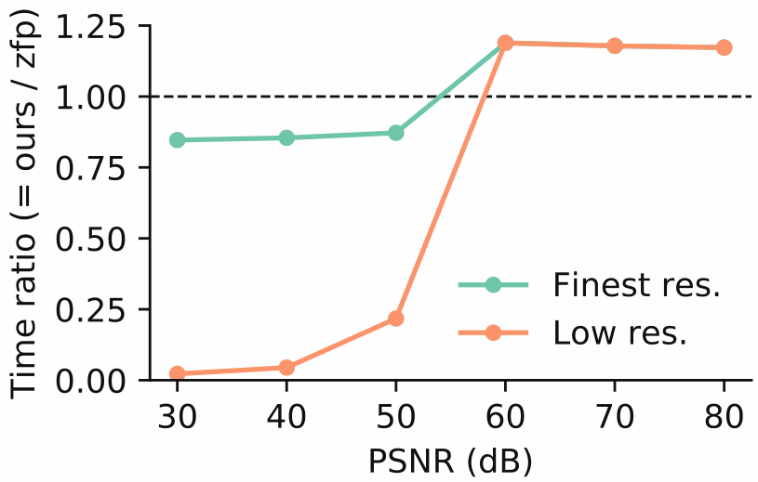
Our method is lightweight and fast
14
Notes:
Here we compare our decode time and memory usage against those of SZ and TTHRESH.
Looking at the vertical axis on the right which is time, and the black curve which plots the decode time, we see that our method is about five times faster than SZ and a hundred times faster than TTHRESH.
Looking at the vertical axis on the left and the orange bars which plot the memory usage for decoding, again our method uses orders of magnitude less memory compared to SZ and TTHRESH. Note that both vertical axes are in log scale.
If we compare our decode time against zfp, and plot that ratio against the data quality measured in Peak signal to noise ratio, then we see that if we only consider decoding at the finest resolution level, then the speed of our method is always within 20% that of ZFP, as indicated by the green curve. If our method is allowed to decode at low resolution levels also, then for low and middle data quality, namely PSNR from 30 to 50, our method can achieve much better speed compared to ZFP because for these quality levels our decode can works at lower resolution levels.

Slide 16
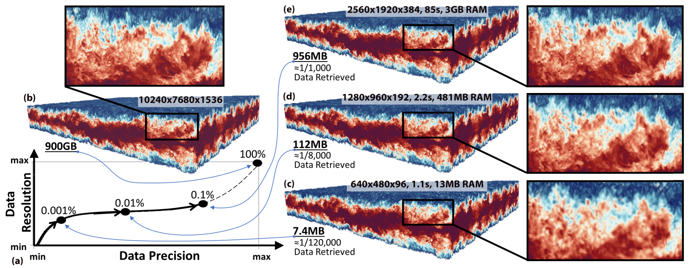
Our method allows flexibility in handling large data
15
Notes:
Here is an example of what you can do with our data layout. We revisit the 900 GB volume shown at the beginning of the talk. We show here three approximations of increasing resolution and precision, all obtained from a single data layout. They are of sizes 7 MB, 112 MB and almost 1 GB, obtained in 1s, 2s, and 85s respectively. You may image each of these approximations is useful in a different situation, depending on the hardware you are using and the task at hand.

Slide 17
Conclusion
Unify precision and resolution in a single hierarchical model
Introduce a family of data layouts that encode such trees; classical encoding schemes are members of this family
Give implementation that achieves competitive speed, memory usage, and compression ratios
Allow decoding with different precision-resolution trade-offs, per the needs of the application
16
Notes:
In conclusion, we have introduced a unified model that unifies precision and resolution in a single tree.
We also introduced a family of data layouts to encode such trees, and classical encoding schemes are members of this family.
With carefully chosen parameters for the family of layouts, we proposed an implementation that achieves competitive speed, memory usage and compression ratios, and
Our data layout allows decoding with different precision-resolution trade-offs, per the needs of the application.

Slide 18
Thank you
Code
https://github.com/sci-visus/IDX2
Slides and paper preprint
U.S. Department of Energy by Lawrence Livermore National Laboratory under Contract DE-AC52-07NA27344
LLNL-LDRD Program under Project No. 17-SI-004 and Project No. 20-SI-001
Department of Energy, National Nuclear Security Administration, under Award Number(s) DE-NA0002375
Exascale Computing Project (17-SC-20-SC), a collaborative effort of the U.S. Department of Energy Office of Science and the National Nuclear Security Administration
NSF DMS award 1664848, NSF IIS award 1657020, NSF OAC award 842042, NSF OAC award 1941085, and NSF CMMI award 1629660
17
Notes:
Our code can be found on github. The slides and paper preprint can be found by scanning this QR code. We thank these sources of funding for the project. Thank you for your attention.

Slide 19
References
23
[HKB19] A Study of the Trade-off Between Reducing Precision and Reducing Resolution for Data Analysis and Visualization
Hoang, Klacansky, Bhatia, Bremer, Lindstrom, and Pascucci. IEEE TVCG, 25(1), 2019
[BHM20] AMM: Adaptive Multilinear Meshes.
Bhatia, Hoang, Morrison, Usher, Pascucci, Bremer, and Lindstrom. arXiv e-prints, 2020.
[TDC17] Significantly improving lossy compression for scientific data sets based on
multidimensional prediction and error-controlled quantization.
Tao, Di, Chen, and Cappello. IPDPS ’17, 2017.
[BRL19] TTHRESH : Tensor compression for multidimensional visual data.
Ballester-Ripoll, Lindstrom, and Pajarola. IEEE TVCG, 29, 2019.
[SP96] A new, fast, and efficient image codec based on set partitioning in hierarchical trees.
Said and Pearlman. IEEE TCSVT, 6(3), 1996.
[L16] Fixed-rate compressed floating-point arrays.
Lindstrom. IEEE TVCG, 20(12), 2014.
[DM01] JPEG 2000: Image Compression Fundamentals, Standards and Practice.
Taubman and Marcellin. Springer, 2001.
[LH07] Compressed random-access trees for spatially coherent data.
Lefebvre and Hoppe. EGSR’07, 2007.
[PF01] Global static indexing for real-time exploration of very large regular grids.
Pascucci and Frank. SC ’01, 2001.
0
Notes:
Here is the list of all papers mentioned in this talk.

Slide 20
Next: Computing and storing the precision-resolution tree on disk
15
Goals:
Effective compression
Fast random access
High-quality reconstruction
Fast disk I/O

Slide 21
We introduce a formula, parameterized on a single number $d$, to construct such trees
11
Log branching factor
0
4
1
5
0
8
2
10
$$d=2$$
“Quadtree”
$$d=1$$
“Kdtree”
8
12
9
13
4
9
5
11
2
6
3
7
1
12
3
14
10
14
11
15
0
6
13
7
15
0
1
2
3
1
2
3
4
5
6
7
4
5
6
7
8
9
10
11
12
13
14
15
8
9
10
11
12
13
14
15
Notes:
In fact, our tree model is a family of trees and not just one.
The family is parameterized by a single number d, which controls the

Slide 22
Blocks as units of compression
16
Blocking in spatial domain
e.g., zfp
Bread-first blocking
in tree domain
e.g., JPEG2000
Depth-first blocking
in tree domain
e.g., SPIHT/SBHP
Tree of samples becomes of tree of blocks
Notes:
Now that we have modeled the precision-resolution tree, let’s talk about how it is computed and stored in practice.
The first concern is compression, which in practice is often done in blocks.
Blocking can happen in different domains. For example, ZFP uses blocking in the spatial domain, whereas JPEG2000 and SBHP use blocking in the tree domain, in bread-first and depth-first manner respectively.
Once the data samples are put into blocks, our tree of samples becomes a tree of blocks.
In the proposed data layout, we use bread-first blocking in the tree domain, similarly to JPEG2000.

Slide 23
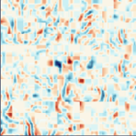
Bricks can be independently reconstructed
19
We use linear lifting extrapolation to mitigate blocky artifacts
Reference
Refinement map
Without extrapolation
With extrapolation
[BHM20]

Slide 24
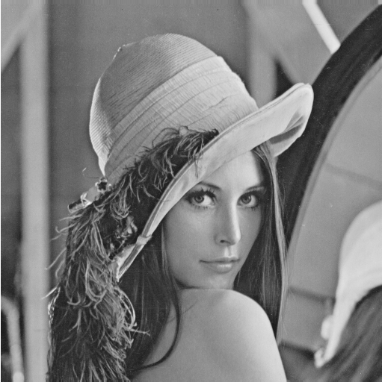
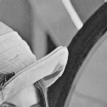
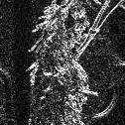
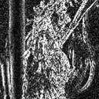
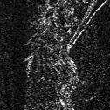
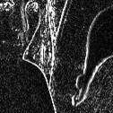
Data reconstruction algorithm
18
SELECT * FROM Data WHERE Resolution=0 AND Precision=0
Fetch relevant chunks
from disk
Copy relevant bricks
(In place) Inverse
wavelet transform
and decompress
0
Notes:
Here is how the field is reconstructed.
Given a query which contains a region of interest, a resolution level, and a precision level, we first fetch relevant chunks from disk.
The compressed blocks in relevant bricks within each chunk are then copied and decompressed into a buffer.
This gives us a set of wavelet coefficients. Note that some coefficients in a brick can be missing, which we simply assume to be 0. These missing blocks are shown as black squares here.
We then inverse transform the wavelet coefficients to get back an approximation of the original data within the requested region of interest.

Slide 25
Our parameter choices
17
Brick size: ${64}^{3}$ grid samples
Tile size: $8^{3}$ bricks (resulting in chunks in hundreds of kilobytes)
Filtering: Linear B-spline wavelets
See paper for an example where max filter works better
Block size: $4^{3}$ grid samples
Compression method: (slightly modified ZFP)
0
Notes:
In our data model, the brick size, filtering operation, block size, compression method, and tile size are all parameters.
For the proposed implementation, we have chosen particular values for the brick and tile sizes, based on extensive experiments.
For filtering, we use the linear b-spline wavelets, but note that for certain analysis tasks, other filters such as the max filter may work better. For details please see the paper.
For compression, we use ZFP in fixed accuracy mode to compress the wavelet coefficients for performance reason, but note that other bit plane coders may also work.

Slide 26
Traditional trees have the grid points at the leaf level
9
Mipmaps
Image pyramids
Quadtrees/octrees
0
Notes:
We note that our tree model is different from a traditional quadtree and octree.
In a traditional quadtree, the leaf nodes correspond to grid points, and each parent node is positioned exactly at the center of cell formed by their children.
This kind of tree is also known by other names such as mipmaps or image pyramids.

Slide 27
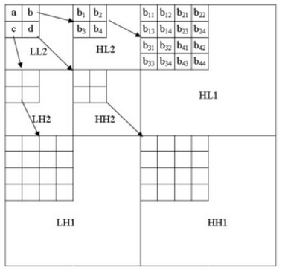
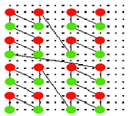
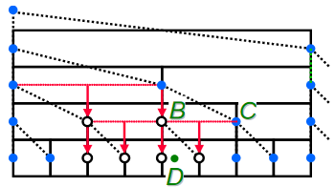
Our formula unifies SPIHT, HZ ordering, and primal trees
$d=$ Log branching factor
$D=$ Dimensionality
Wavelet tree (SPIHT)
$$d=D=2$$
Hierarchical Z order
$$d=1, D=2$$
Primal subdivision
$$d=D=1$$
[SP96]
[PF01]
[LH07]
[SP96] A new, fast, and efficient image codec based on set partitioning in hierarchical trees [PF01] Global static indexing for real-time exploration of very large regular grids [LH07] Compressed random-access trees for spatially coherent data
8

Slide 28
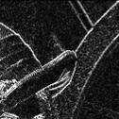
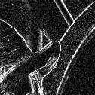
Chunks as units of disk I/O
16
Chunks
Tile
Tile
0
Notes:
Next, we need to store the compressed blocks to disk. For this purpose, we define the concept of a tile.
In the simplest case, a tile is a spatial grouping of bricks, here a tile is shown with green boundary encompassing two bricks.
We further split a tile into chunks, each chunk contains blocks belonging to only one bit plane and one subband.
In this example, there are two bit planes and four subbands, so a tile contains eight chunks in total.
Chunks are our units of disk I/O. That is, for efficiency, we write to disk and read from disk one chunk at a time.

Slide 29
We want single layout, multiple queries
SELECT * FROM Data WHERE Resolution=R
AND Precision=P
Single data layout
R=0, P=0
R=3, P=0
R=1, P=1
R=0, P=3
4

Slide 30
We start by constructing a resolution tree
Advantages
No “extra” nodes
Simpler interpolation
Approximations
correspond to cuts
Quadtree
6

Slide 31
We model the whole field as a tree and approximations as cuts
Encapsulates both resolution and precision
6

Slide 32
Future work
How to find optimal mixtures of resolution/precision for a given task
How applications can benefit from the data layout
How to efficiently maintain a compressed approximation in memory
17

