Slide 1
Multi-Resolution Screen-Space Ambient Occlusion
Thai-Duong Hoang
Kok-Lim Low
National University of Singapore

Slide 2
Ambient Occlusion (AO)
$$p$$
$$q$$
Notes:
AO is the lighting phenomenon under the direct illumination of a diffuse, uniform, spherical light source surrounding the scene, which is this yellow ring in this figure.
Under such a lighting condition, less exposed areas such as the point q here will receives less light, and becomes darker than more exposed areas such as point p.
Note that AO is not a real-world phenomenon, since we are assuming the light is uniform in every direction, which is rarely true in the real world.
Nevertheless, it can make a scene look more realistic, that’s why it is widely adapted in, for example, CG movies.

Slide 3
AO
$$q_{i}$$
Cosine-weighted fraction of a tangent hemisphere that is occluded
$$n$$
$$θ_{i}$$
$$d_{i}$$
$$p$$
$$d_{max}$$
$$AO\left(p\right)=\frac{1}{π}\int_{Ω}{ρ\left(p,d_{i}\right)\cos{θ_{i}}dw_{i}}$$
$$d_{i}≥d_{max}:ρ=0$$ $d_{i}=0$: $ρ=1$
Notes:
Formally, for each point p, AO is define by this integral over a hemisphere above p.
Intuitively, it can be understood as the cosine-weighted fraction of the tangent hemisphere that is occluded.
It is important to note that we only look for occluders inside a certain hemisphere that has a certain radius d_max.
Because otherwise, AO does not work for enclosed environment such as this room, everything inside it will be totally dark.
Now it is natural to evaluate AO using Monte Carlo ray casting.
But do we really need to do that all the time if the only thing we want is to darken some creases or holes?

Slide 4
Screen-Space AO (SSAO)
$$p$$
Volumetric AO [SKUT10]
Notes:
It turns out there is a much more efficient approach to approximate AO that only uses information available in screen-space, namely per-pixel depths and normals.
As an example, for this point p here, we can generate a few samples inside a hemisphere above it and project the samples back to the eye.
If a sample’s depth is larger than the depth value store in the depth buffer, the sample is considered an occluder that block lights from p.
This is efficient because sampling is much faster than ray casting.
But this approach also is inaccurate, for example, as you can see, some samples can be identified as occluder, yet do not block light from reaching p in that direction.

Slide 5
SSAO (Dis)Advantages
Inaccurate
Local AO
Over/underestimated AO
Low quality
Noise
Blur
Simple
Fast
General
Easy to integrate
Notes:
It turns out SSAO has other disadvantages as well.
On the other hand, it has a number of important benefits.
That’s why it’s useful in applications that care less about accuracy, but more about performance, such as games.
We want to overcome some of these limitations, particularly the local AO, noise, and blur problems.

Slide 6
Multi-Resolution AO (MSSAO) Intuition
$$AO_{1}$$
$$AO_{2}$$
$$AO_{3}$$
$AO_{final}=$ $\max\left(AO_{i}\right)$
Notes:
Our algorithm is based on this intuition:
The hemisphere above p can be partition into several sub-hemispheres, smaller ones contained in bigger ones.
For each hemisphere, we compute AO caused by occluders inside that hemisphere.
The final AO value is naturally the maximum of all the partial AO values computed for all the hemispheres.

Slide 7
Multi-Resolution AO (MSSAO) Intuition
256x256
$$AO_{256}$$
512x512
$$AO_{512}$$
1024x1024
$$AO_{1024}$$
$$AO_{final}=f\left(\max\left(AO_{i}\right), average\left(AO_{i}\right)\right) \\ AO_{final}≥\max\left(AO_{i}\right) \\ AO_{final}∝average\left(AO_{i}\right)$$
Notes:
Another observation is that occlusion caused by distant occluders is often low-frequency, and can be computed at coarser resolutions to save computation time.
So we correspond each hemisphere to a resolution, the bigger the hemisphere, the coarser the resolution.
Now the problem is AO computed at coarser resolutions may miss occlusion caused by nearby occluders, so the final AO is no longer the maximum value, but larger than it.
We use a heuristic to compensate for this, as we modulate the maximum value by the average AO value across all resolutions.
So the final AO is a function of these two values, and we must design f so that the final AO value is always larger or equal to the maximum value, and proportional to the average value.

Slide 8
MSSAO Overview
Geometry
g-buffer (1024x1024)
Downsample
AO buffer (256x256)
Compute AO
(256x256)
g-buffer (256x256)
Blur & Upsample
AO buffer (512x512)
Compute AO
(512x512)
g-buffer (512x512)
Blur & Upsample
AO buffer (1024x1024)
Compute AO
(1024x1024)
g-buffer (1024x1024)
Notes:
Our algorithm works like this:
First we render the scene at the finest resolution to a g-buffer which contains per-pixel eye-space coordinates and normals, then downsample multiple times to get low-resolution g-buffers.
Then we start from the coarsest g-buffer, compute AO for all pixels at that resolution and store the results in an AO buffer.
The AO buffer is then blurred and upsampled, and the result is put through the next rendering pass, where we compute AO for the next finer resolution and combine that with the upsampled results, output another AO buffer, which is agained blurred and upsampled, and the result is used as input to the next rendering pass, where we compute AO at a finer resolution, and so on, until the we reach the final resolution.
At this point, we output the highest-resolution AO buffer as the final result.

Slide 9
MSSAO AO from Multiple Resolutions
Notes:
Here is an example of combining AO values from different resolutions.
In this example we use 5 levels of resolution.
Each resolution captures a different AO frequencies, and they are all finally combined together to produce the image in the lower right.

Slide 10
MSSAO Overview
Geometry
g-buffer (1024x1024)
Downsample
AO buffer (256x256)
Compute AO
(256x256)
g-buffer (256x256)
Blur & Upsample
AO buffer (512x512)
Compute AO
(512x512)
g-buffer (512x512)
Blur & Upsample
AO buffer (1024x1024)
Compute AO
(1024x1024)
g-buffer (1024x1024)
Notes:
Now let’s get to the details.
First we’re gonna look at the downsampling pass.

Slide 11
MSSAO Downsampling
$$p_{1}^{z}≤p_{2}^{z}≤p_{3}^{z}≤p_{4}^{z}$$
if $p_{4}^{z}−p_{1}^{z}≤d_{threshold}$
$$p←(p_{2}+p_{3})/2 \\ n←(n_{2}+n_{3})/2$$
else
$$p←p_{2} \\ n←n_{2}$$
$$p_{1}$$
$$p_{2}$$
$$p$$
$$p_{3}$$
$$p_{4}$$
Notes:
For each low-resolution pixel p, we look for the four nearest pixels to p at the finer resolution, p_1 to p_4, and sort them according to their liner z values.
Then we take the eye-space coordinates of the two “middle” pixels and average them to get the eye-space coordinates of p.
This is similar to taking the median “values” of the four pixels.
Now taking the median does not always make sense if the four pixels are very different in depth.
In fact it creates artifacts where geometry beyond the AO radius of influence can occlude a point, since by taking the median, we are in effects changing the relative distance between surfaces.
So we check if the maximum depth difference among four pixels are large enough, we choose to keep the eye-space coordinates of just one of the four pixels.
Now the reason we do not do this all the time is that the median method does help reducing self-occlusion artifacts and also provides better temporal coherence.
You may haved noticed that the normals are treated in the same way as the eye-space coordinates.
The reason we do not normalize the sum, instead divide it by 2, which may not make sense, is that it is not necessary to normalize the normals.
In fact we have found that dividing it by 2 gives better looking results and also less over-occlusion artifacts.

Slide 12
MSSAO Overview
Geometry
g-buffer (1024x1024)
Downsample
AO buffer (256x256)
Compute AO
(256x256)
g-buffer (256x256)
Blur & Upsample
AO buffer (512x512)
Compute AO
(512x512)
g-buffer (512x512)
Blur & Upsample
AO buffer (1024x1024)
Compute AO
(1024x1024)
g-buffer (1024x1024)
Notes:
Now let’s move on to the computing AO part.

Slide 13
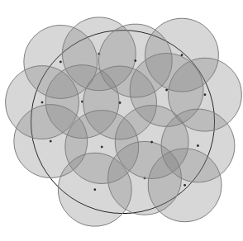
MSSAO Neighborhood Sampling
Project the AO radius of influence to screen space at each pixel $p$ at resolution $Res_{i}$ to get $r_{i}(p)$ (in terms of pixels)
Cap $r_{i}\left(p\right)$ to some value $r_{max}$ (typical value is 5)
512x512
256x256
Works well with a 3x3 Gaussian filter
1024x1024
16-point Poisson disk
Notes:
Firstly we will look at how samples are taken in screen space.
First, for each pixel p at some particular resolution Res_i, we project the AO radius of influence to screen space to get a “ring” of radius r_i(p) around p.
Now remember we do not want to sample in this whole ring, but usually a smaller ones, corresponding to some inner hemispheres, so we cap the screen-space sampling radius to some value, typically 5, and sample a 11x11 region in screen-space.
We have found that for coarser resolutions, using the sampling scheme on the left gives best results without degrading performance.
It also works well for a 3x3 Gaussian blur which is applied later.
For pixels at the finest resolution, we don’t want to use the sampling scheme on the left because there is no blur pass at the final resolution, so we use a 16-point poisson disk pattern instead.
Notice we do not jitter this pattern but use the same pattern for every pixel.
It produces some aliasing but not too noticeable given the small kernel size.

Slide 14
MSSAO Computing AO
$$q_{i}$$
Low-variance
Cheap
Biased
$$n$$
$$θ_{i}$$
$$d_{i}$$
$$p$$
$$AO(p)=\frac{1}{N}\sum_{i=1}^{N}{ρ(p,d_{i})\overline{(n∙\hat{q_{i}−p})} }$$
model after the Monte-Carlo approximation of
$$AO\left(p\right)=\frac{1}{π}\int_{Ω}{ρ\left(p,d_{i}\right)\cos{θ_{i}}dω_{i}}$$
Notes:
Now that we have collected, let’s say N samples, we put them through the first formula to compute the AO caused by these N samples.
This formula is modeled after the Monte-Carlo approximation of the original formula for AO.
You can see the correspondence highlighted by the colors.
The nice thing about our formula is that it gives low-variance results, in the sense that nearby pixels have quite similar AO values.
One of the reasons is that our samples are distributed in two dimensions instead of 3, we do not distribute samples in the direction dimension like some other methods.
We pick samples directly from screen space, the use texture lookup to fetch their 3D-coordinates and normals, and plug the values right into the formula.
it is also cheap to compute, requiring only a dot product operation for each sample.
The falloff function rho is just a simple quadratic one in terms of the distance d_i.
But sampling and computing AO this way is certainly biased, with regards to true AO, because neighboring pixels in screen-space often do not correspond to uniform directions in object-space.
The results is that the shape and intensities of the shadows look incorrect comparing to ground truths.
This is a common problem in SSAO not just our method.

Slide 15
MSSAO Overview
Geometry
g-buffer (1024x1024)
Downsample
AO buffer (256x256)
Compute AO
(256x256)
g-buffer (256x256)
Blur & Upsample
AO buffer (512x512)
Compute AO
(512x512)
g-buffer (512x512)
Blur & Upsample
AO buffer (1024x1024)
Compute AO
(1024x1024)
g-buffer (1024x1024)
Notes:
Next we turn to the blurring and upsampling pass.

Slide 16
MSSAO Bilateral Upsampling
Bilinear weights$w_{b}$
Depth weights
$$w_{z}\left(p_{i}\right)={\left(\frac{1}{1+\left|z_{i}−z\right|}\right)}^{t_{z}}$$
Normal weights
$$w_{n}\left(p_{i}\right)={\left(\frac{n∙n_{i}+1}{2}\right)}^{t_{n}}$$
$$\frac{9}{16}$$
$$\frac{3}{16}$$
$$\frac{3}{16}$$
$$\frac{1}{16}$$
$$AO\left(p\right)=\sum_{i=1}^{4}{w_{b}\left(p_{i}\right)w_{z}\left(p_{i}\right)w_{n}\left(p_{i}\right)AO\left(p_{i}\right)}$$
Notes:
Let me talk about the upsampling method first.
We use a typical bilateral upsampling here.
For each high-resolution pixel p, we weight and blend the AO values from its 4 nearest low-resolution pixels p_1 to p_4.
The weight for each pixel is a product of 3 weights, w_z is the weight due to depth differences, w_n is the weight due to normal differences, and w_b is a bilinear weight due to differences in screen-space coordinates.
Using bilateral upsampling prevents occlusion to leak through large depth and normal differences and at the same time smoothly blends the AO values from the four low-res pixels, which prevents the results from getting blocky artifacts.
The blur which is done before we upsample is very similar, it is a bilateral filter which uses a very small 3x3 kernels and a Gaussian weight instead of a bilinear one.

Slide 17
MSSAO Combining AO Values
$$AO_{final}=1−\left(1−\max\left(AO_{i}\right)\right)\left(1−avg\left(AO_{i}\right)\right)$$
$\max\left(AO_{i}\right)$ and $avg\left(AO_{i}\right)$ are computed by “propagating” appropriate values across resolutions
Avoid underestimating AO by ensuring $AO_{final}≥\max\left(AO_{i}\right)$
And a plausible heuristic $AO_{final}∝avg\left(AO_{i}\right)$
Notes:
Now we talk about how the AO values are combined together.
At the finest resolution ,we use this formula to compute the final AO value for each pixel.
The maximum and average AO values are obtained by propagating certain values up from coarser resolutions and I’m not going to get into the details here, which is pretty hairy.
Notice that the formula we use here satisfies both conditions we set in the beginning.

Slide 18
MSSAO Temporal Filtering
$$k=0.5$$
$$k=0$$
$$AO_{curr}=k AO_{prev}+\left(1−k\right)AO_{final}$$
$$k=0$$
Notes:
Finally, we employ a temporal filter to reduce the shimmering or flickering effects due to the use of multiple resolutions.
For each pixel in screen-space, we project it back to object space, undo whatever transformation from the previous frame, and project it to last frame’s screen-space.
We then fetch an AO value from last frame at that screen-space coordinates and assign a weight to it, if the pixel was occluded or outside of the screen in the last frame, the weight is 0, otherwise it is 0.5
Then we linearly blend the previous-frame AO value with the AO computed in the previous slide, to obtain the AO value for the current frame.

Slide 19
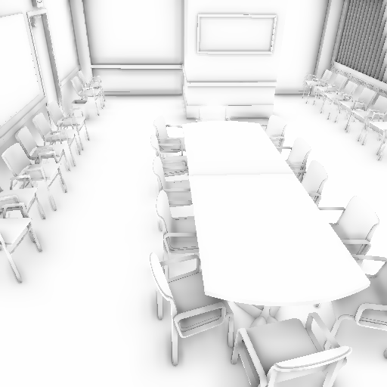
Results Quality
Blizzard [FM08]
MSSAO
Notes:
So we can look at some results, on the left is the method by Blizzard Entertainment which is noisy, on the right is ours.
Note that the computation time is roughly the same, more on that later.

Slide 20
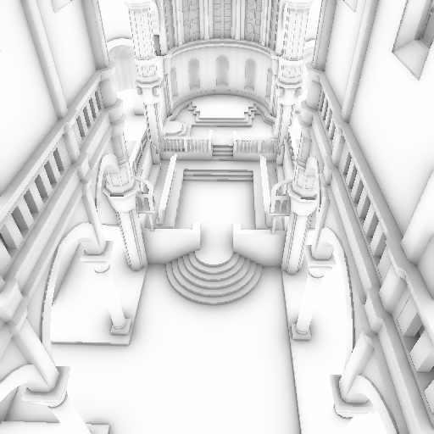
Results Quality
HBAO [BSD08]
MSSAO
Notes:
Here we compare our result with Horizon-based AO by NVIDIA.
Their result is quite blurry.
Our image looks sharper since we do not blur at the final resolution.

Slide 21
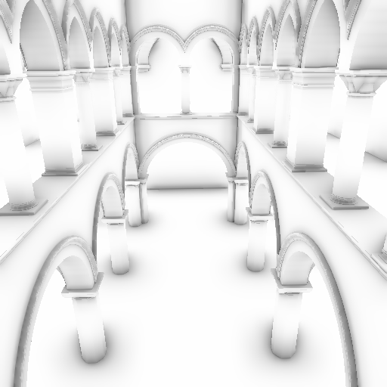
Results Quality
VAO [SKUT10]
MSSAO
Notes:
Here is another comparison, with a method called Volumetric AO, which is more recent than the other two.
Again, our result looks nicer.

Slide 22
Results Ground-truth Comparison
Blender
MSSAO
Notes:
Here we compare our result with ray-traced result using Blender.
There are over occlusion here and there, but since accuracy is not our main concern, it is not much of a problem.

Slide 23
Results Noise/Blur
Blizzard [FM08]
HBAO [BSD08]
MSSAO
Notes:
Here is a closer look to show that our result is free of both noise and blur and preserves high frequency details better than other methods.

Slide 24
Results Multiple AO Scales
Small AO radius
Large AO radius
MSSAO
Notes:
Here is another advantage of our method.
In existing SSAO methods, when the AO radius of influence is large, small details are lost.
Our method pick up multiple AO scales in different frequencies and retain them in the final image.

Slide 25
Results Performance
Scenes rendered at 1024x1024 on GeForce GTX 460M
Exclusive of geometry pass
The same parameters used to produce the shown images
 | MSSAO | VAO | Blizzard | HBAO
Sibenik Cathedral | 21.9 ms | 22.9 | 25.7 | 50.1
Conference Room | 24.0 ms | 24.8 | 24.9 | 49.5
Sponza Atrium | 22.2 ms | 24.0 | 28.9 | 54.3
Notes:
Here we compare the computation time among methods.
The parameters for each method are the same as those used to produced the previously shown comparison images.
These three scenes are those that are shown in previous slides as well.
As you can see, our method is the fastest in all three scenes, due to the fact that our sampling kernel in each resolution is small and we do not need to filter the final result, which is a relatively costly operation.

Slide 26
MSSAO Conclusions
Inaccurate
Local AO
Over/underestimated AO
Low quality
Noise
Blur
Use more memory
Poor temporal coherence on very thin geometry
Not too noticeable
Errors due to the use of coarse resolutions
Not too noticeable unless compared with ground-truths
Simple
Fast
General
Easy to integrate
Capture multiple shadow frequencies
Notes:
In conclusion, I believe we have overcome some quality limitations of SSAO while retaining all the positives.
Our methods have a few drawbacks as well.
First it uses more memory than the others.
Secondly, for certain kinds of small and thin geometry such as leaves or chair legs, some flickering artifacts can be seen when the camera moves, but since the objects are small anyway, this is not too noticeable.
Finally, the use of multiple resolutions introduce some errors in certain cases, but again, utmost accuracy is not our aim here, so that’s not a really a problem.

Slide 27
Results Additional Results

Slide 28
Results Additional Results

Slide 29
Results Additional Results

Slide 30
Results Additional Results

Slide 31
Thank You

