Slide 1
High-Quality and Low-Memory-Footprint Progressive Decoding of Large-Scale Particle Data
0
Duong Hoang, Harsh Bhatia, Peter Lindstrom, Valerio Pascucci
Notes:
Hello. My name is Duong Hoang. I’m here to present our work on lossy compression of particle data. This is a joint work between the University of Utah and Lawrence Livermore National Laboratory.

Slide 2
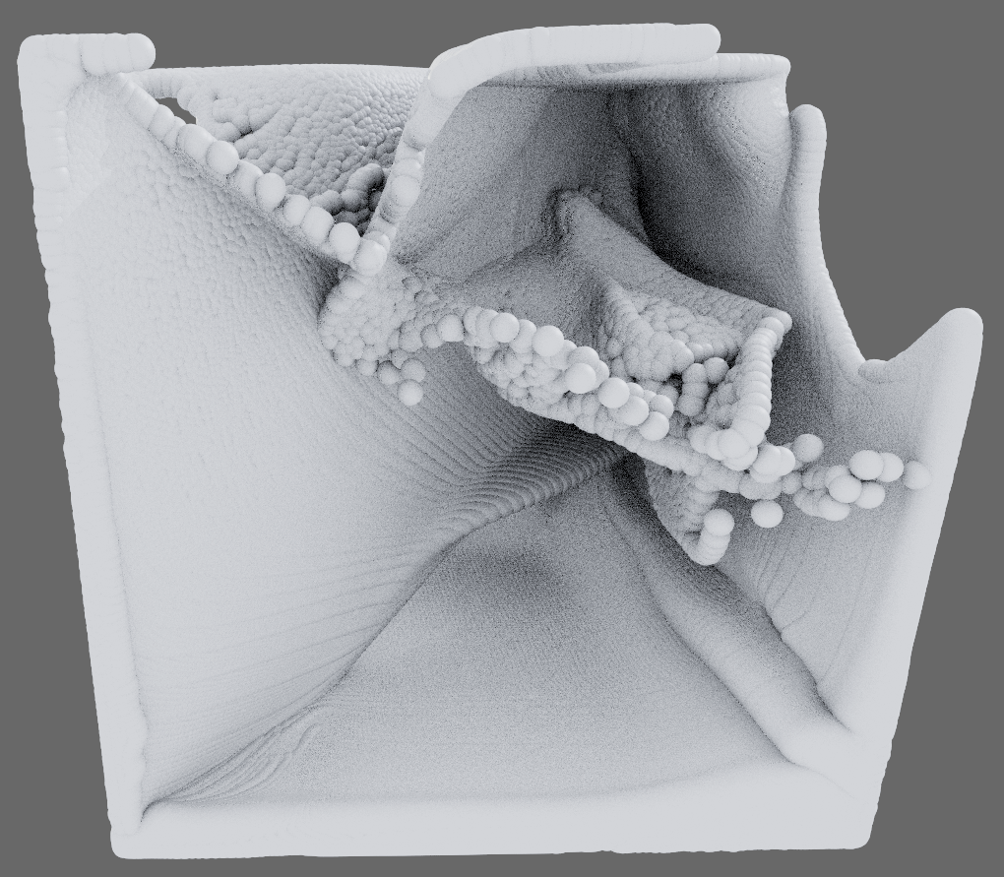
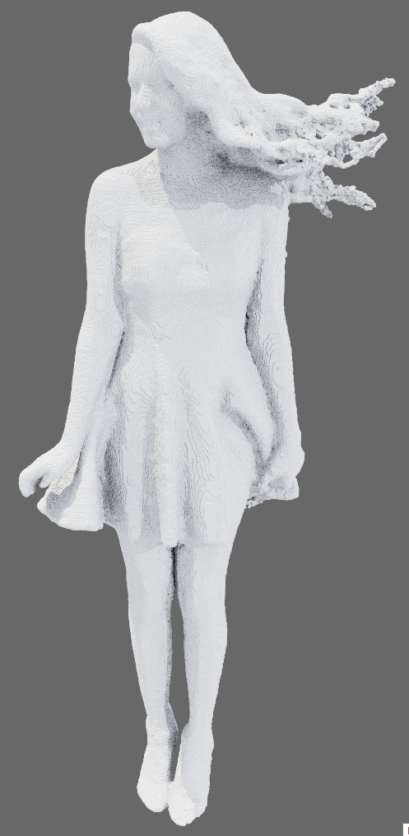
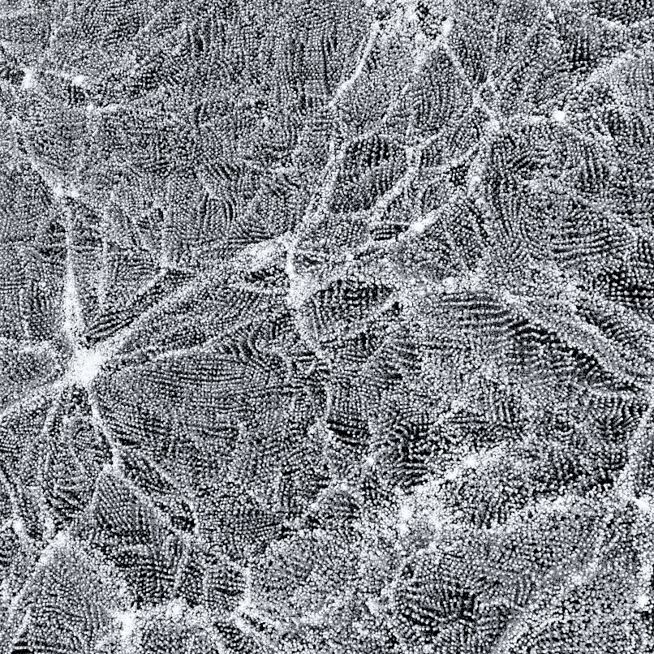
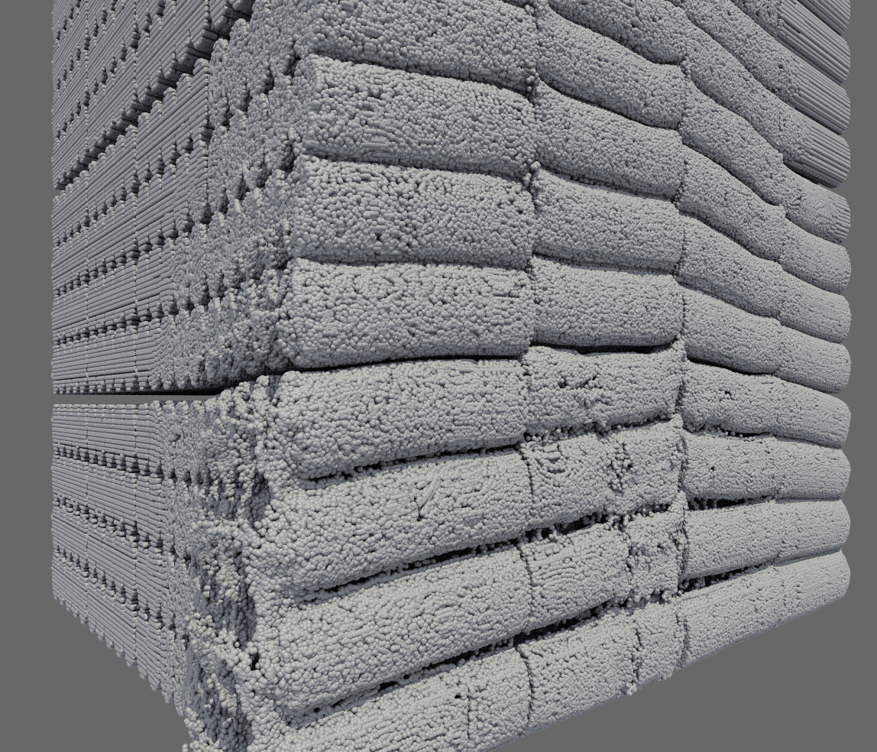
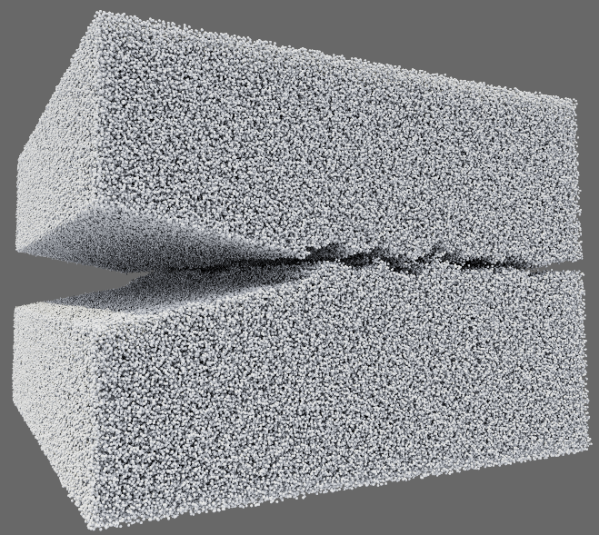
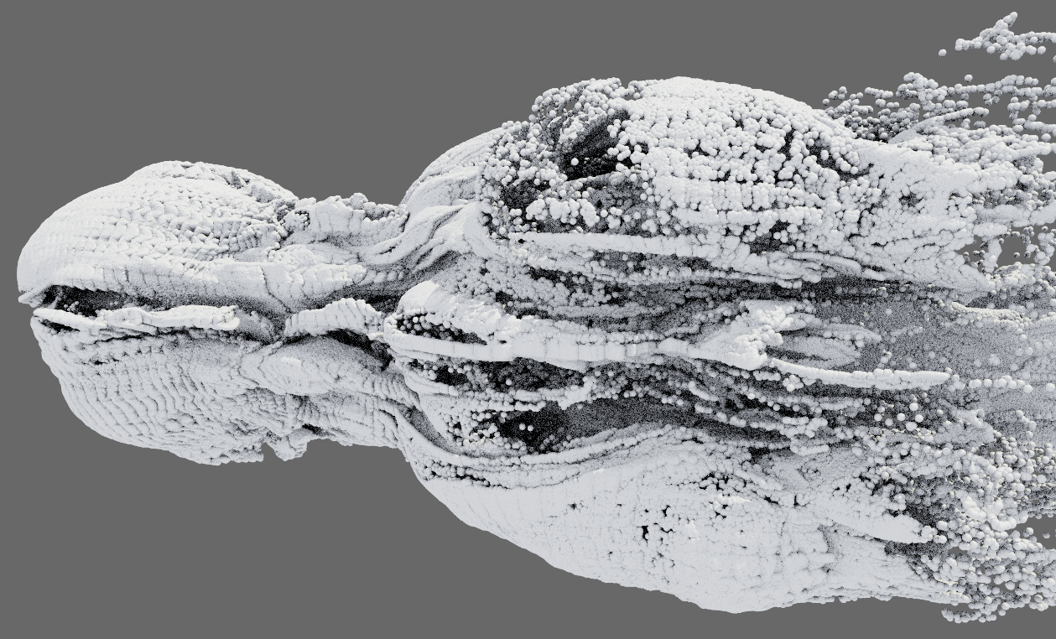
Goal
1
Lightweight and high-quality progressive (de)compression of particle positions
detonation (968M particles) $−$ Progressive reconstruction results on my desktop with 64 GB memory
The work is about compression, not rendering
Notes:
Our goal in this work is to come up with lightweight and high-quality progressive compression and decompression methods for lossy compression of particle positions.
These are a few examples of particle data, obtained from different kinds of simulation and imaging processes.
By particles we mean a set of points in space with x/y/z positions and possibly other attributes. But here we are only interested in compressing the positions.
For example, the detonation simulation data here has almost a billion particles. Here we show three snapshots of a progressive decompression of this dataset at three quality levels. The full dataset cannot be rendered on my machine with 64 GB of memory, but with our technique, we can reconstruct the data at lower quality levels and also lower number of particles, so it can be rendered. This example also demonstrates the importance of progressive decompression; depending on the machine that is used to decompress and visualize the data, I can decide on the quality level to reconstruct the data at, without having to first compress the data again at that level.
Notice that all three approximations use a constant amount of memory which is only 50 MB. This is what we mean by “lightweight”, meaning our progressive decompressor has a low upperbound for memory footprint regardless of how much to decompress. These three are obtained by our proposed method called “block-hybrid trees”. Our other contribution is called “hybrid trees”, and this talk will motivate these two constructs and show why they achieve better trade-offs between memory footprint and reconstruction quality compared to traditional techniques such as depth-first or breadth-first traversals on k-d trees.
And, just to avoid confusion, even though we show rendering results throughout the talk, our work is about compression, not rendering.
All our rendering results are obtained with vanilla OSPRay, after a separate decompression pass.

Slide 3
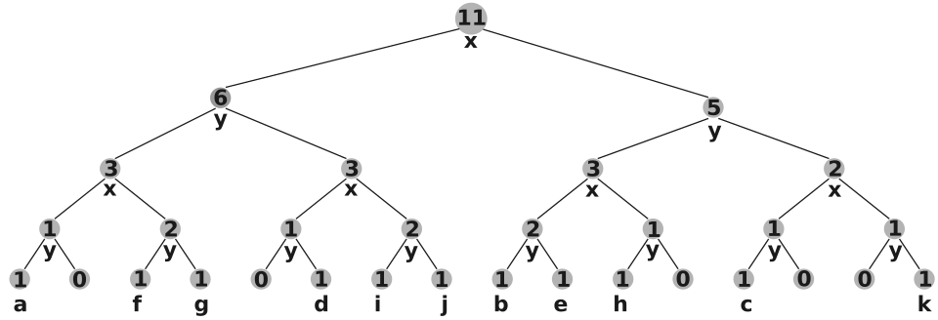
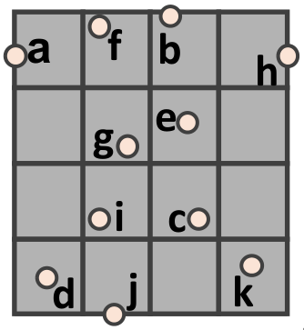
(K-d) tree-based compression
2
Depth-first
11 | 6 | 3 | 1 | 1 | 1 | 1 | 0 | …
Breadth-first
11 | 6 | 3 | 3 | 1 | 1 | 2 | 1 | …
Geometric compression for progressive transmission [Devillers & Gandoin, VIS 1999]
Notes:
We will first introduce particle position compression based on k-d trees. This was introduced by Devillers and Gandoin in 1999.
Consider this dataset of 11 particles in 2D. We build a k-d tree where the root stores the total number of particles (11).
If we then split the root in the middle in x direction, the left child will store the number of particles falling into the left half of space, and the right child stores the number of particles in the right half.
We can continue building the tree in the same way, alternating between the x and y direction of splitting. At the end we arrive at the individual particles at the leaf level.
Both the compressor and the decompressor follow the same order of constructing the tree.
If we go depth-first, these are the values that we will store into our bitstream for compression.
And if we go breadth-first, these are the values.
Note that at each node, we only need to store the number of particles in the left child because the number in the right child can be deduced from the two numbers at the parent node and the left child.
We achieve compression because we know that for any value, it can be at most the value at the parent node, so we can use fewer bits to encode each value.
For example, to encode this number 6, we know 6 is less than or equal to 11, so at most 4 bits are needed to encode 6. Similarly, at most 3 bits are needed to encode 3 because 3 <= 6.
Toward the leaf level, we use fewer and fewer bits to encode each node’s value.
That’s how we achieve compression.

Slide 4
Memory footprint - DT = low, BT = high
3
Front of traversal = stack with at most $H$ nodes
Low memory footprint
Front of traversal = queue with at most $2^{h}$ nodes
High memory footprint
Notes:
The depth-first and breadth-first traversals have different memory requirements.
In particular, the front of the traversal for depth-first can be stored in a stack with at most H nodes where H is the height of the tree.
In contrast, the front of a breadth-first traversal needs to be stored in a queue with at most 2^h nodes where small h is the current height.
So, it can be seen that breadth-first traversal has a much higher memory requirement compared to depth-first traversal.

Slide 5
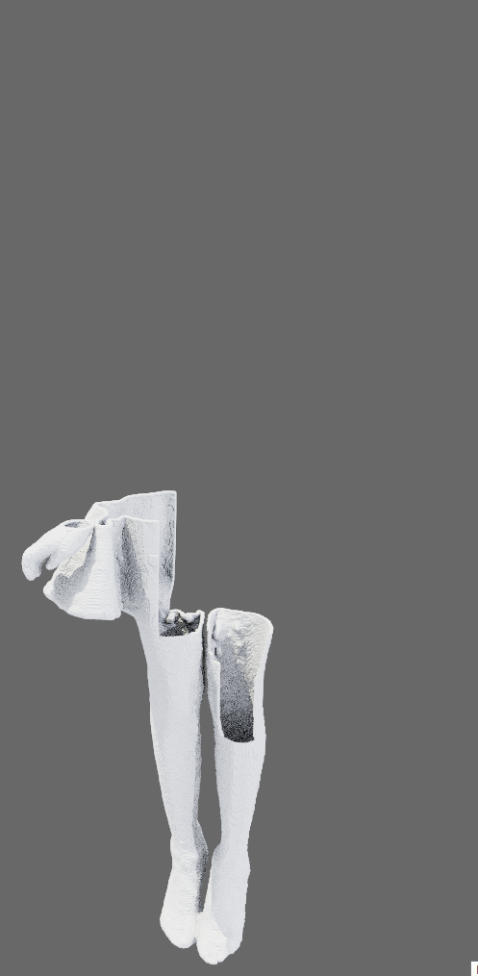
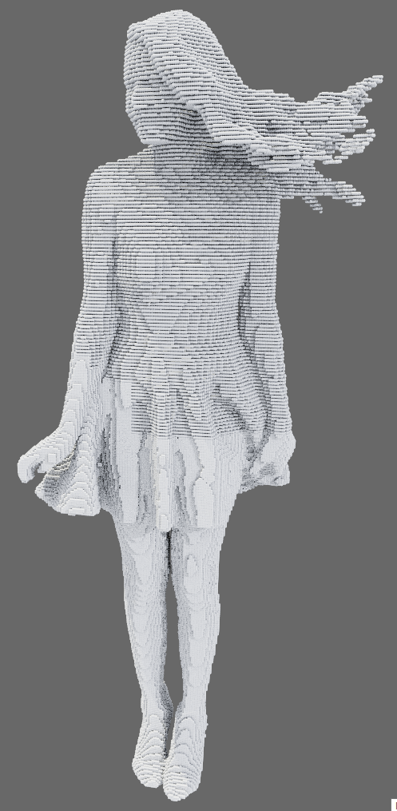
DT = local + fine, BT = global + coarse
4
Lossy decompression at the same ratio (~ 90x)
Reference
Depth-first
Breadth-first
???
How to combine the strength of both?
Notes:
The two traversal orders also result in different data qualities for lossy reconstruction.
We can see here that at the same compression ratio of 90x, the depth-first order reconstruct a portion of the data perfectly, while completely missing the rest.
The breadth-first order on the other hand reconstructs all parts of the data, but only coarsely.
In many cases though, the breadth-first order is preferred, and it is in fact the more common order used in the literature.
The question then, is can we combine the strength of both traversal orders? Namely the low memory footprint of depth-first traversal and the coarse-to-fine property of breadth-first traversal?

Slide 6
Odd-even splits: DT of tree $→$ BT of space
5
left child $=$ top or left half
right child $=$ bottom or right half
left child $=$ even cells
right child $=$ odd cells
Depth-first traversal of tree = broad coverage of space
Problem: bad compression (empty cells not quickly culled)
Notes:
Our answer to this question is a new way to split a tree node, called odd-even split.
With a k-d tree, the left child corresponds to the top or left half of the parent’s bounding box, while the right child corresponds to the bottom or right half.
With the odd-even split instead, the bounding box of the parent becomes a grid, and the left child corresponds to the even-indexed cells in this grid, while the right child corresponds to the odd-indexed cells.
In this example, the left child of the root contains particles in the first and third columns, while the right child contains the other two columns.
In the next level, we put the first and third rows on the left and second and fourth rows on the right, and so on.
Because we sort of “interleave” the bounding boxes of the left and right children of a node, a depth-first traversal of the tree corresponds to broad coverage of space, and we have the coarse-to-fine quality without having to use an expensive breadth-first traversal.
We can build a whole tree using only odd-even splits.
There is one problem with this approach though: with a k-d tree, empty space can be quickly culled away (separated from particles) with a split, whereas with an odd-even split, the empty cells will be “distributed” to both the left and right subtrees, which hurts compression.
We want to limit the use of odd-even splits while still getting most of its benefits.

Slide 7
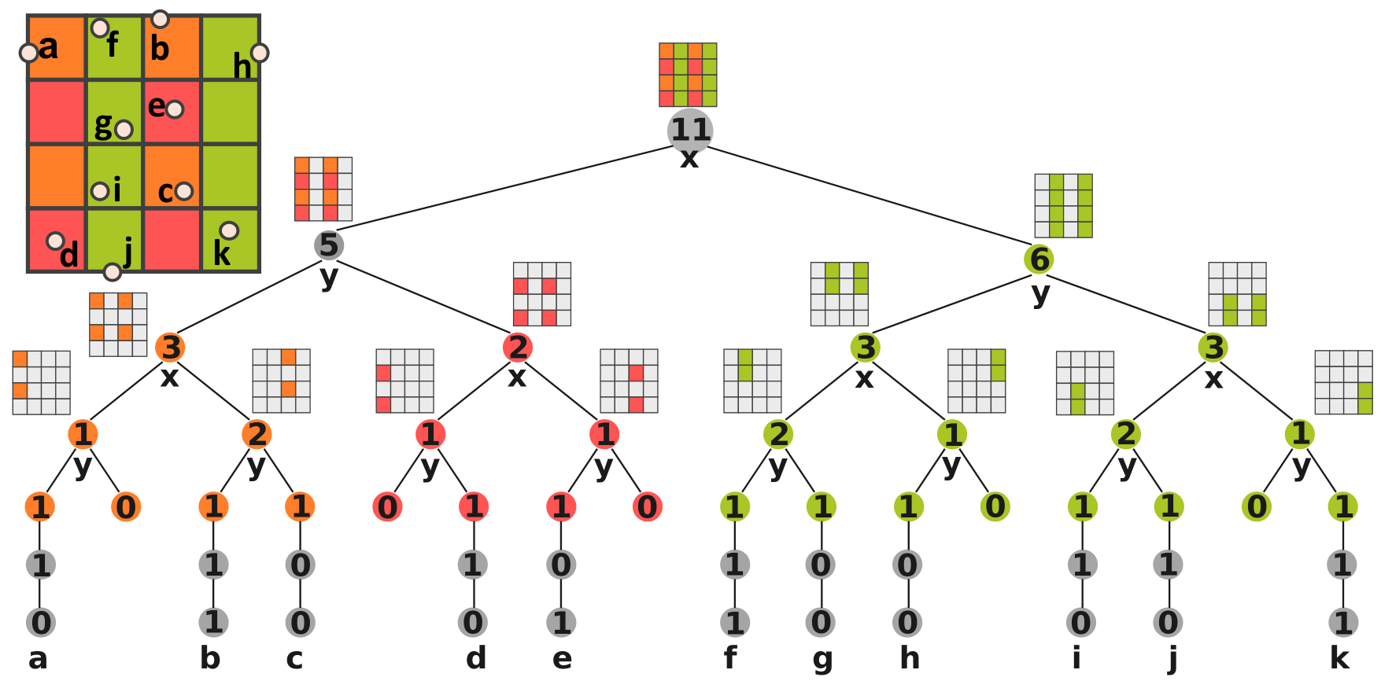
Hybrid trees = k-d + odd-even splits
6
Restrict odd-even splits to the left-most path
$=$ resolution level 0
$=$ resolution level 1
$=$ resolution level 2
Notes:
So we propose a particular use of odd-even splits, by restricting its use only to the path from the root to the left-most leaf of the tree.
In this example, we do only three odd-even splits, at the root, its left child, and the left child of that.
The rest of the splits are regular k-d splits.
This in effect creates three “resolution levels” (each odd-even split will create on more resolution level).
The levels here are denoted by the green, red, and orange colors.
From left to right, each level represents a finer and finer approximation of the original dataset.

Slide 8
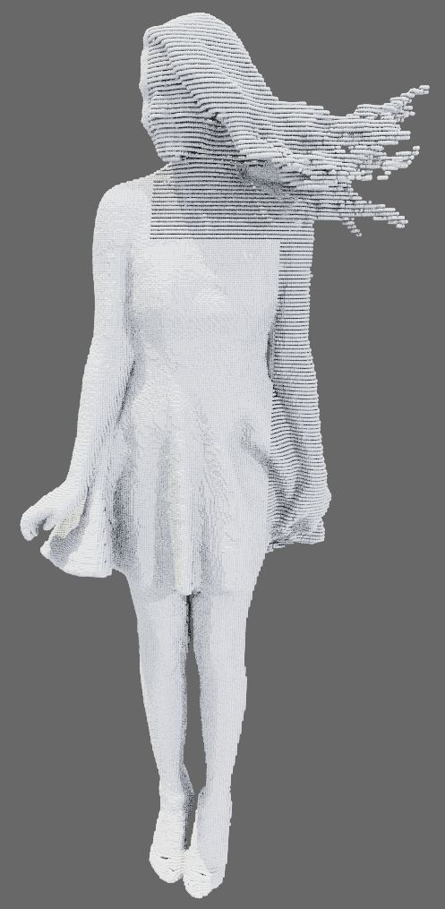
DT on hybrid trees
7
Lossy decompression at the same ratio (~ 90x)
DT on k-d
BT on k-d
DT on hybrid
Reference
???
How to combine the strengths of both?
Problem:
Uneven error
distribution
Notes:
So, let’ revisit the same dataset and two reconstructions using depth-first and breadth-first traversals on k-d trees that we have seen.
With the hybrid tree defined, we can perform a depth-first reconstruction of the data on the hybrid tree.
We see here that the reconstruction quality, at the same compression ratio, of the DT on hybrid tree is much better compared to both depth-first on k-d and BT on k-d trees.
There is a problem though: the reconstruction error is uneven: some parts are better reconstructed than others.
This is actually also a problem with breadth-first traversal as you may have noticed.

Slide 9
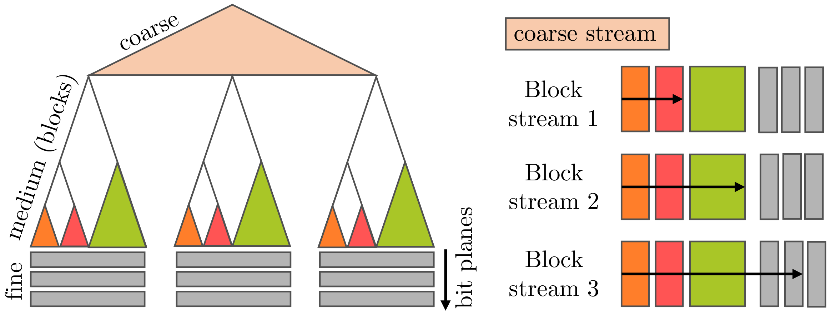
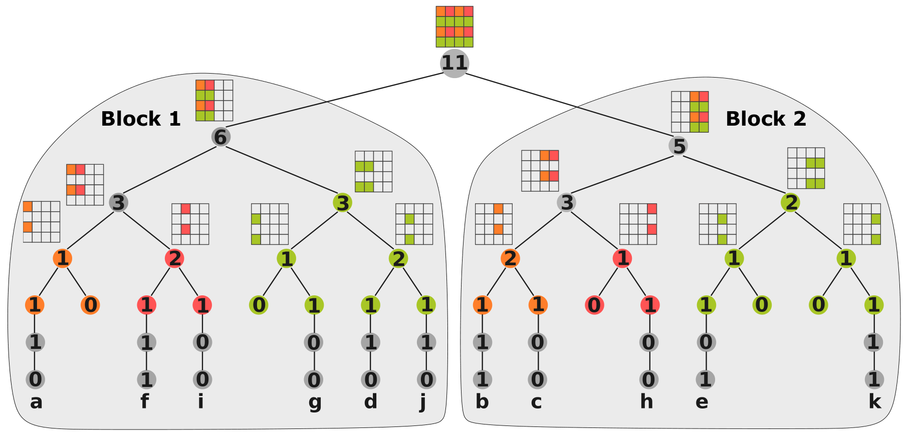
Block-hybrid trees = k-d + many hybrid
8
Use k-d splits to create blocks ($=$ hybrid trees)
Hybrid tree 1
Hybrid tree 2
Adaptive decoding of blocks
Notes:
To overcome the uneven error problem, we introduce a new kind of tree, called block-hybrid tree.
The idea is to use a number of k-d splits first to create a number of blocks.
Then, we build a hybrid tree out of each block.
In this example, we use on k-d split at the root to create two blocks, then in each block we build a hybrid tree like before.
Schematically, our block-hybrid tree has a coarse portion which is a k-d tree, then each leaf of the k-d tree is the root to a block which is a hybrid tree.
Here we use 3 triangles of different colors to indicate that we have three resolution levels in each block.
Now, once we reach the level where each grid cell contains only one particle, we stop with the hybrid tree and store the bits that further refine the particles within their cells in a breadth-first manner (or you can say by bitplane order).
These refinement bits are indicated by the gray color.
On disk, we store the bitstreams for the blocks separatedly, so during decompression, the blocks can be decompressed independently.
In this way we support adaptive decoding of blocks.
For example, if we are rendering a particle dataset, we might want to decompress blocks closer to the camera more than blocks further away.
In general, the user can give a definition of error, and the decompressor can prioritize blocks based on this error definition.
This is independent of how the data is compressed; so we can compress once, and decompress in many different ways depending on the analysis and visualization task.

Slide 10
Block-adaptive traversal $→$ smaller error
9
Lossy decompression at the same ratio (~ 90x)
Reference
BT on k-d
DT on hybrid
BAT on block-hybrid
Error heuristic
Blocks have equal
spacing between cells
Notes:
We come back to this example; we have seen the results of BT on k-d tree and DT on hybrid tree before.
With our new block-adaptive traversal on block-hybrid tree, we obtain an even better reconstruction where the error is distributed evenly.
Again, all three reconstructions are at the same compression ratio, here about 90x.
Visually our reconstruction with the block-adaptive traversal is very close to the reference rendering.
Here, the error heuristic supplied to the decompressor is to force the blocks to have equal spacing between cells.
The details are given in the paper.

Slide 11
Tree $=$ particle indexing (sorting)
10
Global Static Indexing for Real-time Exploration of Very Large Regular Grids [Pascucci & Frank, Supercomputing 2001]
Notes:
So, it is well known that building a k-d tree is the same as sorting the particles using their Morton code, which is formed by interleaving the position bits in x/y/z.
In this context, an odd-even tree (which consists of only odd-even splits) is the same as sorting particles by their backward Morton codes.
A hybrid tree corresponds to a kind of indexing called hierarchical Z indexing, introduced by Pascucci and Frank back in 2001 for regular grids.
In this scheme, we identify the position of the last significant bit in the Morton code, then swap the two sides of this bit, then sort the particles according to this new index.
The position of the last significant bit from the right is the resolution level of the particle.
Finally, a block-hybrid tree corresponds to performing forward Morton for the coarse k-d part, then HZ indexing for the medium hybrid part, then again forward Morton for the refinement bits that locate the particles within individual cells.

Slide 12
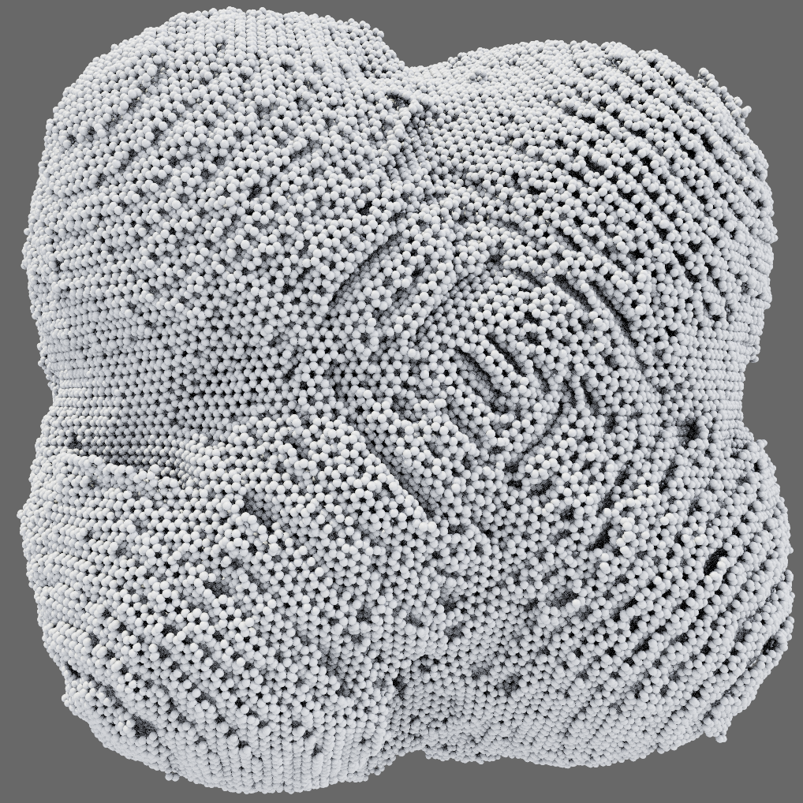
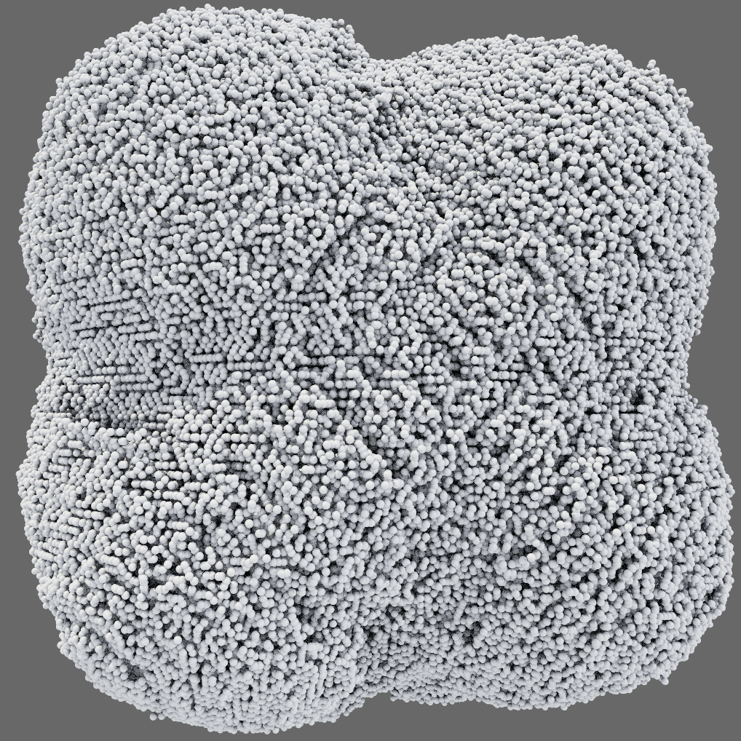
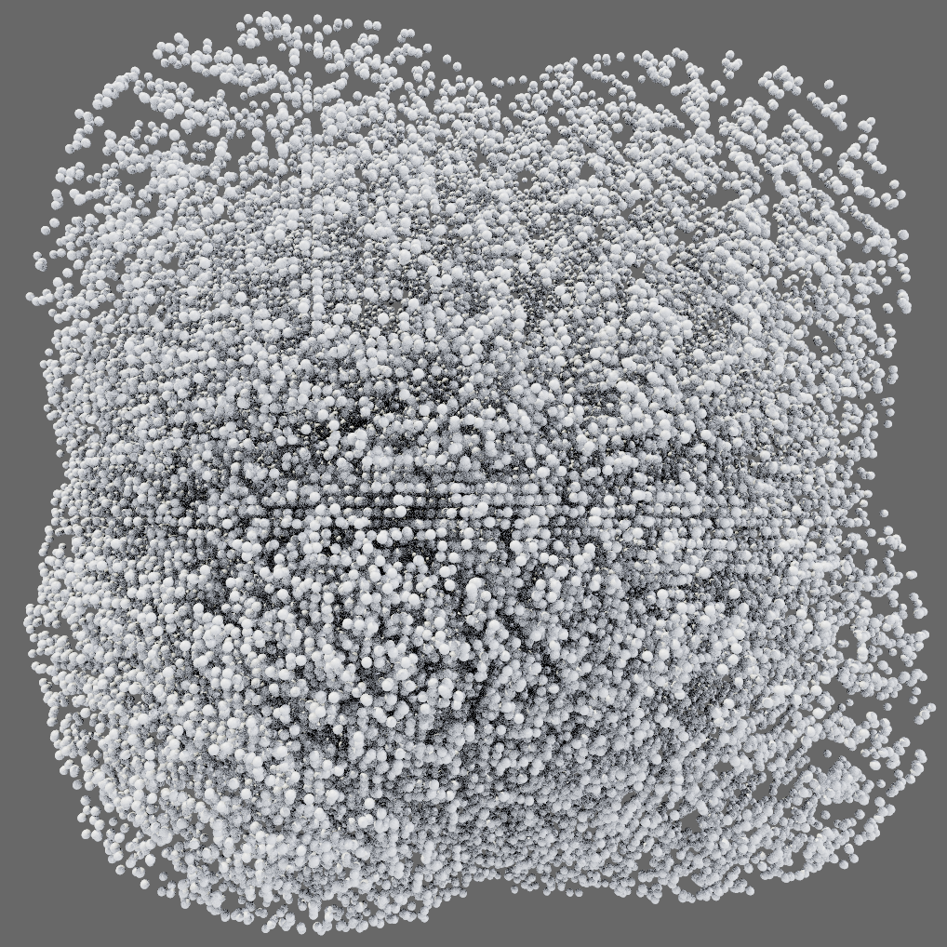
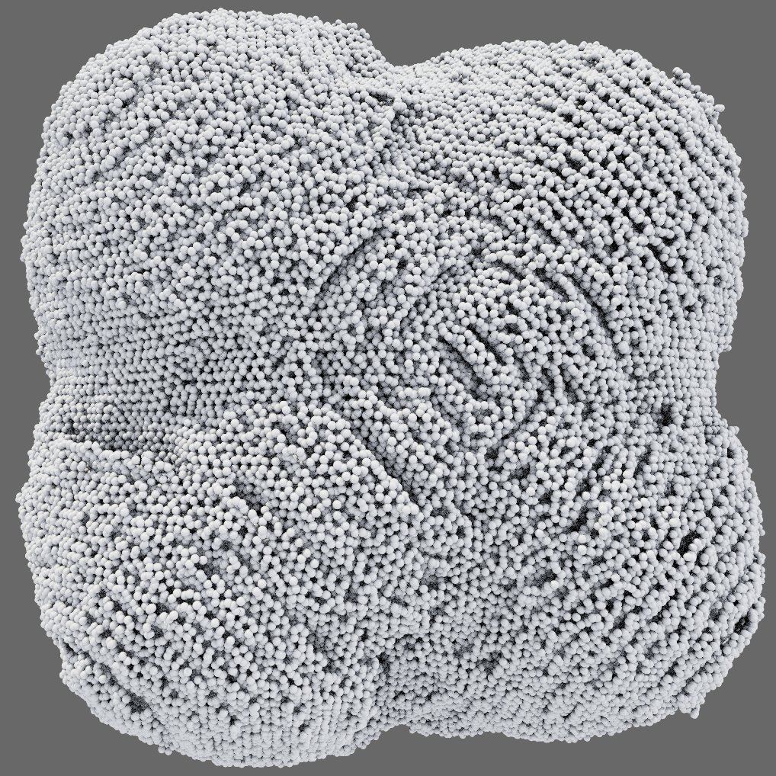
Better reconstruction using fewer particles
11
Lossy decompression at the same ratio (~ 20x)
molecule
BT on k-d
DT on hybrid
BAT on block-hybrid
n = 742,614
particles
0.28s
|C| = 725K, n = 725K
0.11s
|C| = 24, n = 550K
0.30s
|C| = 580, n = 504K
Notes:
Here is another comparison of different schemes.
This dataset is a molecule simulated with 700K particles, and we show three reconstructions at about 20x lossy compression ratio.
We also give the time to decompress, and the number of elements in the containers used for traversal (queue/stack etc) denoted by |C|, and n is the number of output particles which is often less than the original number of particles for lossy reconstruction.
We see that compared to the standard BT, the block-adaptive traversal needs orders of magnitude smaller state for traversal (by comparing the |C|), and it also can generate fewer output particles while achieving better reconstruction visually.
The DT on hybrid tree is even cheaper and faster, but the reconstruction quality is not great in this case.

Slide 13
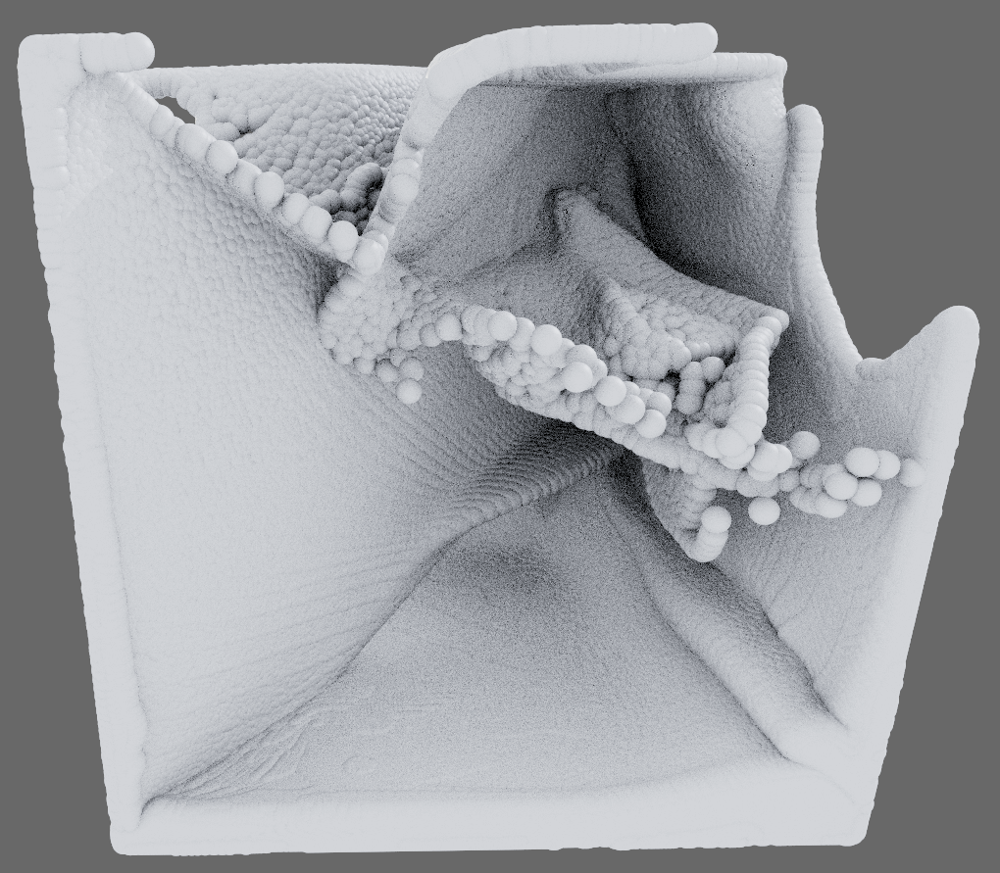
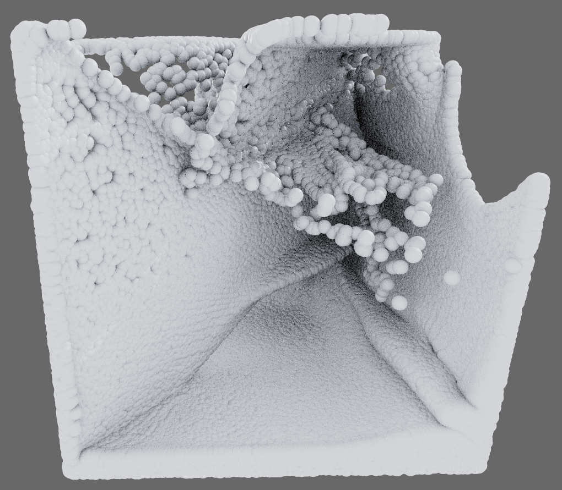
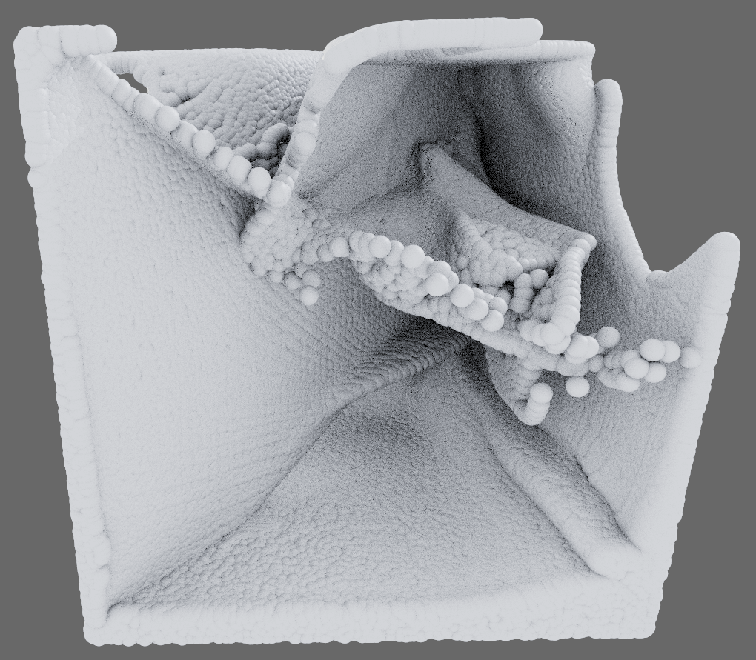
BAT gives better quality-cost trade-off
12
Lossy decompression at the same ratio (~ 30x)
dam break
BT on k-d
DT on hybrid
BAT on block-hybrid
n = 8,054,368
particles
1.99s
|C| = 5.6M, n = 5.6M
1.04s
|C| = 57, n = 706K
2.56s
|C| = 280K, n = 640K
Notes:
Here is another example.
For this dam break simulation, the block-adaptive traversal outputs orders of magnitude fewer particles compared to breadth-first, while almost matching its reconstruction quality.
The DT on hybrid is again, fast and cheap, but has higher reconstruction error in some parts.

Slide 14
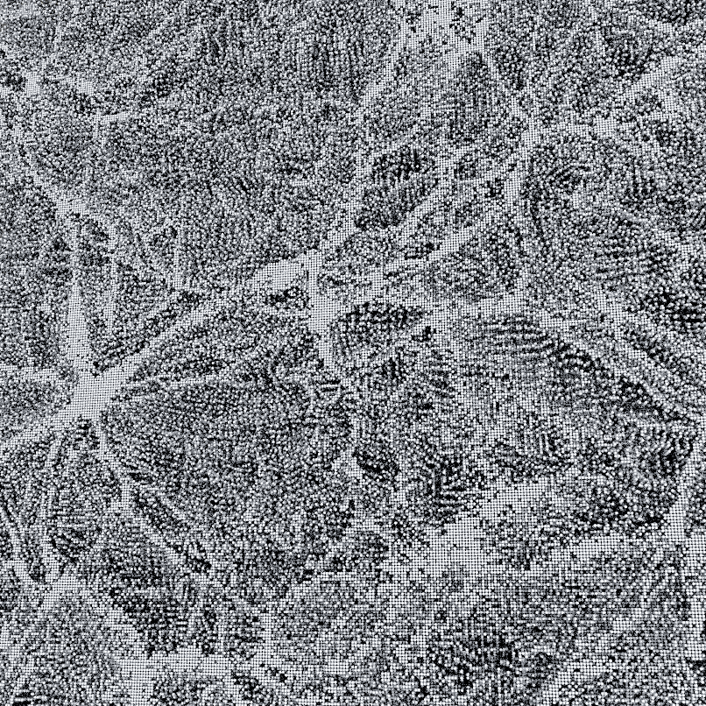
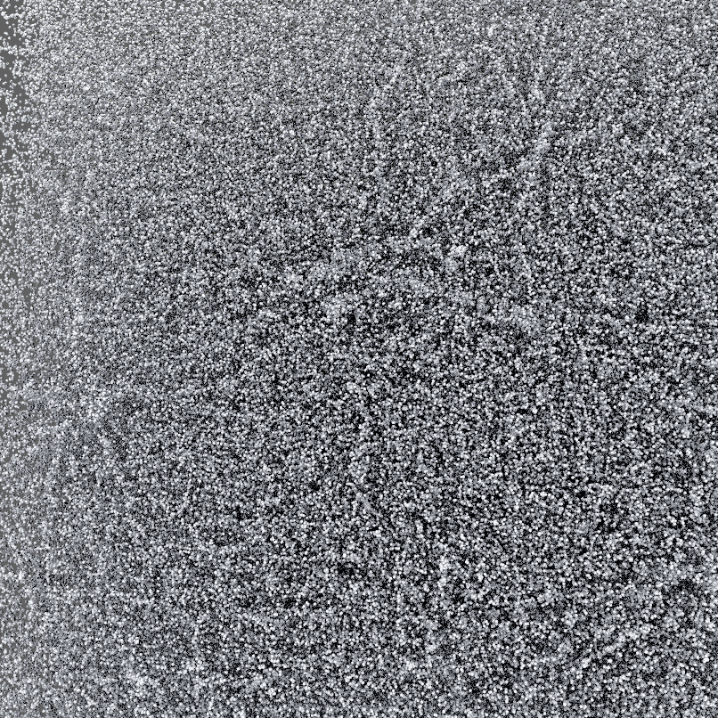
Uniform spacing is not always ideal
13
Lossy decompression at the same ratio (~ 70x)
cosmic web
BT on k-d
BAT on block-hybrid
Problem: need to prioritize dense regions
Notes:
However, the block-adaptive traversal not always produces a good reconstruction.
Here is an example of a cosmology simulation, where the dense regions correspond to the features of interest such as galaxies forming, while the rest are more of a background.
Since block-adaptive traversal enforces uniform spacing of particles, it does not reconstructs well the features of interest.
For this dataset, we need to prioritize dense nodes in the tree.

Slide 15
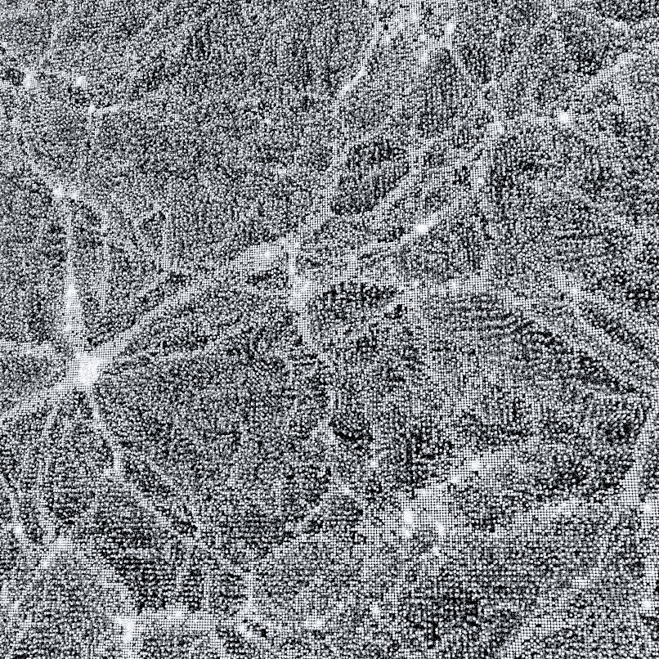
Adaptive traversal can prioritize nodes
14
Use priority queue in place of stack/queue
cosmic web
BT on k-d
BAT on block-hybrid
AT on k-d
Notes:
We propose a solution to this in the paper, in the form of an “adaptive” traversal on traditional k-d trees.
Note that while block-adaptive runs on block-hybrid trees, the simple adaptive traversal runs on traditional k-d trees.
The idea is simple: we replace the stack/queue used by breadth-first and depth-first traversals with a priority queue and prioritize nodes with higher errors with some definition of errors.
In the paper we give a formula to estimate node density and use that as the criterion to rank the nodes for adaptive traversal, which produces the result shown here.
Note that compared to breath-first traversal, the adaptive traversal better captures the more dense regions of the data, resulting in a more faithful reconstruction to the original data.

Slide 16
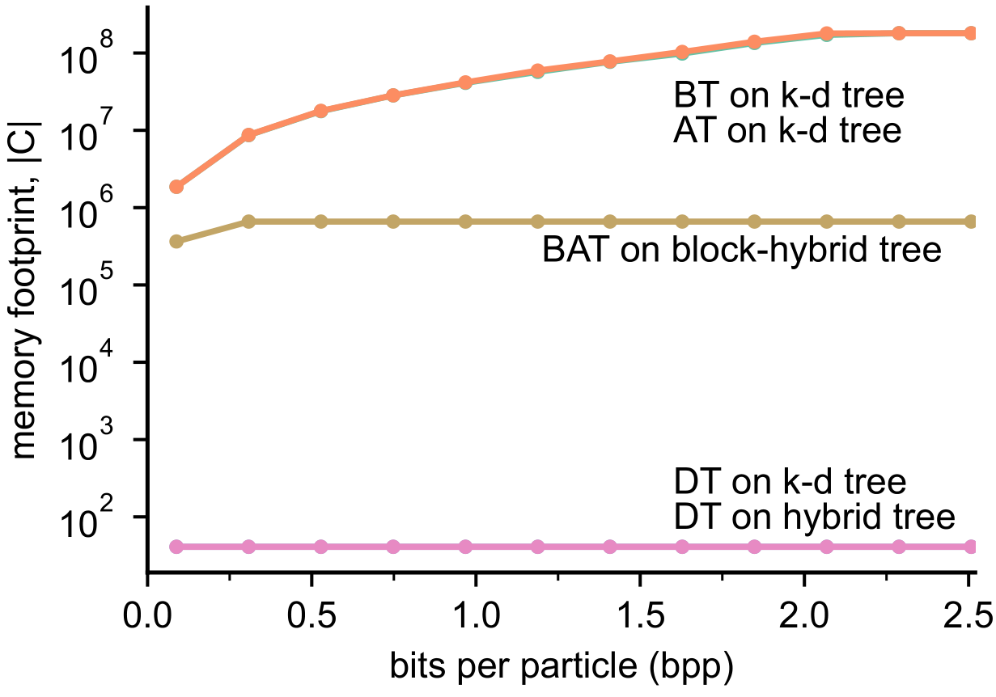
(Block) hybrid trees are cheap to traverse
15
detonation-small
180M particles
~ 2 GB uncompressed
Notes:
Here we compare the memory footprint in terms of the number of elements in the traversal data structures for the various methods discussed.
The horizontal axis is the bits per particle for progressive decompression, so compression is less toward the right.
We can see that hybrid trees are very cheap to traverse, requiring only kilobytes to traverse this 180M particles dataset (2 GB uncompressed).
Block-hybrid trees are not as cheap to traverse but still relatively cheap in practice, requiring megabytes of memory to traverse using the block-adaptive traversal method.
The most expensive methods are breadth-first and adaptive traversals on k-d trees, which require hundreds of megabytes or gigabytes to traverse.

Slide 17
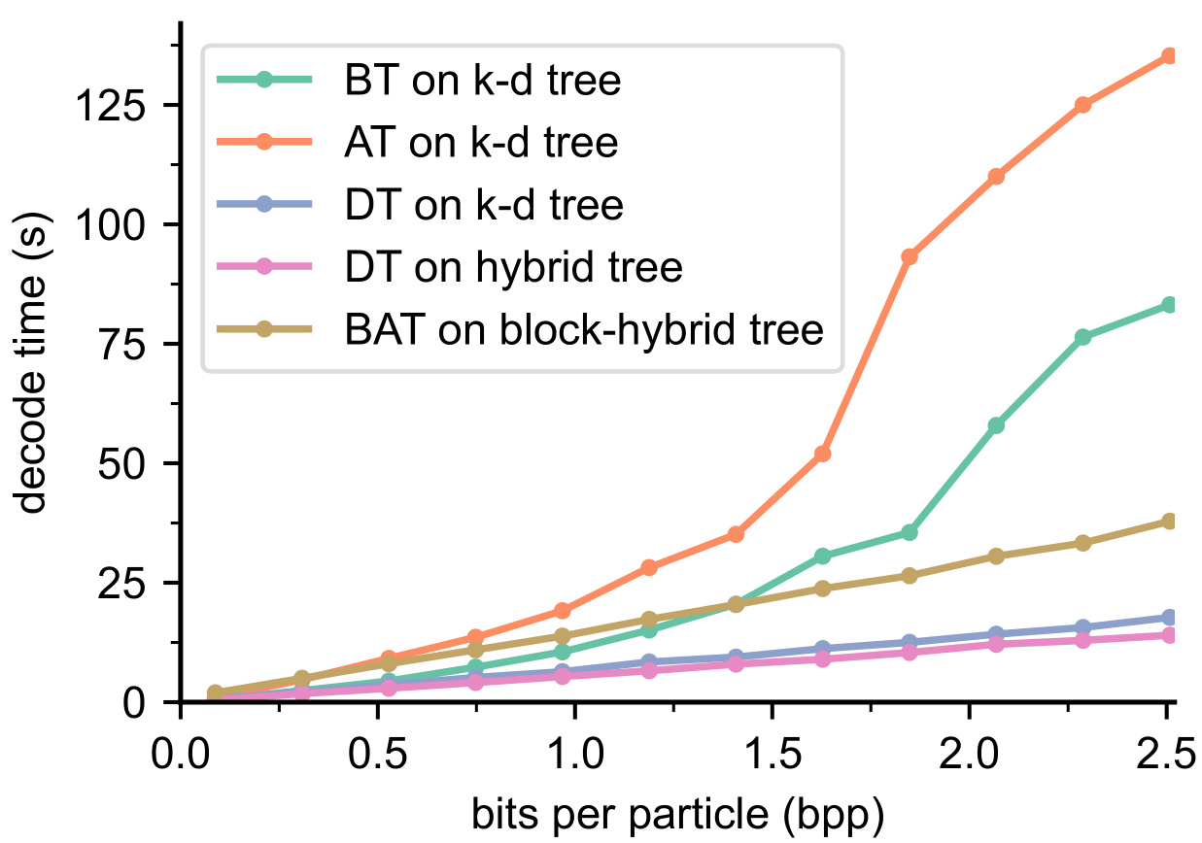
(Block) hybrid trees are fast to traverse
16
detonation-small
180M particles
~ 2 GB uncompressed
Notes:
The hybrid trees and block-hybrid trees are also fast to traverse.
Again, the horizontal axis is bits per particle (so toward the right we decompress more and more data).
The vertical axis is decoding time in seconds.
We can see that depth-first traversals on k-d and hybrid trees are the fastest methods, followed by block-adaptive traversal, then breadth-first traversal, and finally the (non-block) adaptive traversal.

Slide 18
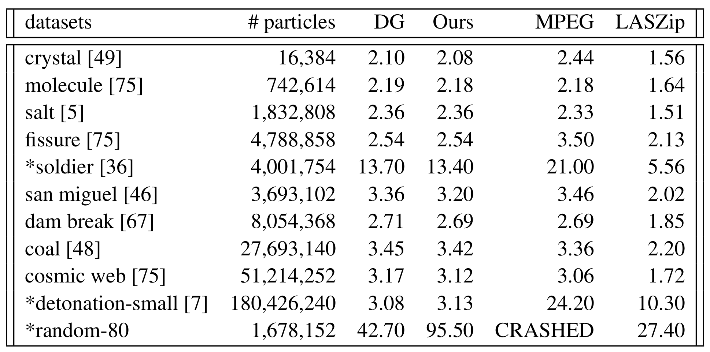
Lossless: MPEG > DG = Ours > LASzip
17
Emerging MPEG standards for point cloud compression [Schwarz et al., IEEE Journal on Emerging and Selected Topics in Circuits and Systems, 2019]
Geometric compression for progressive transmission [Devillers & Gandoin, VIS 1999]
LASzip: lossless compression of LiDAR data [Isenburg, Photogrammetric Engineering & Remote Sensing 2013]
Notes:
Here we compare lossless compression ratios among our method, the original k-d compressor of Devillers and Gandoin, MPEG, and LASzip, which are the more established standards.
In terms of lossless compression ratios, our methods are better than LASzip but worse than MPEG.
For the numbers in this table, higher is better.
The DG method is the original k-d tree compressor of Devillers and Gandoin.
Since we target only lossy progressive compression, our lossless compression ratios are similar to theirs.
It is worth noting that our hybrid trees keep the lossless compression ratios of Devillers and Gandoin but with the added benefit of better lossy reconstruction quality.
For simulation data which are high precision, MPEG is better than ours in general but not by much.
Where MPEG really shines is the low-precision, scan data such as “soldier”.
This is not surprising as MPEG is designed for compressing such data.
LASzip is an industry standard but as this table shows, its lossless compression ratios are not very competitive.

Slide 19
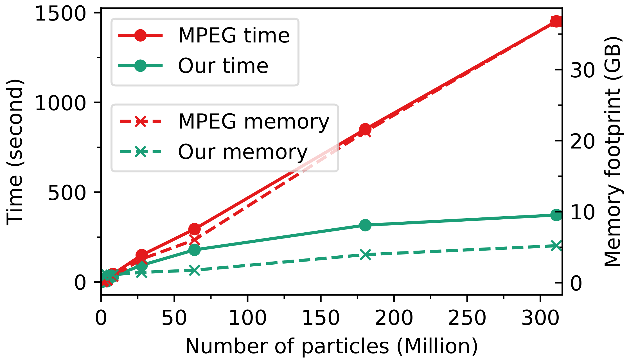
Our BAT is cheaper & faster vs MPEG
18
Notes:
Here we compare our encoding time and memory requirements with MPEG.
The left vertical axis is encoding time in log scale, right vertical axis is gigabytes of memory used by the compressor.
On the horizontal axis we have number of particles.
So the trend lines are obtained by compressing many different datasets with different number of particles and recording the time and memory usage for each.
MPEG is red and ours is green.
It can be seen that our block-adaptive method is both faster and requires substantially less memory than MPEG, and our growth rates for such costs are also less.

Slide 20
Limitations and Conclusion
19
Odd-even splits: DT of tree = broad coverage of space
Hybrid trees: k-d + odd-even splits amenable for compression
Block-hybrid trees: k-d + hybrid trees for adaptive block traversal
Does not improve lossless compression ratio
Works on quantized particle positions
Does not compress other attributes
Notes:
In conclusion, we have introduced the concept of odd-even splits, that allows turning a cheap depth-first traversal of a tree into broad coverage of space.
Combining this odd-even split with the traditional k-d split, we construct hybrid trees that enables high quality depth-first traversal without negatively affect compression.
We also introduce block-hybrid trees which combine k-d and hybrid trees to achieve adaptive block traversal where error heuristics can be supplied by the user at decompression time.
Our two contributions compare favorably against traditional depth-first and breadth-first traversal orders in the 2D space of memory footprint versus reconstruction quality.
For limitations, our methods do not improve lossless compression ratios.
The good news is that our methods do not hurt lossless compression ratios compared to the base k-d tree compressor.
Our odd-even scheme only requires data to be quantized, to avoid inaccuracy associated with floating-point computations.
There might be clever tricks to avoid such inaccuracy but we have not looked much into it.
And finally, we only compress particle positions and not other attributes, although we can see our scheme works well in combination with wavelet-based methods, since the odd-even splitting is basically just a lazy wavelet transform.

Slide 21
Reference
DT on k-d
BT on k-d
DT on hybrid
BAT on block-hybrid

Slide 22
Combinations of trees and traversals

