Slide 1
A Study of the Trade-off Between Reducing Precision and Reducing Resolution for Data Analysis and Visualization
Duong Hoang – Pavol Klacansky – Harsh Bhatia
Peer-Timo Bremer – Peter Lindstrom – Valerio Pascucci

Slide 2
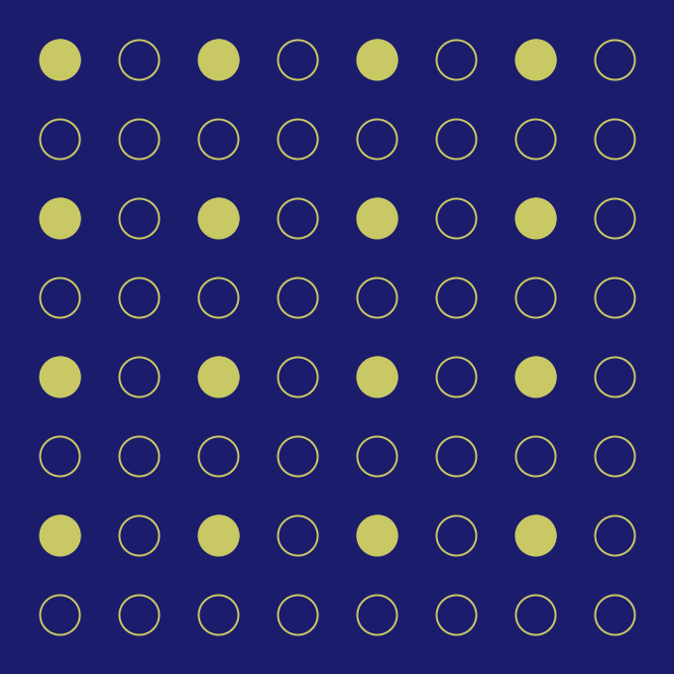
Scientific data is too large to be used without any form of reduction
Original data
Reduced precision
Quantization, truncation, etc
Reduced resolution
Octrees, wavelets, subsampling, etc
Notes:
We all know that scientific data has been getting ridiculously large, which makes it really difficult and costly to use the data for answering scientific questions. So most of the time we will want to reduce the data in some way before using it.
Most data reduction techniques in practice work in one of two ways. The first way is to reduce data precision, denoted here by a grid of partially-filled circles. This can be done using quantization, truncation, and so on.
The second way is to reduce data resolution. Here empty circles represent data points that have been removed. This can be done through the construction of some sort of hierarchy, for example an octree, a wavelet hierarchy, subsampling, and so on.

Slide 3
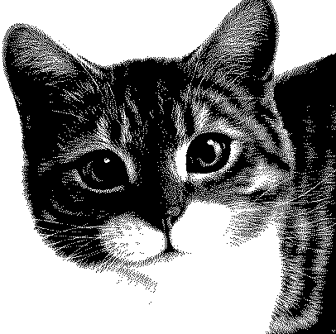
Reducing data in just one dimension is limited
Original data
Quality too low
Quality too low
Notes:
Now, the problem with reducing data exclusively in either precision or resolution is that you are limited by the amount of data that can be removed before the data quality becomes too low, making it unusable. So it is natural for us to ask the question whether you can slow down the rate at which data quality degrades by going diagonally instead of going purely in one direction: either horizontally in precision, or vertically in resolution.
By combining both dimensions, we hope that for the same amount of reduction, you obtain higher quality data.

Slide 4
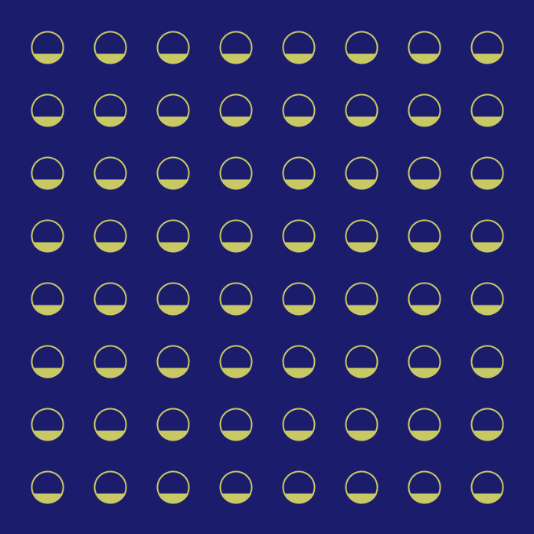
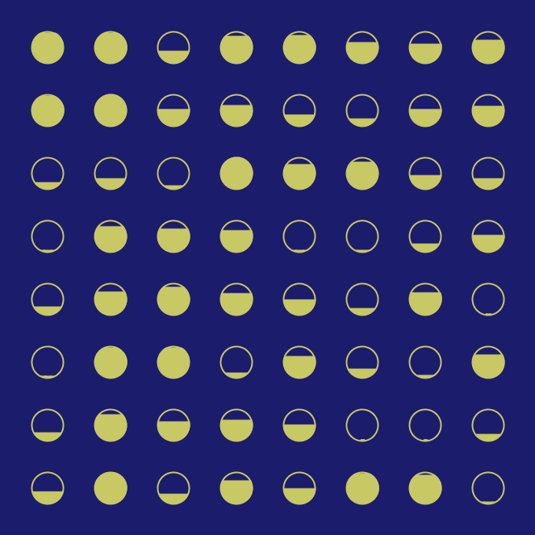
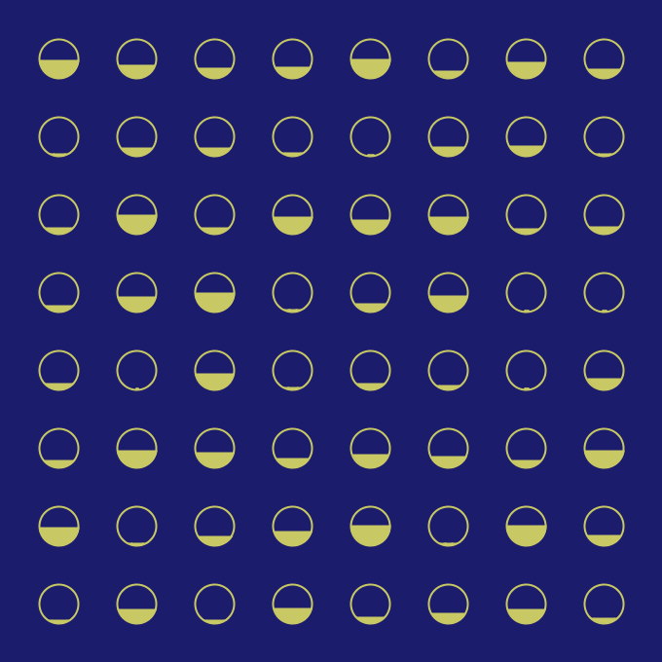
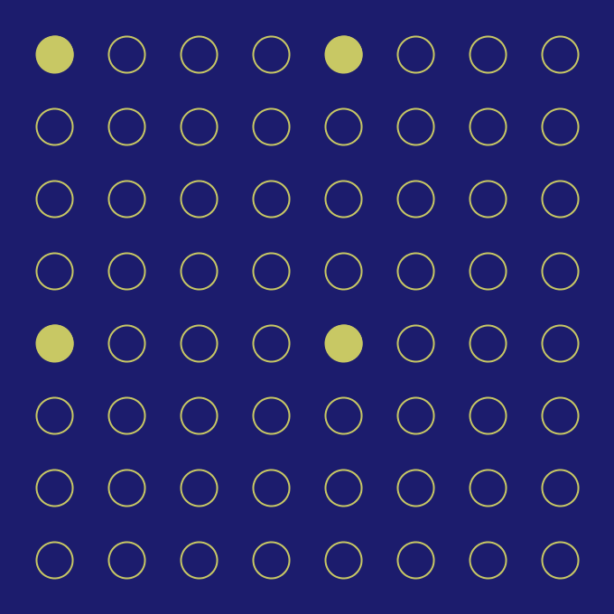
A data reduction scheme is a path in the precision-resolution space
Best for task 1
Path 1 (scheme 1)
Best for task 2
Path 2 (scheme 2)
Notes:
Now we can imagine the two main dimensions of data reduction as forming some sort of the axes of a precision-resolution space. Each of these grids represent a state of the data, and each corresponds to a point in that space. So at the origin is the original data, and going all the way to the right reduces precision to 0, likewise for resolution.
The two states in the middle corresponds to some combined reduction in both precision and resolution.
So a data reduction scheme will be a path in this space. The path can lie strictly on either the precision or the resolution axis, or it can connect the top left and the bottom right corners like what we are seeing now.
In this work we are mainly concerned with data reduction schemes that are tailored to analysis tasks. For example here these two reduction paths might each be the best for a different task. This is because different tasks might have different data requirements in terms of resolution and precision.

Slide 5
We will need to compare different data reduction paths for the same task
?
Best for Task 1
?
Notes:
Given a task, finding the optimal reduction path can be difficult, so for now let’s ask ourselves an easier question. For this task, should I reduce data in precision or should I reduce resolution? Suppose task 1 is just about reconstructing the original data, so we only care about comparing data quality. Now one way to answer this question is to pick a point on each axis where the amounts of data being reduced are the same , then we compare data quality.

Slide 6
It is difficult to do same-size comparison for different data reduction paths
2/3 precision
?
2/3 resolution
Notes:
The first problem we will run into is that it is hard to force two data reduction schemes to use the same amount of data. For example, if our budget is 2/3 of the original data size, to reduce the data to 2/3 of its precision, we can simply reduce the precision of each of its data point. But it is unclear what to do in the case of resolution.

Slide 7
Associate each path with a permutation of data bits
0101010…………………..00010
0010010…………………..01101
1100010…………………..10101
1010110…………………..10010
Notes:
To solve this problem, we associate each data reduction path with a permutation of data bits. These are permutations of the same set of bits which constitute the full data. We have also put an arrow in each path so that everything point to the original data at the origin. The idea is that as we go along each path, we will read the associated data bits from left to right. Each bit will increase the data precision or its resolution or both by a tiny amount. In the end you obtain the original data when all bits have been read.

Slide 8
Same-size comparison is easily done by cutting bit permutations at the same position
2/3 precision
01100........010101.....001000
2/3 resolution
11010........110101.....001010
Keep 2/3 of the bits
Notes:
So now to perform same-size comparison of two data reduction paths we simply take their corresponding bit permutations and chop them off at the same place. For example here we keep the first 2/3 of the bits for each permutation. Now from these bits that remain we can construct two reduced representations of the data and compare data quality.

Slide 9
Comparing data quality between grids of different resolutions is difficult
How to compute this?
RMSE 1
$$≤ ?$$
RMSE 2
vs
Representation 1
Representation 2
Notes:
But here we run into another problem. Say we want to compare data quality between these two reduced representations. The way this is done is that you will compute the root-mean-square error between each of these two with the original data, then we compare the two errors. The representation with smaller RMSE is better.
It is easy to compute RMSE 1 for representation 1, but for representation 2 it is unclear how we can compute RMSE 2 because representation 2 and the original data have different number of grid points. So what we need here is a method that can produce a full resolution grid from any subset of data points.

Slide 10
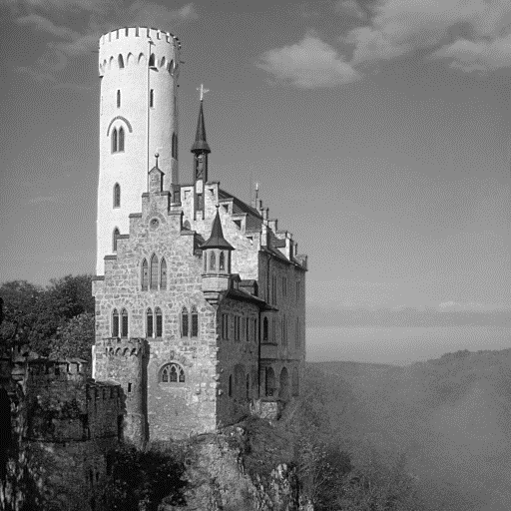
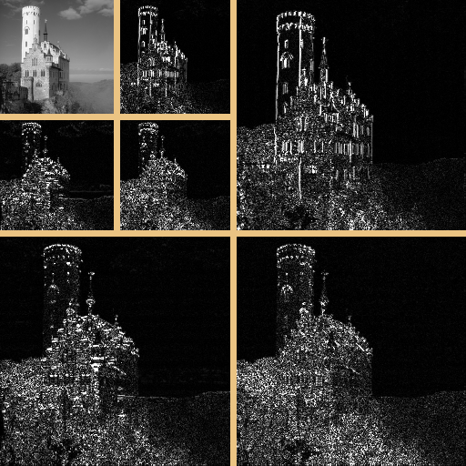
We use wavelets for decomposition and reconstruction
Forward
Original data
Wavelet coefficients
Inverse
Notes:
For that purpose we use the discrete wavelet transform. Wavelets not only give us a way to decompose the data into different resolution levels without increasing the number of data points, which we will need anyway, but it also gives us a principled way to go the other way around, that is, to reconstruct the data to the original resolution from an arbitrary subset of wavelet coefficients. Now the reconstruction might be of low quality but at least it is defined on a grid of the same resolution as the original data, so we can easily compute RMSE and other error metrics.

Slide 11
Streams are different permutations of the same set of bits
Quantize
Integer coefficients
Permutation 1
11010........110101.....001010
Stream 1
Wavelet coefficients
Stream 2
Permutation 2
01100........010101.....001000
Notes:
After we perform wavelet transform, we end up with a set of wavelet coefficients that we will need to quantize, basically turning floating-point coefficients into integer coefficients. This is done so that we have can have very clearly defined precision levels to work with.
Remember the various bit permutation we talked about before? They are really permutations of the set of bits that constitute these integer wavelet coefficients, not bits of the original data values. Now from now on we will refer to these permutations as streams, to signify the fact that the bits come in order from left to right, and are meant to be consumed in the same order.

Slide 12
We studied 6 different streams (4 shown below)
by bit plane
by level
by bit plane
by wavelet norm
task-optimized
Optimized for Task 1
$$2^{b}×\left\|Ψ_{L}\right\|$$
by level
by wavelet norm
Contribution from bit plane b
Norm of a wavelet basis on level L
Notes:
In the paper we study six different bit streams, but I will only talk mostly about four of them here in the interest of time.
The first stream is so called “by bit plane” where the bits come in order of decreasing significance. More significant bits will come before less significant ones. This stream is designed to represent data reduction techniques that work only in the precision axis. Note that “bit plane” is just a term we use to mean as an index to the precision axis.
The second stream we study is called “by level”. This one captures the data reduction techniques that operate only in the resolution axis. Here bits are streamed from coarse to fine resolution levels.
The third stream is called “by wavelet norm”. This stream combines the previous two in the following way. Instead of sorting bits only by bit plane or by level, we sort them using a weight that is a product of two terms. The first term, 2^b is a contribution from bit plane b and the second term is a contribution from level L: it is the norm of the wavelet basis function on level L. So by wavelet norm represents a data reduction scheme that combines precision and resolution, so in the precision-resolution space it will go like that.
The fourth stream is called a task-optimized stream in the sense that given a task, this is the stream that is tailored to a given task. In the paper we give an algorithm to compute this purple, task-optimized stream for any task that comes with a clearly defined error metric. We also discuss at length in the paper about all the intricacies and complexities of computing or even defining this optimal stream.

Slide 13
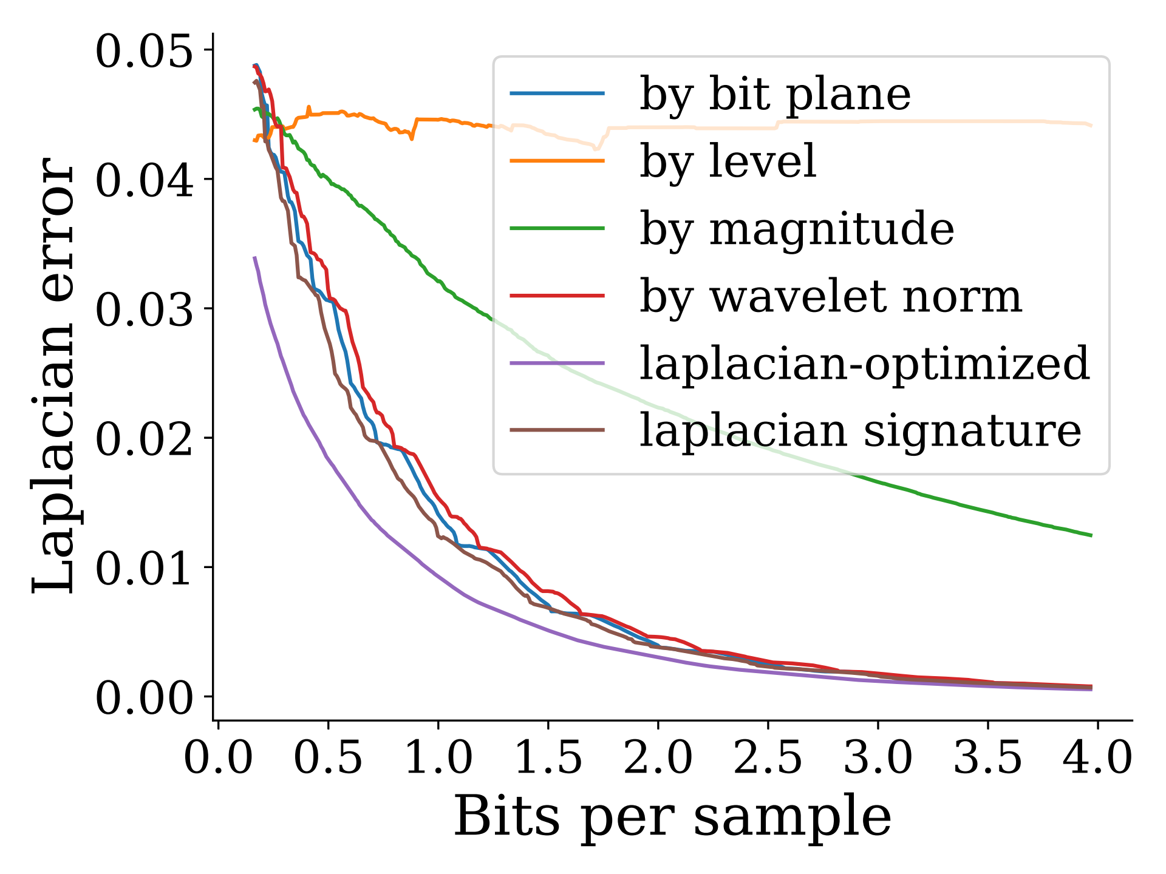
We performed 450 tests (15 x 5 x 6)
15 data sets
................
Combustion simulations
Hydrodynamics simulations
CT scans
Microscope images
Cosmology simulations
Fluid dynamic simulations
Magnetic reconnection simulations
Function reconstruction
Gradient computation
Histogram computation
Isosurface extraction
5 tasks
......................
......
......
................
Notes:
Now, in this work we performed 450 tests in total, that is 15 data sets times 5 tasks times 6 streams.
The data sets are chosen to cover a wide range of data sources that you often find in practice (different types of simulation, CT scan, microscopy data, and so on).
The five tasks are reconstructing the original function, computing the gradient, the Laplacian, the histogram, and extracting an isosurface. We think this list covers some of the most basic building blocks for data analysis and visualization.
Now for each combination of data set and task we construct the six streams, and for each stream, we perform the task with each new bit that arrives, record the error, and plot a curve. In the end we have error curves for all the streams.
So let’s look into one of these plots right now.

Slide 14
Comparison of streams for function reconstruction
Notes:
The first task we will look at is simply to reconstruct the original field. The aim is to best reconstruct the original volume with as few bits as possible, and here we use the root mean square error as the error metric. It can be seen that “by level” in orange performs quite badly. “by bit plane” in blue is much better than “by level”, but “by wavelet norm” is even better. Of course the rmse-optimized stream is the best because unlike the other streams, it is tailored to both the task and the data.

Slide 15
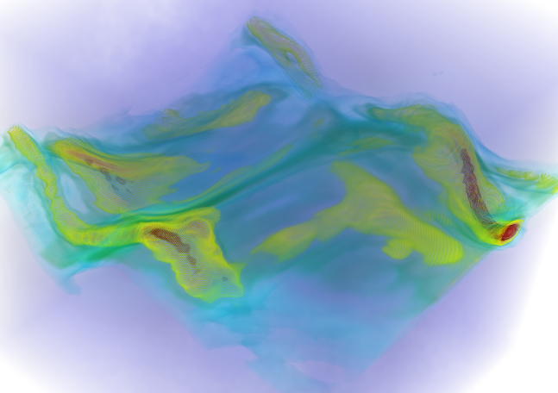
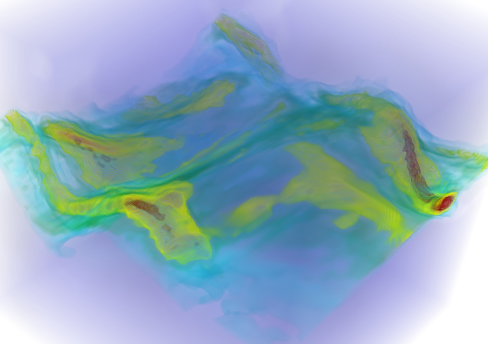
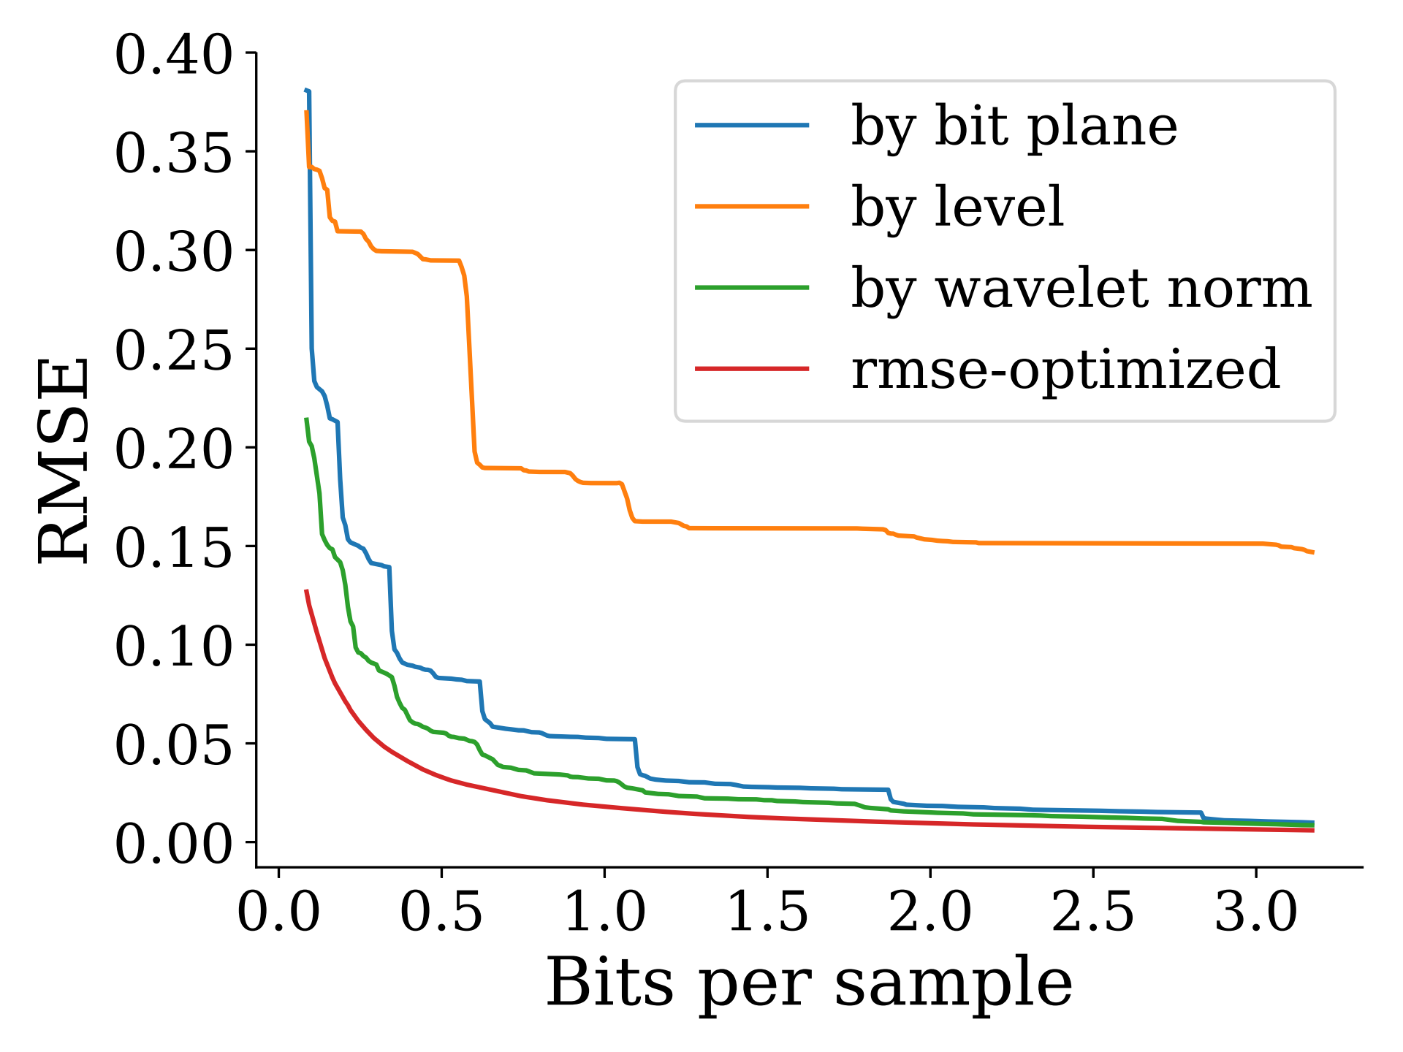
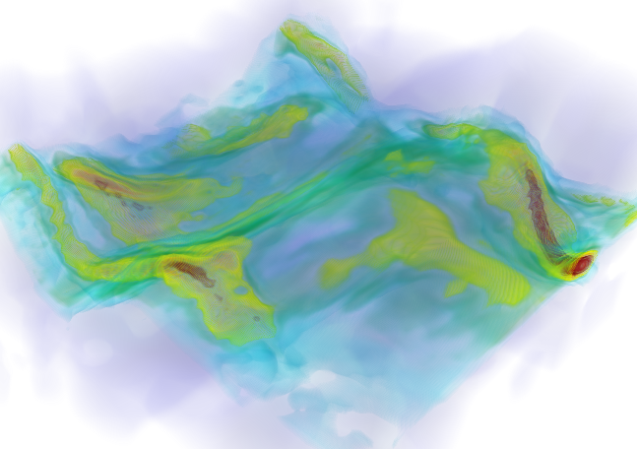
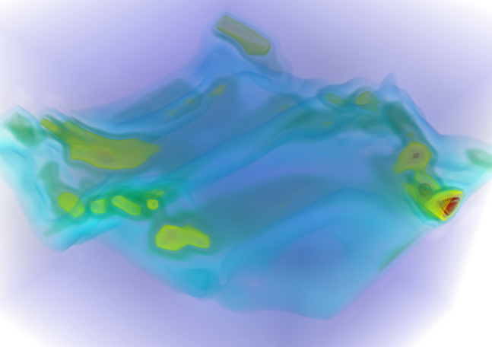
Comparison of streams for function reconstruction
reference
by wavelet norm
0.4 bps
by bit plane
by level
Ranked by quality
(top to bottom, left to right)
Notes:
Let’s also look at volume-rendered images at 0.4 bits per sample for all streams. If you compare it with the reference, “by bit plane” does not capture the low-frequency surrounding region in purple well but otherwise it resolves the fine details (in yellow) in the thin middle layer pretty well. Remember by bit plane is the stream that most prefers resolution over precision, so this makes sense.
In contrast, by level is the stream that most prefers precision over resolution, hence it is not able to resolve the fine details in the middle layer which requires high resolution to resolve, but it reconstructs the smooth region in purple well.
With by wavelet norm, we are able to get better fine details and more of the smooth surrounding region right, combining the strength of by bit plane and by level.

Slide 16
Function reconstruction benefits from a combined reduction of resolution and precision
by bit plane
by level
Optimized for data quality
by wavelet norm
Notes:
So what we have jus seen seem to indicate that for the task of reconstructing the original function, we are better of going in the diagonal direction like that.

Slide 17
Comparison of streams for gradient computation
Gradient computation
Function reconstruction
Notes:
Moving on to the next task which is gradient computation.
Now here the interesting thing to notice is that the gap between by bit plane (blue curve) and by wavelet norm (green curve) becomes almost non-existant. It is clearer if we put this plot side by side with the one we just saw, for function reconstruction. We can see that “by bit plane” performs better when it comes to computing the gradient, why is that?

Slide 18
by bit plane produces slow-varying shifts in function values
Original function
Reconstructed function
by bit plane, 0.6 bps
Notes:
It turns out the by bit plane stream tends to produce slow-varying shifts in the function values as can be seen here in the figure. In the paper we give an explanation for this phenomenon, but the bottom line here is that this almost constant shift will go away when you take the gradient of the field, since the derivative of a constant is zero. So that explains why “by bit plane” works better for reconstructing gradient versus for reconstructing the original function.

Slide 19
Gradient computation prefers higher resolution bits
by bit plane
Optimized for gradient
by level
Optimized for data quality
by wavelet norm
Notes:
With what we have seen, and with more evidence in the paper we conclude that gradient computation is a task that prefers resolution over precision, and thus the optimal path for it thus it goes something like this in the precision-resolution space.

Slide 20
Histogram computation prefers higher precision bits
by bit plane
Optimized for gradient
by level
Optimized for data quality
by wavelet norm
Optimized for histogram
Notes:
In the paper we also show that for histogram computation, which is another task that we study, is the opposite of gradient computation in the sense that it prefers precision over resolution. This makes sense since a histogram does not care about the spatial locations of data points, so bits that give you more precision will be more valuable compared to bits that improve the resolution.
Now you might think we are done. Because we have achieved the ultimate goal right? You give me a data set and task, I give you the optimal way to stream bits so that you can perform the task and incurred the least amount of error at each step.
Well, not quite. These task-optimized streams are great and all, except they are impractical. You can’t implement them in practice. So let’s see why.

Slide 21
Task-optimized streams are not practical
by bit plane
This is 2D projection of a 5D space
by signature
by level
by wavelet norm
Need to stream tuples (b, L, x, y, z)
Notes:
First of all, this whole diagram is not a 2D one but rather a 2D projection of something that lives in five dimensional space.
Remember the two grids we showed at the beginning of the talk and we claim that these two belong in this 2D precision-resolution space? Well that’s a lie. If you vary precision and resolution uniformly in space you can never get to these two states. What you need is spatial adaptivity.
In other words, to implement this purple stream in practice, we not only need to stream value bits but also need to stream a list of 5-element tuples with each bit in the stream. The tuple contains information that tells you which bit plane, which level, and the 3D spatial location of the bit. And that is simply so much information that completely undo any benefits that this optimal stream brings.
Note that we don’t run into the same problem with the three streams in orange because for these streams the ordering of bits are always deterministic and known in advance, regardless of the data or task.
To bring the purple task-optimized stream closer to this class of data-independent streams, in the paper we also construct a so called by signature stream that aims to approximate the behavior of the task-optimized stream in the precision-resolution space, while avoiding the need to stream the additional information that specify bit positions in 5D. Unfortunately, we found that by removing this additional information you reduce the power of the optimal by a lot. That is, in most cases by signature will beat by wavelet norm, but not by much.

Slide 22
What is this paper about?
Explore this 5D space
by bit plane
Framework
Optimized for gradient
by level
Optimized for data quality
Templates
by wavelet norm
Optimized for histogram
Lower bounds
Notes:
So we are finally in a position to answer this question: what is this paper about?
Just to be clear, we did not propose any new technique. This is also not a compression paper although it shares a few similarities.
So our goal with this paper really is to encourage people to look beyond data reduction in either dimension only, but instead go and explore and look for better opportunities in this precision-resolution space. And remember this is a 5D space.
To make this exploration easier, we provide you with a framework based on the wavelet transform and streaming of bits of wavelet coefficients.
We also give you some templates to start with, as well as some lower bounds for some common tasks. The framework is quite general in the sense that if you have a new task that you want to study, you can easily plug it in this framework as long as the task comes with a clearly defined error metric.

Slide 23
Acknowledgements
U.S. Department of Energy by Lawrence Livermore National Laboratory under Contract DE-AC52-07NA27344 and the LLNL-LDRD Program under Project No. 17-SI-004.
NSF: CGV: Award:1314896, NSF:IIP Award :1602127 NSF:ACI:award 1649923, DOE/SciDAC DESC0007446, CCMSC DE-NA0002375, and PIPER: ER26142 DE-SC0010498.
Department of Energy, National Nuclear Security Administration, under Award Number(s) DE-NA0002375.
Notes:
I want to thank the following agencies for funding this research

Slide 24
Thank you
Notes:
With that, I would like to end the talk. Thank you for your attention.

Slide 25
What is this paper about?
Explore this 5D space
by bit plane
Framework
Optimized for gradient
by level
Optimized for data quality
Templates
by wavelet norm
Optimized for histogram
Lower bounds
Notes:
So we are finally in a position to answer this question: what is this paper about?
Just to be clear, we did not propose any new technique. This is also not a compression paper although it shares a few similarities.
So our goal with this paper really is to encourage people to look beyond data reduction in either dimension only, but instead go and explore and look for better opportunities in this precision-resolution space. And remember this is a 5D space.
To make this exploration easier, we provide you with a framework based on the wavelet transform and streaming of bits of wavelet coefficients.
We also give you some templates to start with, as well as some lower bounds for some common tasks. The framework is quite general in the sense that if you have a new task that you want to study, you can easily plug it in this framework as long as the task comes with a clearly defined error metric.
With that, I would like to end the talk. Thank you for your attention.

